Slide 1
Governance policy of digitization and financing energy efficiency in the Russian Federation
Dr. Alexey Tulikov
Director for the Development of Legislation in the Fuel and Energy Sector of the Russian Energy Agency,
Head of the Expert Council TC 039 on High Energy Efficiency Facilities and Technologies
April, 2026

Slide 2
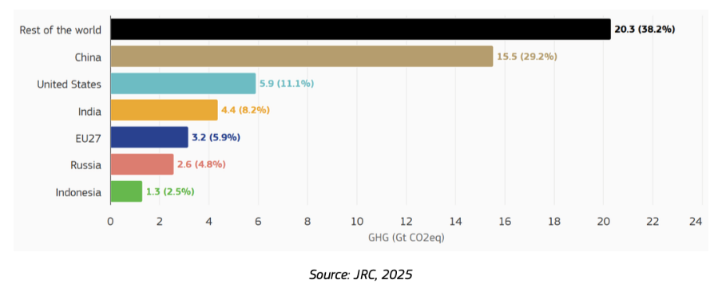
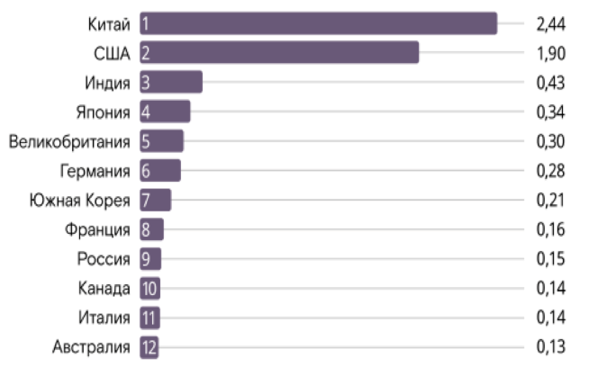
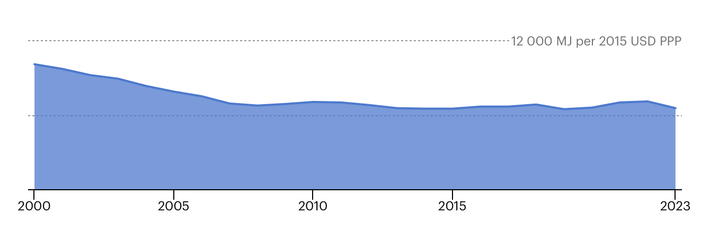
The role and place of Russia in supporting international trends and developing best practices
GHG emissions and contribution of the six largest emitting economies and the rest of the world in 2024 (in Gt CO2eq and percentage of the global total)
Reduction of the energy intensity of GDP
in 2023 from the level of 2000
The contribution of economies (integral weight) to the development of digitalization
35% - in the Russian Federation
China
USA
India
Japan
UK
Germany
South Korea
France
Russia
Canada
Italy
Australia
Source: JRC, 2025
Russia's share in global greenhouse gas emissions decreased from 9% in 1990 to 3% in 2018.
The total reduction of greenhouse gas emissions in Russia since 1990 is the most significant contribution in the world and exceeds 41 billion tons of CO2
Source: IEA, 2026
Global Innovation Index — 46/129
Innovation Development Index — 27/60
Green and Low-Carbon Economy
Energy Efficient Economy
Digital Economy
Comprehensive State Program of the Russian Federation "Energy Conservation and Energy Efficiency Improvement"(Approved by Decree of the Government of the Russian Federation No. 1473, dated September 9, 2023)

Slide 3
National goals
Decree of the President of the Russian Federation dated July 21, 2020
No. 474 “On National Development Objectives of the Russian Federation for the Period Until 2030”
Society
State documents
National programs & projects
State programs & plans
Other state strategic documents
Digital transformation
Decree of the President of the Russian Federation dated May 7, 2024 No. 309 “On National Development Objectives of the Russian Federation for the Period Until 2030 and the Perspective Until 2036”
one of the national development objectives
Corporate documents
Digital transformation strategies
Investment programs
Fuel and energy complex
Other corp. strategic documents

Slide 4
National programs & projects
National Program for “Digital Economy of the Russian Federation”
National project “Economy of Data and Digital Transformation of the State”
Indicators characterizing implementation of the above national development objective in terms of digital transformation
tasks of refining the regulatory legal framework, the information infrastructure, and human resources for the digital economy, information security, digital technologies and digital state governance
continued implementation of the projects and measures aimed at achieving the indicators of the national development objectives in regards to the digital transformation
Achievement of “digital maturity” of the key sectors of the economy and social sphere, including public health and education as well as state governance
Strategic direction in the field of digital transformation of the FEC until 2030
Order of the Government of the Russian Federation dated 03/12/2024 No. 581-r
“Energy infrastructure” industry
“digital maturity”

Slide 5
Use of artificial intelligence technologies in selected fuel and energy sectors and related information systems
National Strategy for AI Development
(Decree of the President of the Russian Federation dated 10.10.2019 No. 490)
Government program of the Russian Federation “Development of Energy Sector”
Fuel and energy sector organizations are the largest purchasers of software for radio-electronic products, with expenditures in 2024 exceeding 150 billion rubles, 90% of which went to Russian solutions.
Ministerial project
“Digital Energy Sector”
Energy Companies
Digital transformation strategies (programs)
action plans which contemplate regular conduct of industry workshops for establishing the needs of FEC companies for AI technologies as well as the performance of relevant measures aimed at satisfying these needs including engaging small-size technology companies (start-ups)
By the end of 2024, about 58% of Russian fuel and energy sector organizations were using AI technologies in their operations, double the figure for 2022 (with a target of 70% by 2027).
Action plans in the AI area
Energy sector occupies the 2nd place among the economy sectors in terms of data availability for the development
and use of AI

Slide 6
The main directions for the implementation of energy efficient technologies in the framework of energy service activities in Russia
Spheres
Residential buildings
State and municipal sectors
Public utilities
Industry, energy, transport
Building lighting systems
Street lighting
Outdoor and indoor lighting
Outdoor and indoor lighting
Heating systems
Outdoor and indoor lighting
Pumping equipment
Modernization of networks
Projects
Accounting and regulation nodes
Heating systems, water conservation
Transition to the use of alternative fuels and RES
Modernization of supply sources
Renovation
Ventilation and air conditioning
Water conservation
Technology
Implementation of complex projects in cities, including Smart City projects
Renewable energy

Slide 7










Dynamics of key indicators of the energy service market 2016-2024 in public sector
№ | indicator | 2016 | 2017 | 2018 | 2019 | 2020 | 2021 | 2022 | 2023 | 2024 | total
1 | total value of contracts, billion rubles | 8,4 | 19,7 | 44,2 | 19,5 | 19,1 | 57,3 | 10,1 | 51,9 | 22,4 | 259,3
2 | number of contracts, units | 694 | 498 | 808 | 940 | 824 | 989 | 564 | 533 | 437 | 6 251
Distribution of energy service contracts by price segments, 2016-2024 гг.
Number of contracts, units
Cost of contracts, billion rubles
Competence Сenters
RAESCO statistics

Slide 8
Conception of ESCO 2.0
Pre-project preparation
commercial closure
Financial closure
Investment stage
Operational stage
Information
Technology
Energy service contract
Concession / PPP
Leasing
Contract with installments and success fee
Life cycle contract and Offset
Legal
instruments
Loans (credits)
Factoring
Financial
lease
Bonds and structured products
Subsidies and budget investments
Financial
instruments
Complex projects (from producer to consumer)
Complex projects "Smart City"
From Energy Efficiency Improvement to Comprehensive Modernization)
From energy saving to ecology and emission reduction
Complexity

Slide 9
Domestic information systems in the field of energy, energy efficiency and related fields
State information system of the fuel and energy complex
State Energy Efficiency System
State information system of housing and communal complex
State information system in the field of industry
Energy efficiency improvement segment
Federal Register of GHG Emissions
Operator: JSC "Information System Operator" (joint venture of the Russian Post)
Operator: Federal state Autonomous Institution "Russian Technological Development Fund"
Operator: REA
Operator: Ministry of Economic Development
collection, processing of information about the housing stock, the cost and list of services for the management of common property in residentional buildings, maintenance and repair of such common property, provision of utilities and supplies of resources, on objects of communal and engineering infrastructure, etc.
stimulating activities in the field of industry, informing about the support provided to subjects of activity in the field of industry, as well as to improve the efficiency of the exchange of information on the state of industry and the forecast of its development
collection, processing of information on the state and forecast of the development of the fuel and energy complex, storage of such information, access to it, its provision and dissemination
ensuring the formation of analytical information
providing with information on the requirements on EE and on them implementation, obtaining objective data on the energy intensity of the economy, on the most effective projects and about outstanding achievements
Register of carbon units (PPP)

Slide 10
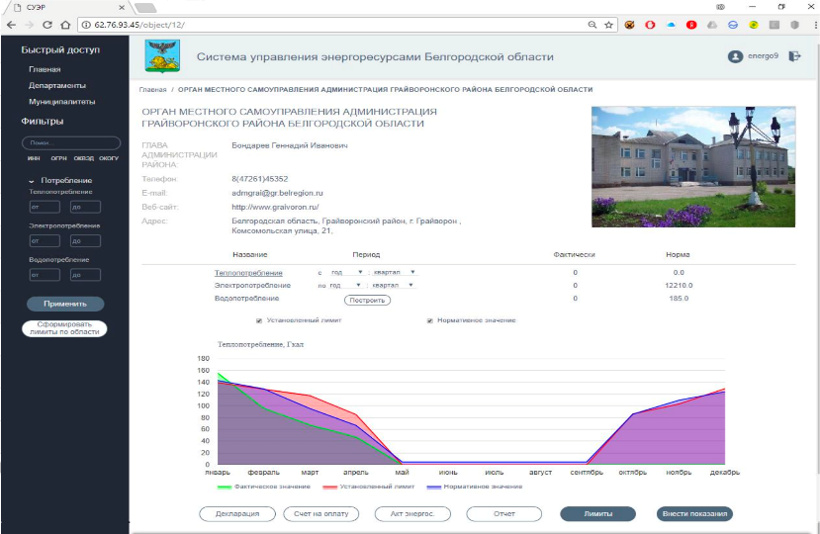
Introduction of a regional information and analytical system for energy resources management in the Belgorod Region
Certification of heat supply systems
Software module BUDGET
Calculation of resource consumption limits
Calculation of the target level of consumption reduction
Technical inspection of networks
моге than 1 bln rubles budget savings of the Belgorod region from 2019
Savings of 150 rubles per 1 resident of the region per year
2000 points of heat supply (data on consumption volumes are analyzed)
3500 buildings (digitized technical specifications)
100 % of energy declarations are filled and verified
Energy saving programs of institutions
Calculation of reliability and energy efficiency indicators
Software module
HEAT SUPPLY
Monitoring the achievement of targets
Definition of a system of measures to ensure reliability
Software module
BUDGET
Development of a heat supply scheme
Development of a municipal modernization program
SUER
digital ecosystem
Decision support system
Dispatching of engineering systems of buildings
Software module
DIGITAL OPERATOR
Regional energy saving program
Certification of equipment
Software module
REGION
Planning and control of technical inspections
Municipal energy saving programs
Development of measures to improve safety and reliability
Monitoring the achievement of targets
Monitoring of maintenance

Slide 11
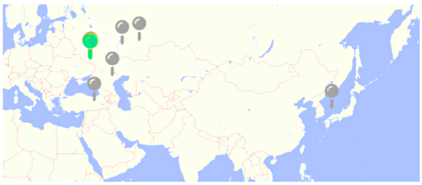
Digital twin-based smart control for building decarbonization
Case summary:
Achieved results
  9-30% energy savings
  10-30% reduction in peak power consumption
  Payback period 1-4 years
The technology has been implemented on 150 sites:
  Office building, fast food restaurants, retail stores, gas stations
  Minicanal facilities in Moscow region – schools, museums, ice rinks, theaters etc. via ~100 energy service contracts
Digital twin-based analytics and control has been used for a wide range
of facilities to achieve energy saving and emission reduction
An IoT platform is used to connect devices and sensors to the digital twin
An AI based software (the “Energy management Droid”) has been used
to monitor and control equipment and infostructure of the building
How is the Digital twin set up
Take all equipment online using specially developed IoT platform Install IoT based submetering for all (typically 100-300 current sensors)
Other sensors - t, CO2, VOC, luminosity, humidity etc.
Connect to all existing controllers and control system in the building
Connect to weather and energy marker data
Create Digital model – hybrid model – uses physical models (incl ASHRAE based thermal models) and ML to fit the model to the building
Create digital twin connect the model to the data

Slide 12
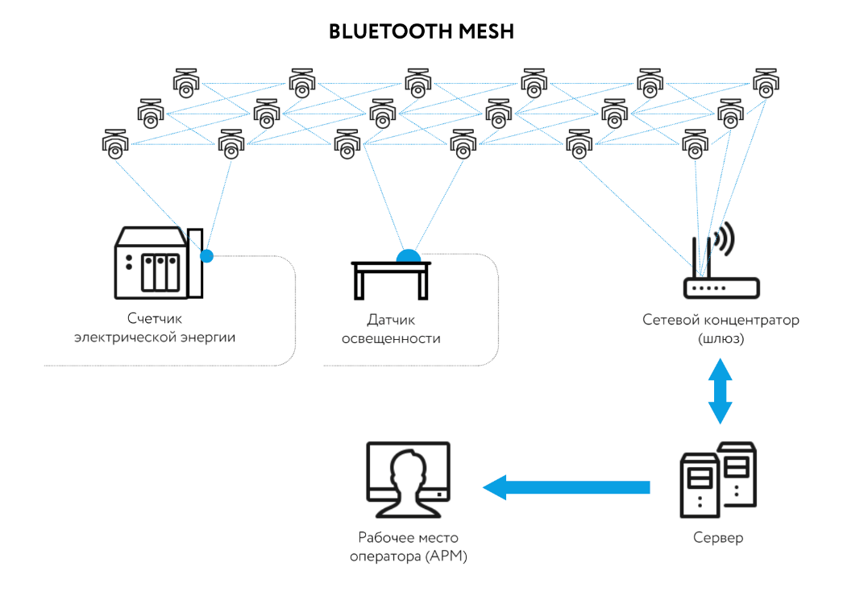
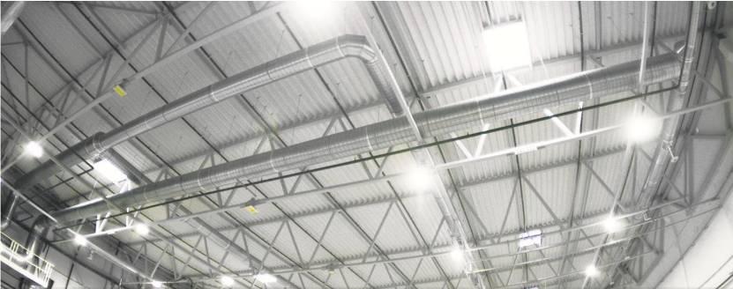
New generation of digital lighting systems
Each luminaire is equipped with a Bluetooth module.
The luminaires are combined into groups with various control methods.
The signal is relayed through multiple lighting fixtures — this increases the reliability of the communication channel.
Each employee is provided with a radio tag. Lighting scenarios are built based on personnel movement tracking.
In other words, the standard illuminance of 200 lx is maintained when employees are present in the area, and when they are absent, the lighting level is systematically reduced to 50–75 lx.
Factoring & rent model («light as a service»)
Lighting control system using radio tags based
on the high-speed Bluetooth 5.0 protocol
(Enercom Live Light )
Electricity meter
Light sensor
Network concentrator
(gateway)
saving an additional 30%–50% on electricity,
bringing total savings to 90% (luminaires + control system),
increasing the lifespan of luminaires by 1.5–2 times.
Operator’s workstation
(AWS)
Server

Slide 13
New Generation of Investments in Energy Efficiency
(project proposal for APEC economies)
This project aims to stimulate investments in energy efficiency and promote the 2022 APEC Energy Security Initiative principles and the Forum's energy sustainability goals by conducting a study and organizing a two-day workshop in Russia for policymakers, financial institutions, and private sector representatives.
The goal is to develop solutions to reduce investment risks and stimulate capital investment in enhancing energy efficiency.
The project's outcomes will directly contribute to achieving APEC's goals of reducing energy intensity (-45% by 2035) and ensuring sustainable growth, as enshrined in the "Putrajaya Vision 2040," by mobilizing critical investments in energy conservation.
The objective of the Project is to build the capacity of APEC economies and stakeholders in attracting investments in energy efficiency.
This will be achieved through the exchange of information, experience, best practices, and recommendations on the application of various mechanisms for investment activities in the field of improving energy efficiency: financial instruments, management models, legal aspects, and technical solutions, primarily in the areas of digitalization and IT.
Project Outputs
Preliminary study of approaches to investing in energy efficiency.
Two-day international workshop on stimulating investments in energy efficiency.
Financial Instruments
Management Models
Legal Aspects
Technical Solutions (Digitalization and IT)
3. Summary report on the results of the activities.
Expected Start Date: 01-03-2027
Project Completion Date: 30-06-2030

Slide 14

Conclusions and suggestions for APEC
Features of the Russian digitalization and investments in EE
The best practices in the field of energy efficiency improvements in line with integration with the trends of the green economy and the digital economy.
Development of comprehensive regulatory frameworks, promotion of inclusive stakeholder engagement, investments in capacity building, facilitation of economic incentives for digitalization
Support of market mechanisms for long-term financing of energy efficiency through legal mechanisms of ESC, leasing, concessions, PPP, offset contracts and instalment payment agreements.
Development of federal state information systems in the field of energy, energy efficiency and related fields for statistic, analysis and making decisions, and supporting of their interaction
Development of regional systems in the field of energy efficiency, supporting digital ecosystem for regional and municipal needs.
Digital technologies and AI open up new opportunities for investments to improve existing equipment and apply new contractual forms and mechanisms.
Suggestions for APEC
Suggestions for APEC
Continue studying the experience of the APEC economics in the field of formation of regulatory mechanisms for the development of energy services and investments in energy efficiency.
To form a description of cases with best practices for the implementation of investment projects in the field of improving energy efficiency with long-term financing.
To form a knowledge base on currently applicable investment forms and products in the field of energy efficiency improvement with focus on PPP and digital technologies

Slide 15


Thanks for your attention!
Dr. Alexey Tulikov
Director for the Development of Legislation in the Fuel and Energy Sector of the Russian Energy Agency,
Head of the Expert Council TC 039 on High Energy Efficiency Facilities and Technologies
e-mail: tulikov@rosenergo.gov.ru
mob.: +79104191896

