Slide 1

EGEDA Updates
The APEC EGEEC 66 AND EGNRET 64 Joint Meeting
1-2 April 2026 – Bangkok, Thailand
Mr Robert TROMOP
Chair, EGEDA

Slide 2
Outline
New EGEDA Chair and Vice Chair
Data collection and processing update
EGEDA training courses and workshops
International cooperation
Next EGEDA meeting
Progress on APEC goals
Final thoughts

Slide 3

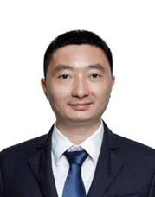
New EGEDA Chair and Vice Chair – 1 January 2026 to 31 December 2027
Mr Robert Tromop, Senior Vice President of APERC was the sole candidate for the position of Chair of EGEDA. His economy of origin is New Zealand. Having no other candidate, Mr Tromop was declared as the new EGEDA Chair, succeeding Mr Glen Sweetnam, former SVP of APERC.
Dr Yang Chun, Deputy Director of Big Data Department, Energy Development Research Institute, China Southern Power Grid was the sole candidate for the Vice Chair position. His economy of origin is China. With no other candidate for the position, Dr Yang was declared as the new EGEDA Vice Chair, succeeding Mr Jenyi Hou of Chinese Taipei.

Slide 4
Data collection and processing update

Slide 5
Regular APEC energy data collection
The secretariat has drafted the APEC Energy Statistics 2023 and will submit for review by the APEC Secretariat.
The EGEDA secretariat is now collecting the 2024 annual energy supply and demand data from member economies and aims to be able to complete collection and processing by end of September 2026.
Other data collection
  Annual energy prices
  Annual GHG emissions
    CO₂, CH₄ and N₂O emissions from energy combustion and fugitive emissions
    CO₂ transported and stored
  Energy efficiency indicators
  Monthly oil and gas supply and demand (JODI)
  Quarterly energy supply
  Major economic indicators
  Energy-related indicators

Slide 6
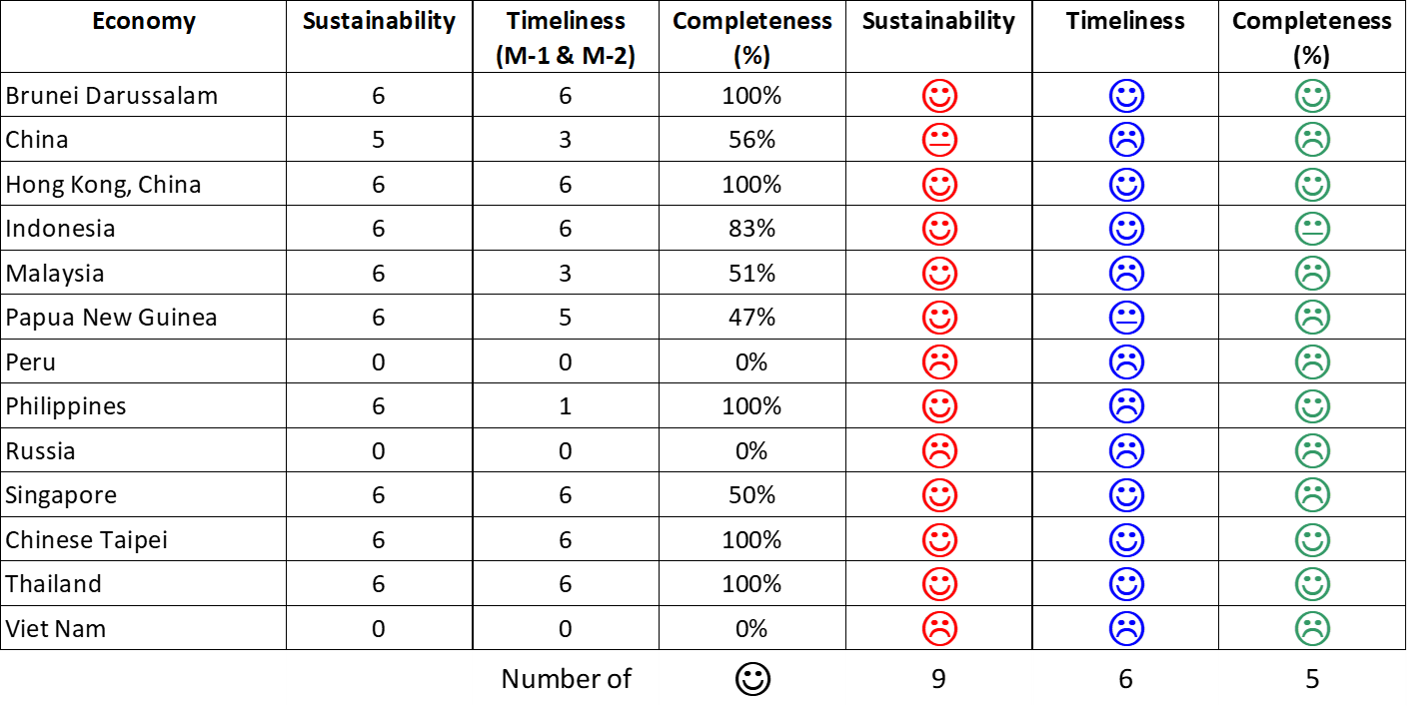
Smiley faces of JODI Oil in APEC (July-December 2025)
Compared to Jul-Dec 2024
Compared to Jan-Jun 2025
-1
-1
-1
No change
No change
-1

Slide 7
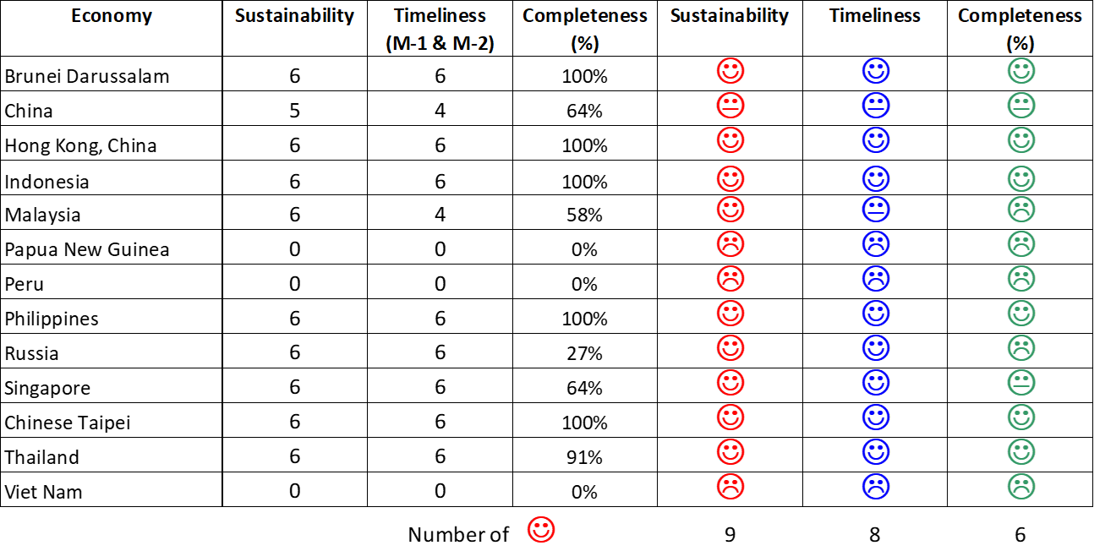
Smiley faces of JODI Gas in APEC (July-December 2025)
Compared to Jul-Dec 2024
Compared to Jan-Jun 2025
-1
No change
-1
No change
No change
No change

Slide 8
EGEDA training courses and workshops

Slide 9
23rd APEC workshop on energy statistics completed
Dates: 17-19 September 2025
Venue: Tokyo Prince Hotel, Tokyo, Japan
Theme: Conducting end-use energy consumption surveys
Objectives:
  The workshop's main objective is sharing of energy consumption survey practices among member economies such as:
    Sampling methodologies
    Preparation of questionnaires and enumerator’s manual
    Conduct of pilot survey
  The workshop facilitates dialogues on the issues and challenges encountered in end-use energy consumption surveys and how these can be addressed.

Slide 10

Energy statistics course (completed)
Dates: 19-30 January 2026
Venue: APERC Headquarters, Tokyo, Japan
Trainers​: APERC ESTO Researchers (EGEDA secretariat)
Objectives
  Increase the capacity of energy statisticians in APEC economies
  Keep members up-to-date with new developments.
  Enhance the human resource network between APEC economies and APERC
  Increase the level of understanding of the APEC energy database by APEC economies
  Introduce world trends in energy statistics to APEC economies
  Improve the reliability of the APEC energy database
Energy statistics training course in 2026

Slide 11
International cooperation

Slide 12
Secretariat’s participation in international meetings
2nd Meeting of IEA’s Committee on Energy Statistics (12-13 November 2025, online)
JODI Energy Market Transparency Seminar on Global Perspectives on Energy Market Transparency and Energy Data Reporting: JODI and Beyond (25 November 2025, Riyadh, Saudi Arabia).
IEA Southeast Asia Energy Efficiency Policy Training Week (1-4 December, Ha Noi, 2025)
JODI Inter-secretariat working group (ISWG) meeting (4 March 2026, online).
Task Team for the Revision of Standard International Energy Classification (TT-SIEC) under International Energy Statistics Working Group (InterEnerStat) (19 March 2026, online)

Slide 13
Results of TT-SIEC discussions
The task team discussed the next steps for the completion of SIEC Version 2.0, including drafting of the introductory text and explanatory notes.
19 March 2026 meeting (Work plan)
March -October 2026: Develop introduction, explanatory notes and correspondence tables
Q4 2026: Broad consultation of introduction and explanatory notes
November 2026: Final draft introduction and explanatory note submitted to the Annual meeting Committee of Experts on International Statistical Classifications for approval
Feb/March 2027: Pre-edit version of SIEC, including the structure introduction, structure explanatory note, submitted to the 58th session of the UN Statistical Commission

Slide 14

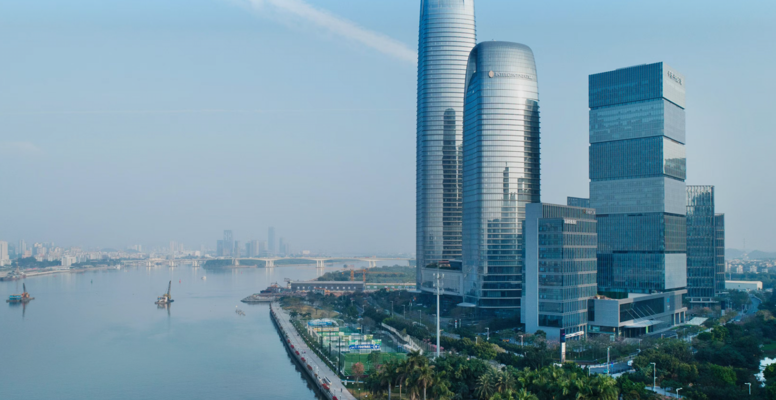
Next EGEDA Meeting
The 37th meeting of APEC EGEDA
Event Info
Date: 8 – 10 April, 2026
Location: InterContinental Guangzhou
Theme: Tracking Energy Transition — Data Collection
Helps Shape the Energy Future
Agenda Highlights
Apr 8: EGEDA Meeting
Apr 9: EGEDA Meeting | Workshops (Restructuring of APEC Energy Supply Chains based on Intelligent Digital Technology/ Integrating Renewable Energy and Hydrogen Technologies for Low-Carbon Transitions)
Apr 10: Meeting & Workshops | Technical Tours
Registration

Slide 15
Progress toward APEC’s energy intensity and renewable doubling goals

Slide 16
APEC’s final energy intensity improved from previous year
Annual change in APEC final energy intensity, 2006-23
 | 2006 | 2007 | 2008 | 2009 | 2010 | 2011 | 2012 | 2013 | 2014 | 2015 | 2016 | 2017 | 2018 | 2019 | 2020 | 2021 | 2022 | 2023 | 2005-23
Δ in Final Energy Consumption (FEC) | 2.4% | 3.6% | 0.8% | -1.2% | 5.8% | 4.2% | 2.0% | 1.4% | 0.4% | 0.6% | 0.4% | 1.5% | 3.3% | 0.6% | -3.9% | 4.8% | 3.0% | 1.2% | 35.3%
Δ in GDP (PPP, constant 2021 US dollars) | 5.4% | 5.5% | 3.1% | -0.3% | 5.7% | 4.3% | 4.3% | 3.9% | 3.9% | 3.7% | 3.5% | 4.1% | 4.2% | 3.5% | -1.1% | 6.4% | 2.9% | 3.8% | 92.0%
Δ in final energy intensity | -2.9% | -1.8% | -2.2% | -0.9% | 0.0% | 0.0% | -2.2% | -2.4% | -3.3% | -2.9% | -2.9% | -2.4% | -0.8% | -2.9% | -2.8% | -1.6% | 0.0% | -2.5% | -29.5%
Sources: APEC statistics (EGEDA), WB (GDP PPP), CT (WEO), APERC analysis
APEC Goal: Decrease energy intensity of TFEC by 45% relative to 2005 by 2035.
Final energy intensity has reduced by 29.5% compared to 2005.
The final energy intensity improvement in 2023 was more than two percentage points from 2022, bringing the average improvement between 2006 and 2023 to almost 2%.
GDP increased to 3.8% in 2023, almost one percentage point increase from 2022 and the average growth between 2011 and 2019 (just after the financial crisis and before COVID-19).

Slide 17
Decoupling continues
Change in FEC vs change in GDP (2006-2023)
APEC final energy intensity reduction goal
GDP continues to decouple from the final energy consumption from 2005 to 2023, even during and after COVID-19;
Current final energy intensity improvement (-29.5%) is just 34% away from the goal.

Slide 18
Renewable energy continues to gain share in both primary and final consumption
Primary energy supply, PJ
Final energy consumption, PJ
 | 2010 | 2023 | % change
Non-renewables | 288,229 | 341,991 | 18.7%
Coal | 116,944 | 129,528 | 10.8%
Oil | 89,684 | 103,991 | 16.0%
Gas | 62,313 | 87,346 | 40.2%
Other non-renewables | 19,287 | 21,126 | 9.5%
Traditional biomass | 3,209 | 2,558 | -20.3%
Modern renewable energy | 14,645 | 30,821 | 110.5%
Modern biomass | 4,186 | 6,959 | 66.2%
Hydro | 6,357 | 8,615 | 35.5%
Geothermal | 1,471 | 1,863 | 26.6%
Solar | 157 | 4,112 | 2521.9%
Wind | 586 | 5,261 | 798.3%
Other renewables | 1,889 | 4,012 | 112.4%
Total | 306,083 | 375,371 | 22.6%
Modern RE share | 4.78% | 8.21% | 71.6%
 | 2010 | 2023 | % change
Non-renewables | 165,110 | 191,505 | 16.0%
Coal | 32,126 | 25,573 | -20.4%
Oil | 64,214 | 71,018 | 10.6%
Gas | 26,155 | 36,928 | 41.2%
Electricity | 34,515 | 44,691 | 29.5%
Heat | 7,884 | 12,921 | 63.9%
Other non-renewables | 217 | 375 | 73.1%
Traditional biomass | 3,209 | 2,558 | -20.3%
Modern renewable energy | 10,757 | 22,790 | 111.9%
Electricity | 6,290 | 16,235 | 158.1%
Heat | 62 | 68 | 9.6%
Modern biomass | 2,816 | 2,940 | 4.4%
Other renewables | 1,589 | 3,547 | 123.2%
Total | 179,076 | 216,853 | 21.1%
Modern RE share | 6.01% | 10.51% | 75.0%
Note: Consumption of electricity and heat from renewables is calculated from the share of total electricity and heat production.Sources: APEC statistics (EGEDA), APERC analysis
RE share of the primary energy supply is just 1.4 percentage points away from the goal, while the share in final energy consumption is 1.5 percentage points away from the goal.

Slide 19
Likely that share of modern renewables in power generation has already doubled
Electricity generation, TWh
 | 2010 | 2023 | % change
Non-renewables | 11,334 | 14,305 | 26.2%
Coal | 6,577 | 8,183 | 24.4%
Oil | 325 | 150 | -54.0%
Gas | 2,687 | 4,053 | 50.9%
Nuclear | 1,658 | 1,844 | 11.2%
Other non-renewables | 87 | 75 | -14.0%
Modern renewable energy | 2,108 | 5,329 | 152.8%
Modern biomass | 67 | 269 | 300.9%
Hydro | 1,780 | 2,450 | 37.6%
Geothermal | 46 | 60 | 29.1%
Solar | 9 | 1,056 | 11642.6%
Wind | 163 | 1,461 | 798.3%
Other renewables | 43 | 34 | -21.6%
Total | 13,442 | 19,634 | 46.1%
Modern RE share | 15.68% | 27.14% | 73.1%
Sources: APEC statistics (EGEDA), APERC analysis
Renewable share of electricity generation also constantly shows good progress and is 4.8 percentage points away from the goal.

Slide 20
Wind and solar drove the increase in total RE
Total supply by energy source (PJ) 2000 - 2023
Sources: APEC statistics (EGEDA), APERC analysis
Solar grew almost 45% (CAGR) and wind grew almost 18% (CAGR) since 2010.

Slide 21
Pursuing and encouraging efforts to triple global renewable energy capacity by 2030

Slide 22
Support for tripling global renewable energy capacity
COP28 Declaration (excerpt)
To accelerate the energy transition, the COP 28 Presidency took a leading role in launching the Global Renewables and Energy Efficiency Pledge. With the endorsement of 130 national governments (as of 11 December, including the European Union (EU)), the Pledge stipulates that signatories commit to work together to triple the world’s installed renewable energy generation capacity to at least 11,000 GW by 2030….. (COP28 UAE, 2023)
2023 APEC Leaders’ Golden Gate Declaration (excerpt)
We will pursue and encourage efforts to triple renewable energy capacity globally through existing targets and policies as well as demonstrate similar ambition with respect to other zero and low emissions technologies including abatement and removal technologies in line with domestic circumstances by 2030.

Slide 23
Global installed renewable energy capacity in 2023
Estimated global RE capacity (GW)
Current and target global RE generation capacity (GW)
Source for both figures: IRENA
The COP28 target for 2030 is 11 000 GW of installed renewable generation capacity.

Slide 24
APEC’s share of global RE capacity in 2023
Estimated APEC RE capacity (GW)
APEC and global level relative to 2030 target (GW)
2,409 GW
Sources: EGEDA, IEA
In 2023, APEC accounted for 62% of global RE capacity.

Slide 25
Final thoughts
Thanks to the members for their kind support to the EGEDA’s activities.
EGEDA will continue to provide relevant workshops and training to keep up with the continuously changing energy systems and technologies. We would like to encourage members to continue participating in EGEDA activities.
Improvement in energy intensity has picked up again in 2023 after slowing down in 2021 and 2022.
Renewable energy, specifically solar and wind, was the fastest-growing energy source in APEC in 2023.
In 2023, APEC accounted for over 60% of global renewable generation capacity.

Slide 26
Thank you.
https://aperc.or.jp

