Slide 1
APEC Workshop: RE Policies and Investments:
Are We on the Right Track?
Bangkok
31 March 2026
Evelyn Wong, Policy Director, AVPN

Slide 2

MOVING CAPITAL TOWARDS IMPACT
WHY CLIMATE IS A KEY PILLAR OF THE SOCIAL IMPACT ECOSYSTEM IN ASIA-PACIFIC
Member economies at greatest risk from climate change
Likelihood of exposure to climate-related extreme events
Population living in areas exposed to extreme heat waves
Asia-Pacific
6x
Asia-Pacific
0.6 – 1.0 B
7 out of 10 are in Asia-Pacific
Globally 1x
Globally 0.7 – 1.2 billion
GDP at risk annually from rising heat and humidity by 2050
Displacement due to climate-related disasters, 2022
Asia-Pacific
USD 2.8-4.7 T
Asia-Pacific
32.6 M
Globally USD 4.0-6.0 trillion
(with significant raise in unpaid
work by women)
Globally 49.4 million (with 80% being women)
Notes:
CONNECT
Ecosystem Building - Leveraging on the diverse engagement models to facilitate awareness, engagement and build collaboration across social causes, markets and approaches.
Forge connections between stakeholders via flagship events; curated events; one-one matchmaking
LEARN
Knowledge and research - Curating white papers, case studies and research reports to mobilize capital entails producing actionable insights that inform investment strategies, guide funding decisions, and amplify impact
Capacity Building Initiatives - Empower stakeholders by providing interactive workshops, and learning circles
ACT
Philanthropic funds - AVPN is a pioneer in our intent to ensure trust-based giving between funders and grantees. The first-of-its-kind in Asia, our philanthropic funds deploy Flexible funding to IOs.
Innovative Finance - Experimenting with new financial tools to bridge funding gaps by hosting projects that mobilize larger sums of impact capital towards Asia through innovative collaboratives, giving models, and blended finance mechanisms.
Pipeline building - Identification and incubation of grassroot level solutions
LEAD
Policy Engagement - Enabling cross-learning and thought leadership for private sector leaders and policy influencers to help shape the impact strategy and policy agenda to solve the SDGs & propel progress across the region.
Global and Regional events - Representing Asian leadership at forums such as G20, ASEAN Summits, COP, World Health Assembly, World Health Summit etc.
Capital Stacks
Impact Investing: Building a thriving ecosystem by connecting investors, impact enterprises, and policymakers, fostering collaboration, and advancing innovative solutions to scale impactful investments across Asia.

Slide 3

The Capital Gap
The Scale of Need
What's Actually Flowing
Why the Gap Persists
~$800B–$1T
~14%
3 failures
needed annually in Asia-Pacific
for climate finance (IMF, 2024)
of global climate finance reaches emerging Asia ex. China (IMF 2024, ADB 2024)
awareness · structure · trust
Asia accounts for over half of global greenhouse gas emissions and faces the most severe adaptation costs. The investment requirement dwarfs current flows by an order of magnitude.
Capital is concentrated in high-income markets and large infrastructure. Early-stage, community-level, and cross-sector solutions — where the need is greatest — receive almost nothing.
-Investors don't know where to deploy.
-Innovators can't access capital at the right stage.
-Governments can't signal demand credibly.
No one is sitting in the middle connecting all three.
Climate Action Platform

Slide 4
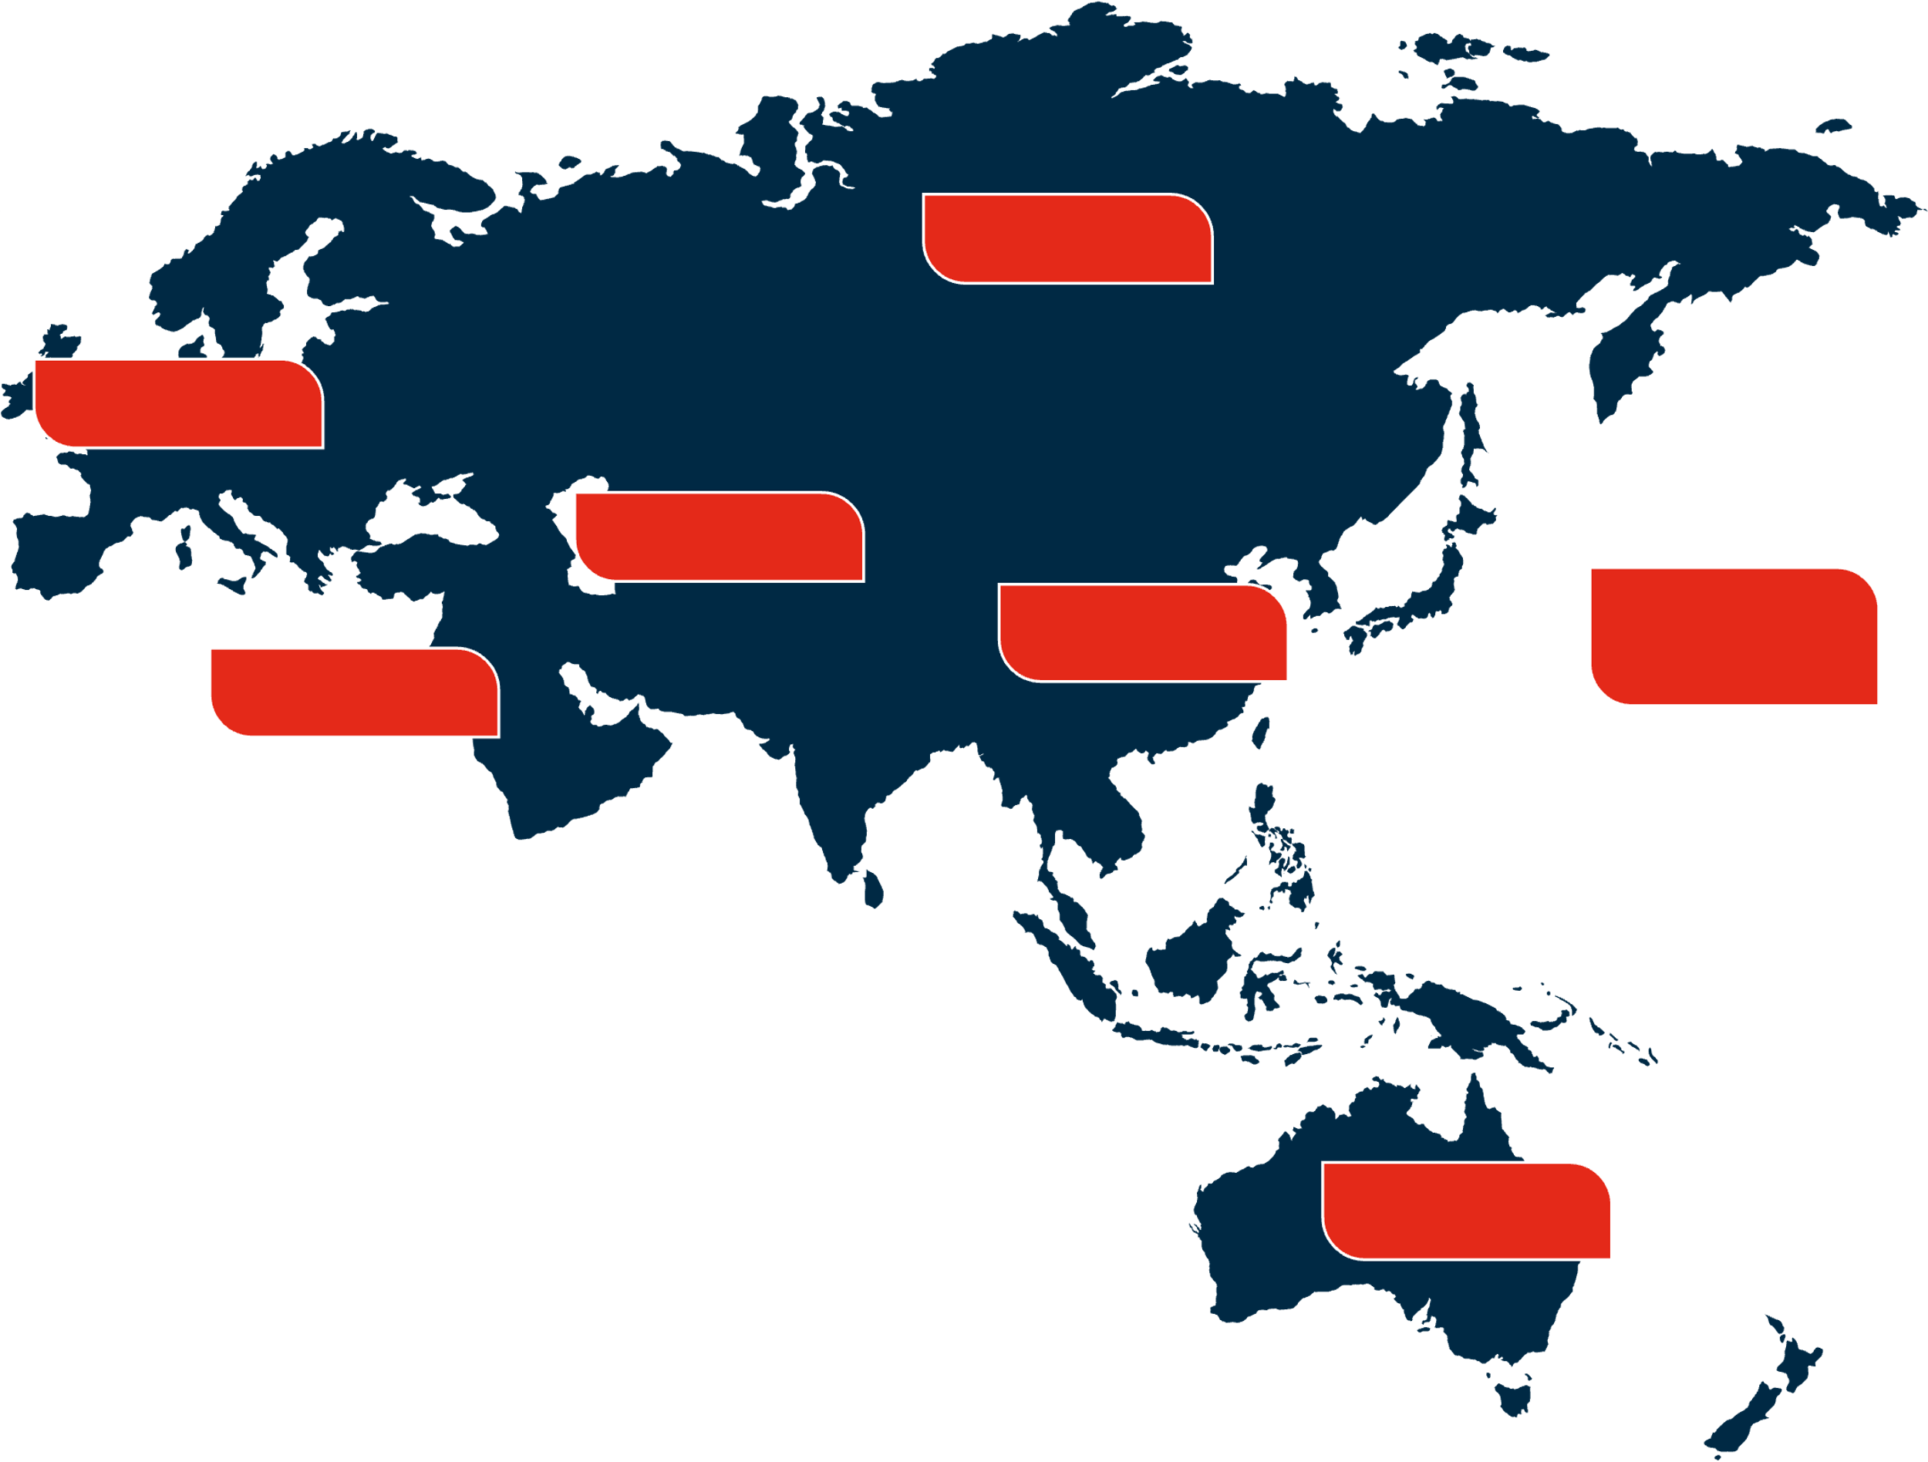





AVPN MEMBERS NETWORK
THE LARGEST NETWORK OF SOCIAL INVESTORS IN ASIA
NORTHEAST ASIA
21%
Being part of the AVPN community has been an enriching experience. The network has provided invaluable opportunities to connect with like-minded organisations who are equally passionate about driving social impact.
Sandhya Dovedy
LinkedIn
EUROPE - UK
7%
SOUTH ASIA
18%
SOUTHEAST ASIA
NORTH & SOUTH
AMERICA
WEST ASIA
38%
10%
1%
AVPN CONNECTS
700+
44
400+
Members Across the World
Markets
Listed Investable Deals
AVPN DIGITAL REACH
AUSTRALIA & NEW ZEALAND
5%
700K
Annual Page Views
to AVPN Website
27K
Subscribers to the AVPN Newsletter
55K
Followers on AVPN
Social Media Platforms
Notes:
AVPN is first and foremost a funders network and an ecosystem builder for the social investment sector in Asia. We have over 600 members who range from foundations, family offices to corporates, financial institution, impact funds, policymakers and intermediaries.
All of them deploy financial capital along a continuum that encompasses everything from philanthropy and venture philanthropy to impact investing. In additional, our members would build capacity as a way of providing human capital, or intellectual capital.
Our mission is to catalyse a more strategic outcomes focused, collaborative approach to social investing. How we achieve this is by supporting our members to connect, learn, act and lead and there are several ways in which these can be tailored to support engagement with the social investing community.

Slide 5
Driving Asian Leadership Toward the Climate Agenda
The Vision
“AVPN’s Climate Action Platform will drive Asian Leadership in Climate Agenda, to channel more resources into climate action, and accelerate the global transformation to resilient, sustainable and positive future, for all.”
The impact in this
“Asian Decade”
“Changes in Asia will significantly contribute to the fight against climate change globally”
Help build this narrative of climate action leading to a new pathway for growth in Asia
Climate Action Platform 2.0
‹#› | www.avpn.asia

Slide 6
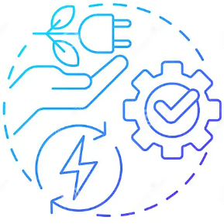
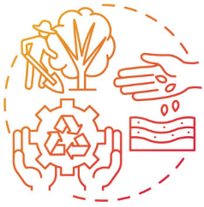

Driving Asian Leadership Toward the Climate Agenda
We are the connective tissue between thought leadership, committed capital and project execution
Advancing initiatives with strong potential to significantly reduce greenhouse gas (GHG) emissions within the current decade, particularly through active engagement with policies and large scale actions.
Greenhouse Gas Emissions (GHG)
Food Systems
Climate
Mitigation
Decarbonisation
Renewable Energy
Connect
Low-Carbon Growth
Forestry & Land Use
Waste Management
Enabling AVPN Ecosystem actors to innovate and implement strategies to combat the vulnerability to the impacts of climate change
Learn
Climate
Adaptation
Nature-Based
Solutions
Ecosystem Restoration
Water Management & Flood Control
Climate Resilient Infrastructure
Resilient Agriculture/ Food Security
Act
Encouraging collaboration and engage with policies that contribute to building resilient communities and actively address climate action in marginalized/vulnerable communities
Climate Action Platform 2.0
Community Resilience
Disaster Preparedness
Climate
Resilience
Sustainable Livelihoods
Lead
Biodiversity Conservation
Resource Management
Health & Social Resilience
‹#› | www.avpn.asia

Slide 7




Examples of Our Initiatives

Slide 8


1. Capacity building for local climate CSOs: Supporting quality evidence generation and bridging policy and implementation
A strategic and collaborative philanthropic effort aimed to provide high-quality inputs, through validated research and learnings from technical partners to governments in two Asian economies – India and Indonesia, to develop and execute evidence based research and practices that reduce greenhouse gas (GHG) emissions in alignment with national & international climate commitments.
THE GAP
THE INTERVENTION
EXAMPLES & IMPACT
Climate CSOs growing across Asia but unevenly, most lack resources to drive change at scale
Strong technical evidence exists but is not reaching policy actors or capital providers in decision-ready form
Limited pathways to translate climate research into investable narratives and regulatory signals, particularly for RE adoption
Donor fund: unrestricted, multi-year grants enabling research-to-policy translation
Tailored technical assistance based on organisational needs
Knowledge-sharing forums connecting researchers with investors and policymakers
Partner convenings to connect ecosystem actors across RE and decarbonisation (IRADe, AEEE)
CEEW: Positioned green economy research (incl. RE pathways) for investment and regulatory audiences
Development Alternatives: Piloted LC3 low-carbon cement with JK Lakshmi Group, moving from lab to commercial adoption
IIHS: Policy-relevant research on building energy performance, improve urban sustainability standards
IRADe: Inception workshop on low-carbon captive power options for the Indian aluminium industry, identifying RE-based alternatives to fossil fuel captive generation
AEEE: Decarbonising horticulture cold chain launch and e-cart demonstration in Bihar, exploring last-mile delivery models and RE-powered cold chain scaling
Collective abatement target: 100M tCO2e annually
Notes:
Speaker notes: The number of CSOs working on climate change in Asia has grown in recent years, but this growth is uneven across member economies. Most lack the resources, networks, and positioning to convert their technical work into policy or investment outcomes. This is particularly true for renewable energy, where the gap between evidence on viable RE solutions and actual policy uptake or capital deployment remains wide.
AVPN addresses this primarily through the ACAII Fund, which provides unrestricted, multi-year grants. The design is deliberate: unrestricted funding gives grantees the flexibility to pursue research-to-policy translation, test ideas with capital providers, and refine their positioning, none of which project-tied funding typically allows.
Three examples illustrate how this works. CEEW had strong analytical work on green economy pathways, including renewable energy, but needed sharper positioning to reach investment and regulatory audiences. Two years of unrestricted funding enabled structured engagements and knowledge products that strengthened CEEW's ability to frame its research for these audiences. Development Alternatives had proven LC3 low-carbon cement technology, but advancing adoption required flexibility to engage market and policy actors beyond what project funding allowed. AVPN's support enabled a pilot with JK Lakshmi Group, shifting the work from a technical exercise to a commercial adoption strategy. IIHS used the funding to produce more robust research on building energy performance, positioning findings to inform urban planning standards.
Beyond direct grantmaking, AVPN participates in ecosystem convenings that connect RE and clean energy actors. IRADe convened a workshop on low-carbon captive power options for the aluminium industry, exploring how heavy industry can shift from fossil fuel captive generation to renewable alternatives. AEEE launched a decarbonising horticulture cold chain initiative in Bihar, demonstrating e-cart last-mile delivery models and exploring RE-powered cold chain infrastructure for rural livelihoods. AVPN participated in both, connecting these efforts with our broader network of funders and capital providers.
These examples show the model: catalytic funding and ecosystem participation build the evidence base and policy bridges that make RE investment and adoption possible at scale

Slide 9
2. Facilitating clean growth investment: subnational funding vehicles, partnerships, pipelines
This initiative aims to build institutional muscle and momentum in several South Asian states as they takes steps to lower the intensity of its emissions. It enables convergence across key sectors such as energy, industry, transport, buildings, and agriculture, with a focus on emission mitigation, job creation, vulnerability reduction, and broader co-benefits.
THE GAP
THE INTERVENTION
EXAMPLES & IMPACT
Subnational climate finance overwhelmingly public, straining limited state budgets
No established models for private and philanthropic capital to de-risk distributed RE and clean growth at the state level
Rural enterprises and SMEs lack access to RE financing despite clear economic and environmental benefits
Leverage investment potential by designing viability gap funding and blended finance structures and providing subsidies and capital investment.
Facilitate public/private partnerships and city/state grantee agreements.
Support the scaling of research/ solutions; provide technical assistance and digital tools to implement actionable climate solutions.
Provide strategic advisory, policy support and design compliance incentives to trigger structural shifts.
Capital and Partner Mobilisation: UP MoU: USD 325M expected mobilisation over 5 years. Initial focus: rooftop solar for industrial parks (Gautam Buddh Nagar, Ghaziabad), agri-voltaic solutions in polyhouses, solarisation of agricultural feeders, transition of diesel irrigation pumps to solar
Direct Deployment: 2 examples of rooftop solar (3.5kW and 35 kW systems) in Maharashtra for farmer associations (FPOs); supported district-wide pipeline development including 35 project design documents representing 220kW solar pipeline.
Notes:
Speaker notes: The bulk of climate finance at the subnational level remains public, placing immense pressure on limited state budgets and subsidies. There is an urgent need for new models where private and philanthropic capital can share risk and catalyse systemic shifts, particularly for distributed renewable energy that is too small for DFI or MDB deal sizes but critical for last-mile impact.
AVPN works at this layer through two channels: institutional partnerships with state governments, and direct deployment support for distributed RE.
In February 2026, AVPN signed an MoU with the Government of Uttar Pradesh in Singapore, in the presence of Chief Minister Shri Yogi Adityanath, to accelerate climate-aligned investments. The partnership targets USD 325 million in mobilisation over five years. The RE focus is specific: initial areas of collaboration include aggregated rooftop solar across UP State Industrial Development Authority industrial parks starting with Gautam Buddh Nagar and Ghaziabad, agri-voltaic solutions in polyhouses, solarisation of agricultural feeders, and transitioning diesel irrigation pumps to solar-powered systems. AVPN deploys philanthropic technical assistance alongside its 700+ member network to build investment-ready pipelines and improve transaction readiness. Two AVPN member organisations, PIDG and Kaizenvest, signed separate MoUs with UP during the same visit, signalling early investor alignment.
At the enterprise level, AVPN supported MP Ensystems in deploying rooftop solar PV for rural enterprises in Maharashtra. In Gadchiroli, a 3.5 kW system was installed for a women-majority herbal cluster FPO under a 60-month operating lease model. The FPO processes medicinal plants and electricity is a major operational cost. The solar installation reduces this, builds tariff resilience, and frees savings for reinvestment in procurement, packaging, and market linkages. In Sindhudurg, a 35 kW system was installed for the Devgad Alphonso Mango and Multifruit Association, generating over 52,000 kWh annually. Across the district, 53 units were surveyed and 35 project design documents developed, representing a 220 kW solar pipeline.
The pattern across these examples is consistent: AVPN provides the catalytic layer, through technical assistance, blended finance design, and pipeline building, that makes distributed RE investable at the subnational level.

Slide 10
3. ASCENT: Accelerating Asia's Energy Transition through Blended Finance
This initiative aims to build institutional muscle and momentum in several South Asian states as they takes steps to lower the intensity of its emissions. It enables convergence across key sectors such as energy, industry, transport, buildings, and agriculture, with a focus on emission mitigation, job creation, vulnerability reduction, and broader co-benefits.
THE GAP
THE INTERVENTION
EXAMPLES & IMPACT
Asia produces >50% of global emissions, receives <20% of global climate finance
<1% of transition financing reaches people-centric solutions
Workers, communities, SMEs, and low-income consumers face job losses, rising costs, and inequality during transition
RE infrastructure is scaling, but without inclusion mechanisms the transition risks being fast in scale and unjust in impact
Launched ASCENT to mobilise blended capital into socially inclusive energy solutions
Phase 1 complete: evidence base established, people-centric feasibility demonstrated, ecosystem alignment built
Impact measurement framework across 4 stakeholder groups: Workers, Communities, Consumers, SMEs
Published BCG-AVPN framework report (Sept 2025)
Case studies documented in BCG-AVPN report include: RE upskilling for workers (Singapore), solar-powered cold storage for fisherfolk communities (Indonesia), rural electrification via off-grid solar and mini-hydro (Malaysia), and SME capability building for clean energy investment (South Africa)
Growing interest from impact investors in exploring people-centric energy transition opportunities
Phase 2: designing blended finance mechanisms leveraging philanthropic and concessional capital, expanding investor partnerships, fund launch
Notes:
Speaker notes: Asia's energy transition will determine the pace and equity of the global climate response. The region produces more than half of global emissions but receives less than 20% of global climate finance. Of the financing that does flow, less than 1% reaches people-centric solutions. This means the workers who need reskilling, the communities dependent on fossil fuel economies, the SMEs that make up 97% of APAC enterprises, and the low-income consumers who need affordable energy access are largely left out. If financing continues to prioritise infrastructure without inclusion, the transition will be fast in scale but unjust in impact.
AVPN launched ASCENT with BCG to address this structural gap. Cathay Financial Holdings is the anchor sponsor. Phase 1, completed in 2025, focused on building the foundation: establishing the evidence base for people-centric approaches, curating a solutions repository from consultations with over 30 stakeholders across governments, financiers, business leaders, and NGOs, and developing an impact measurement framework.
The framework identifies four key stakeholder groups and maps specific risks, solutions, and metrics for each. For Workers, the focus is on reskilling and transition readiness. For Communities, it is economic diversification and resilience. For Consumers, it is affordability and access. For SMEs, it is capacity building and financing. The BCG-AVPN publication, released September 2025, provides the full framework alongside case studies that illustrate what people-centric RE looks like in practice. These include the RISE programme in Singapore, which upskilled 200 learners in green economy skills, solar-powered cold storage on Bungin Island in Indonesia, rural electrification planning in Sabah, Malaysia, and SME capability building in South Africa.
The tangible impact of Phase 1 is twofold. First, we have seen enhanced engagement from the ecosystem towards the impact framework, with funders and solution providers aligning on shared measurement standards that work for both investor due diligence and social impact assessment. Second, and most importantly, we are seeing growing interest from impact investors in exploring concrete investment opportunities in the people-centric energy transition space. This investor signal is what validates the approach and sets up Phase 2. Phase 2 will focus on designing financial mechanisms that leverage philanthropic and concessional capital, expanding partnerships with institutional and corporate investors, and launching the ASCENT fund.

Slide 11
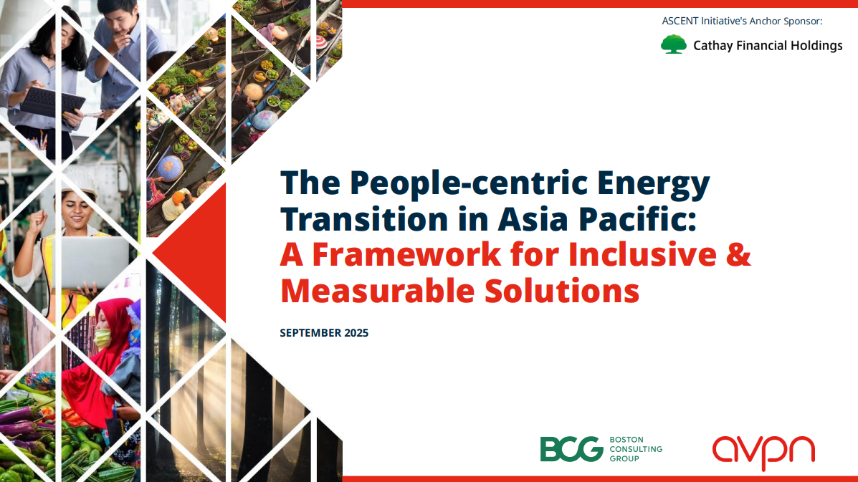
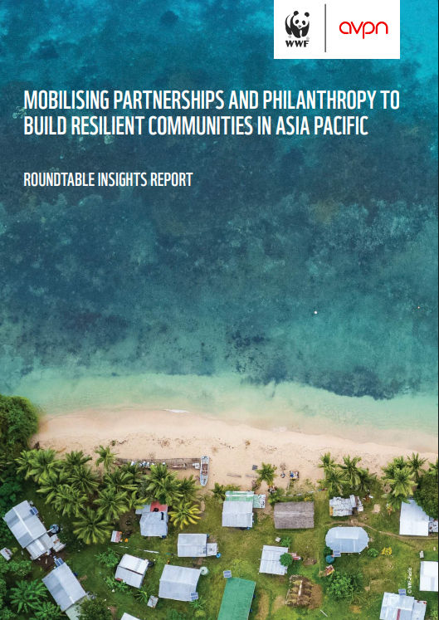
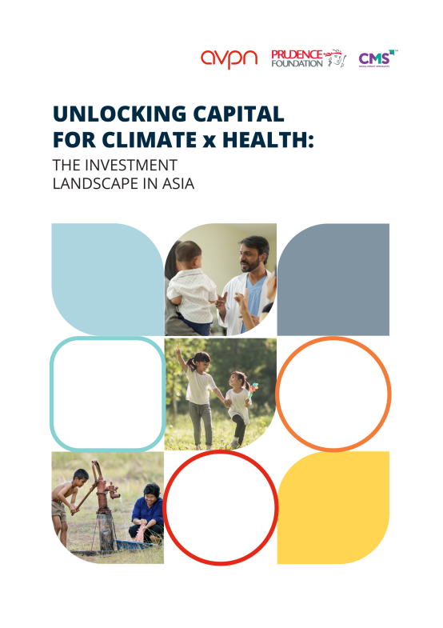


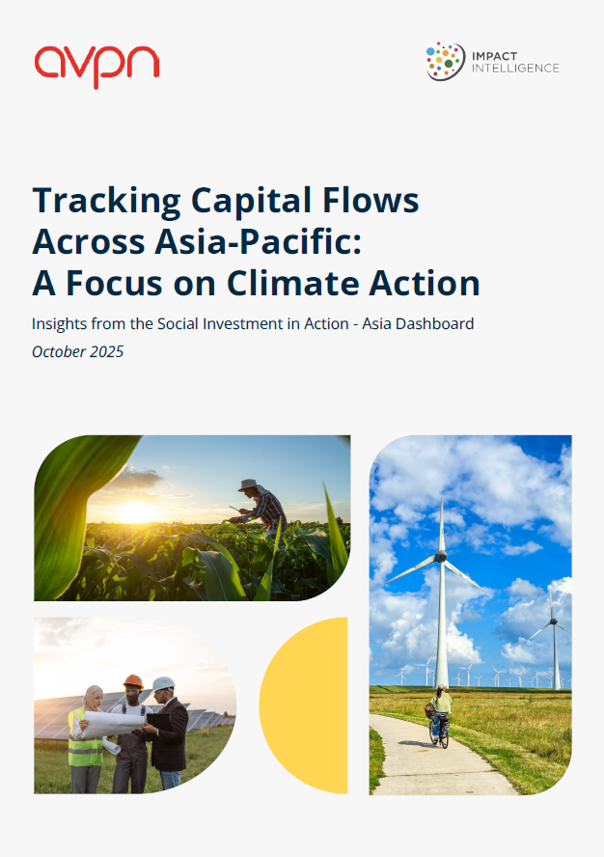

Read Our Latest Reports
https://siaa.avpn.asia/reports

Slide 12





info@avpn.asia
avpn.asia
©2020 AVPN
AVPN is registered in Singapore as a charity (UEN 201016116M)

Slide 13





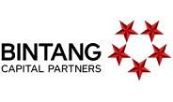
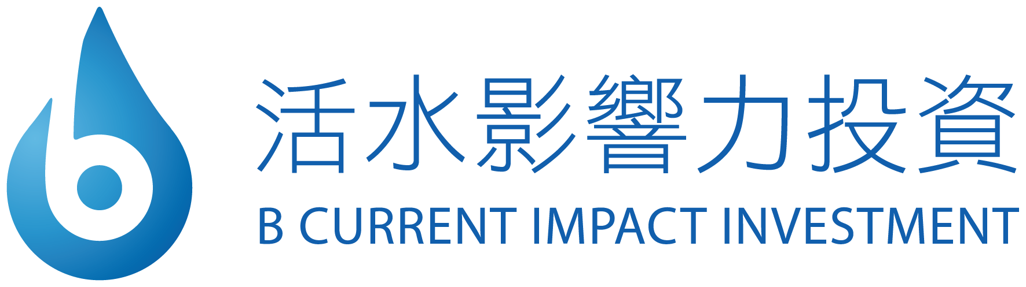




















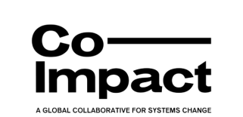









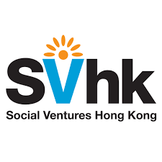

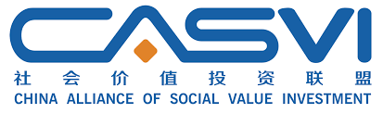

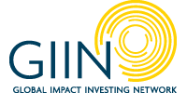








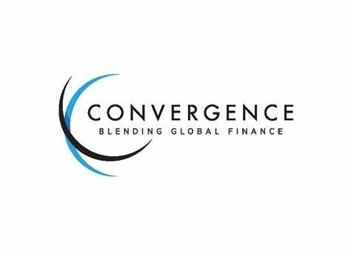







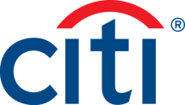
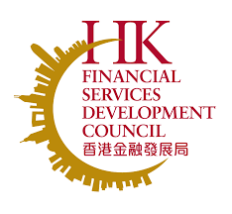






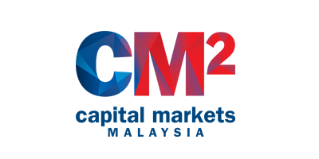
AVPN MEMBERS NETWORK
SERVING THE FULL SPECTRUM OF SOCIAL INVESTORS IN ASIA
FOUNDATIONS / FAMILY OFFICES
IMPACT FUNDS
CORPORATIONS / FINANCIAL INSTITUTIONS
INTERMEDIARIES
GOVERNMENT RELATED

Slide 14
MOVING CAPITAL TOWARDS IMPACT
HOW WE BUILD THE SOCIAL IMPACT ECOSYSTEM IN ASIA
As Asia’s largest social investment network with over 700+ members, we aim to increase impact and flow of capital deployed towards closing the Sustainable Development Goals (SDG) gaps in Asia.
Connect
Learn
Act
Lead
THEMATIC AREAS
Capacity Building
Climate
Ecosystem Building
Academy
Pipeline Building
Policy Engagement
Gender
Flagship Events
Research & Insights
Philanthropic Funds
Representation at Global and Regional events e.g. COP29
Health
Curated Events
Impact Measurement and Management
Innovative Finance
Youth
Matchmaking
Workshops & Learning Circles
CAPITAL
Philanthropy
Impact Investing
Blended Finance
Corporate Social Responsibility
Notes:
CONNECT
Ecosystem Building - Leveraging on the diverse engagement models to facilitate awareness, engagement and build collaboration across social causes, markets and approaches.
Forge connections between stakeholders via flagship events; curated events; one-one matchmaking
LEARN
Knowledge and research - Curating white papers, case studies and research reports to mobilize capital entails producing actionable insights that inform investment strategies, guide funding decisions, and amplify impact
Capacity Building Initiatives - Empower stakeholders by providing interactive workshops, and learning circles
ACT
Philanthropic funds - AVPN is a pioneer in our intent to ensure trust-based giving between funders and grantees. The first-of-its-kind in Asia, our philanthropic funds deploy Flexible funding to IOs.
Innovative Finance - Experimenting with new financial tools to bridge funding gaps by hosting projects that mobilize larger sums of impact capital towards Asia through innovative collaboratives, giving models, and blended finance mechanisms.
Pipeline building - Identification and incubation of grassroot level solutions
LEAD
Policy Engagement - Enabling cross-learning and thought leadership for private sector leaders and policy influencers to help shape the impact strategy and policy agenda to solve the SDGs & propel progress across the region.
Global and Regional events - Representing Asian leadership at forums such as G20, ASEAN Summits, COP, World Health Assembly, World Health Summit etc.
Capital Stacks
Impact Investing: Building a thriving ecosystem by connecting investors, impact enterprises, and policymakers, fostering collaboration, and advancing innovative solutions to scale impactful investments across Asia.

Slide 15
Driving Asian Leadership Toward the Climate Agenda
Climate Action Platform Strategy
Asia is both the world’s largest emitter and its most climate-vulnerable region. AVPN’s 2025–2030 Climate Strategy responds with a bold agenda by aligning capital with community-driven action, bridging global ambition with grounded execution.
$1 Billion
Unlocked Catalytic Capital
1 Gt CO₂e
Drive GHG Emissions Abatement
100 Million
Build Climate Resilience for Climate-affected People
OUR
ASPIRATIONS
OUR MODEL
OUR MOMENTUM
Execute through 5 levers: Capital innovation, Local institution building, Regional collaboration, Narrative influence, and Intersectional implementation
Mobilised $53M+ to date, supported 100+ climate projects, and built an ecosystem of 400+ members catalysing climate solutions across Asia.
OUR EDGE
OUR FOCUS
Embed climate action within broader development goals, gender, youth, health for systemic, co-benefit-driven outcomes
Double down on India and Indonesia as climate exemplars, while scaling impact across South, Southeast, West, and Northeast Asia
Climate Action Platform 2.0
Source: AVPN Climate Strategy 2025-30
‹#› | www.avpn.asia

Slide 16
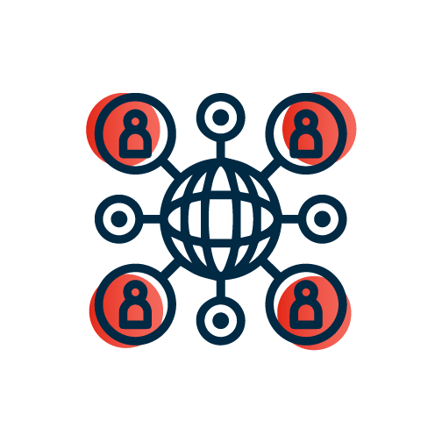



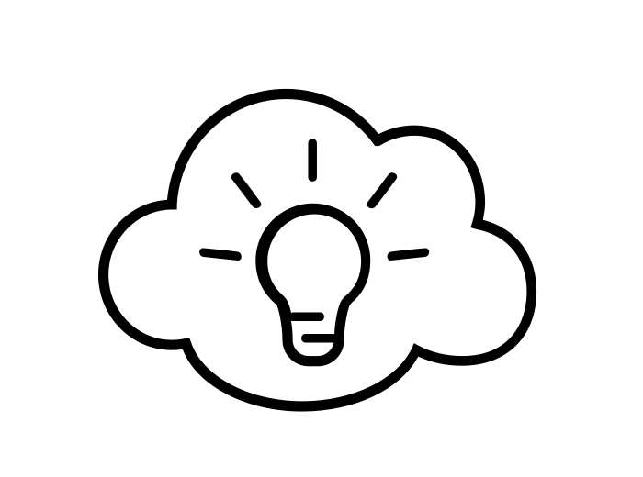
1. Capacity building for local climate CSOs: Supporting quality evidence generation and bridging policy with ground action
A strategic and collaborative philanthropic effort aimed to provide high-quality inputs, through validated research and learnings from technical partners to governments in two Asian countries– India and Indonesia, to develop and execute evidence based research and practices that reduce greenhouse gas (GHG) emissions in alignment with national & international climate commitments.
Setting the Context: Number of CSOs focusing on climate change has increased in recent years, this growth has been uneven across economies, and most of them lack the necessary levels of resources required for them to drive change effectively.
Ecosystem Gap: AVPN aims to bridge critical gaps in enabling low-carbon development by supporting key actors across the ecosystem. This includes assisting policymakers in designing effective regulatory frameworks, providing CSO, including NGOs, think tanks & technical partners with flexible funding and technical assistance, and enabling them to make strategic, evidence-based decisions.
AVPN also engages with philanthropies to deliver catalytic financing, promote innovation, and scale impactful climate solutions.
Focus Region - India, Indonesia
APPROACH
Support Cohort of Grantees for Climate Impact: Provide a cohort of established technical partners with flexible, multi-year funding to implement evidence-based initiatives that reduce emissions & inform regional climate regulations, targeting a collective impact of 100 million MT CO₂e annually
Strengthen Grantee Capacity for Climate Action: Provide tailored technical assistance based on organizational needs assessments to equip partners in two geographies for effective climate action
Foster Collaboration and Knowledge Sharing: Facilitate interactions among grantees and the broader climate mitigation ecosystem to enable cross-regional idea exchange and accelerate collective action.
Raise and Mobilize Funding: Partner with aligned regional and global funders to secure resources that support impactful climate mitigation initiatives
Develop & Enhance Monitoring & Evaluation (M&E): Develop & Implement robust M&E processes to track progress, ensure accountability & effectiveness of of research projects in achieving outputs and outcomes

Slide 17




2. Facilitating clean growth investment: subnational funding vehicles, partnerships, pipelines
This initiative aims to build institutional muscle and momentum in several South Asian states as they takes steps to lower the intensity of its emissions. It enables convergence across key sectors such as energy, industry, transport, buildings, and agriculture, with a focus on emission mitigation, job creation, vulnerability reduction, and broader co-benefits.
Setting the Context: The bulk of climate finance at the state level remains public, placing immense pressure on limited budgets and subsidies as subnational governments take steps to lower the intensity of its emissions. There is an urgent need to create new models where private and philanthropic capital can unlock demand, share risk, and catalyse systemic shifts—particularly through blended finance structures that de-risk emerging markets like distributed energy, storage, electric mobility, and climate-resilient public infrastructure.
Ecosystem Gap: This initiative responds to this need by strengthening institutional capacity not only to implement projects at scale, but also to establish systems that can continuously imagine, design, and deliver clean growth solutions. It does so through a range of support models—including research, research-to-policy translation, technical assistance, and private sector engagement
APPROACH
Financial Levers of Change: Leverage investment potential by designing viability gap funding and blended finance structures and providing ,subsidies and capital investment.
Institutional Levers of implementation: Facilitate public/private partnerships and city/state grantee agreements.
Technical levers of implementation: Support the scaling of research/solutions ++,provide technical assistance and digital tools to implement actionable climate solutions.
Regulatory levers of implementation: Provide strategic advisory, policy support and design compliance incentives to trigger structural shifts.

Slide 18


3. Asia’s Clean Energy Transition Initiative (ASCENT): Accelerating Asia's Energy Transition through Blended Finance
ASCENT is a new initiative spearheaded by the AVPN Climate Action Platform and will focus on building capacity for the climate action ecosystem at large and facilitate the channelling of catalytic capital to climate solutions via blended finance vehicles.
Setting the Context:
Asia's rapid economic and population growth have increased energy demand, with 85% still dependent on fossil fuels, making it a major global emitter of GHGs. The region is facing an urgent pressure to transition to cleaner energy to meet climate goals.
Ecosystem Gap:
While the transition is crucial, the ecosystem's lack of mechanisms to mobilise catalytic capital poses a significant barrier, requiring blended finance and stronger collaboration among philanthropies, governments, and financial institutions.
APPROACH
ASCENT DEVELOPMENT ROADMAP
Create avenues for philanthropies to engage with development agencies and country governments on energy transition.
Phase 1 (0-12 months):
Launch of ASCENT Initiative
Establish a solution repository
Develop an impact measurement framework.
Phase 2 (13-36 months):
Adopt and promote the ASCENT metrics, launch the fund, and build capacity.
Design financial mechanisms leveraging philanthropic and concessional capital.
Expand partnerships with investors and corporate partners.
Improve access to knowledge and information on just energy transition, in particular aspects like best case practice, impact measurement metrics, and key success factors.
Forge a regional coordinating mechanism and leverage the social capital of philanthropies, especially HNIs and family offices, to lead and advocate the charge for a just and equitable energy transition.
Establish collaborative investment vehicles for philanthropies to participate alongside public finance providers like DFI’s and support facilitation of deal execution by leveraging the assets of the AVPN network.

