Slide 1
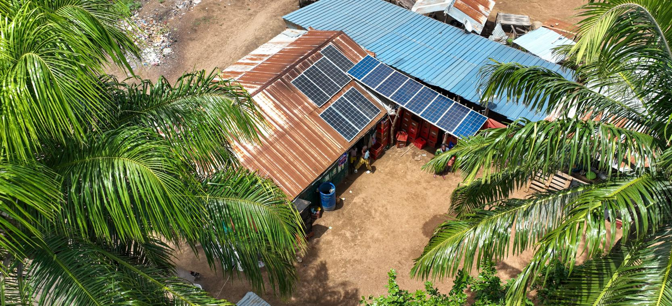
Bridging the Financing Gap –
What it really takes to get Clean Energy Projects Funded
Peter Storey, PFAN
APEC Workshop on RE Policies & Investments - Are we on the Right Track?
Bangkok, 31.03.26

Slide 2
Contents
Brief Introduction
Overview of the Project Development & Financing Cycle
What are the Challenges
An Eco-system Approach
  Buy-Side
  Sell- Side
  Enabling Environment
Lessons Learned & Recommendations
We'll examine how our three-pillar approach creates a cohesive, unified offering that addresses the "missing middle" in climate finance.

Slide 3
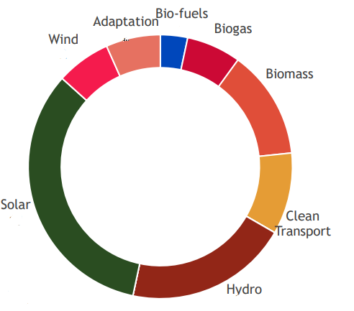





20 Years of Successful Project Preparation for
Clean Energy & Climate Projects & SMEs
Impact so far:
$
3,6
264
BN
Investment Leveraged
Projects Financed
1.847
5,2
MW
GT
Clean Capacity Added
Annual CO2 Emissions Mitigated
1.400+
Projects Supported
Notes:
For investors and fund managers: PFAN 3.0 builds on 17 years of sell-side success to bridge both sides of the climate finance market, integrating entrepreneurs, investors, and policy actors into a unified ecosystem that accelerates clean energy and climate adaptation investments.
For donors: PFAN 3.0 leverages 17 years of proven sell-side expertise to unite entrepreneurs, investors, and policymakers in a fully integrated climate finance ecosystem—mobilising capital, delivering measurable impact, and advancing national and donor climate goals.

Slide 4
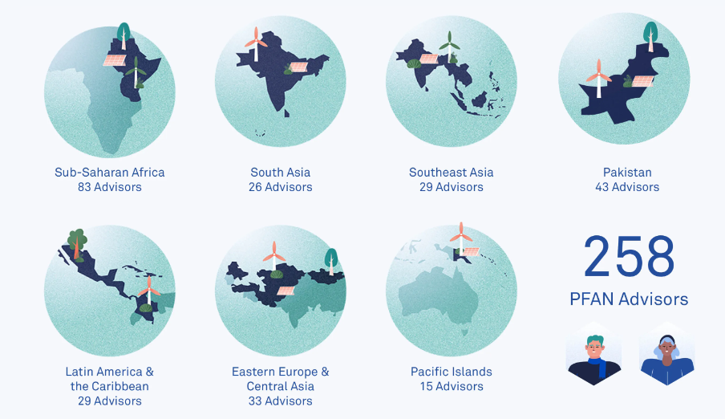
The Private Financing Advisory Network (PFAN)
PFAN is a global network of financing experts aiming to transform investment ecosystems through advisory services and transaction support to entrepreneurs developing clean energy and climate adaptation solutions.
Acting as a trusted intermediary, PFAN facilitates increased financing flows between investors and climate adaptation and clean energy businesses by:
  Creating investor-ready opportunities
  Building capacity in local financing ecosystems
  Accelerating project development and investment

Slide 5
PFAN’s Evolution: From Projects to Ecosystems
PFAN has evolved from facilitating individual transactions to building resilient climate investment ecosystems, integrating the buy and sell sides
PFAN 1.0
Seeding:
Proof of concept
IEA / CTI
PFAN 2.0
UNIDO and REEEP:
Mainstreaming
Industrialisation and scaling
USD 2 billion raised
USD 3,6 billion raised in total
Cottage industry
Early growth
Adaptation
USD 1 bn raised
PFAN 3.0
Transforming investment ecosystems
2008 - 2012
2013 - 2016
2017 - 2024
2025 +

Slide 6
The Project Development & Financing Cycle
Financing Gaps
High
Early Stage Support
Own Equity
Seed Capital
Angels
Friends & Family
Grants
Technical Assistance
Development
Financing
Results Based Financing (RBF)
Pre-Series A
Impact Funds
Blended Finance
DFIs
Venture Capital
Commercial
Funding
Blended Finance
DFIs
Impact Funds
Private Equity / VC
Series A & B
Commercial Banks
Risk
Capital Markets
Commercial Banks
Private Equity
Green Bonds
IPOs
Low
Technical Assistance
Funded
Commercially Contracted
Scaling &
Diversification
Concept
Proof of
Concept
Early
Growth
Maturity
Pilot

Slide 7


What are the Challenges?
The
“Missing Middle”
Limited Supply of
Investor-ready Projects
(S)Low Investment Levels
Oversupply of poorly structured projects
Lack of financial & commercial skills
1st time developers
High perceived risk levels
Lack of reliable data
Unrealistic expectations
Increasing sector & transaction differentiation
Large supplies of financing
Underdeveloped investment cultures and risk assessment
Low familiarity with technologies & business models
Low liquidity - limited number of exits
Lack of resources for investment preparation & post investment Technical Assistance
Need for transaction volume & scale
Ecosystem Inefficiencies
Regulatory gaps hinder innovative financing approaches
Unclear Sector Regulation
Lack of Coordination
Slow Decision Making
Incomplete / inefficient Value Chains
Conservative approach to technology & business model innovation

Slide 8






Integrated Eco-System Approaches
An integrated service delivery model creates a virtuous cycle where improvements in one area strengthen the entire ecosystem, maximizing impact and sustainability.
Sell-Side Support
to SMES
Origination
Deal Preparation
Transaction Mgmt
Investment Facilitation
Integration of Funding
Growth
Co-financing
Impact & ESG
Compliance & Governance
Gender
Buy-Side Support
to Investors & Facility Managers
Pre-Investment
Pipeline Preparation
Investment Preparation
Transaction Mgmt
DD & CPs
Post-Investment
Co-Finance
Growth Strategy
Compliance & Gov.
ESMS & Gender
Trouble Shooting
Ecosystem Integration
Deepening of Value Chains
Co-Creation of Financial Instruments to fill gaps
Sectoral Approaches
Regulatory Strengthening
Identification and solving of bottlenecks
Stakeholder co-ordination

Slide 9
Lessons Learned & Recommendations
Focus on Sectoral Approaches: Energy Access / Solar / Energy Efficiency / Bio-Energy / W2E (etc) in respect of Value Chain Approach and to generate efficiencies & respond to investor appetites
Need for integrated TA service delivery models deploying proven methodologies, but with high degree of flexibility for customization, delivering state of the art data, analysis, knowledge products & MRV and built on robust back offices and established systems
Emphasis on building the local investment eco-system, reducing donor and fly-in consultant dependency
Need for alignment with NDCs, donor programmes and cross-sector stakeholder engagement.
Local Task Forces and Communities of Practice to address market gaps: operational on-ground insight informs research, knowledge products & targeted capacity building as well as development of financial instruments to address critical market gaps
Challenges of developing & structuring blended finance instruments and platforms especially in respect of time to market
High leverage effect & transformational impact at ecosystem level

Slide 10
Thank you!
Peter Storey
Global Coordinator peter.storey@pfan.net www.pfan.net

Slide 11
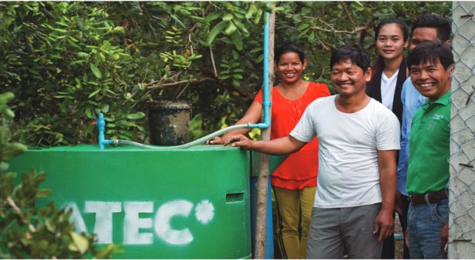
Success story – Asia
ATEC Biodigesters International
ATEC Biodigesters International, which reached financial close after winning the business plan competition at the 2017 PFAN Climate & Clean Energy Investment Forum in Vienna, has become the world’s leading producer of household biodigesters, providing renewable biogas for cooking and organic fertiliser to low-income households.
Technology:
Biogas
Location:
Cambodia
Investment amount:
US$ 700,000

Slide 12
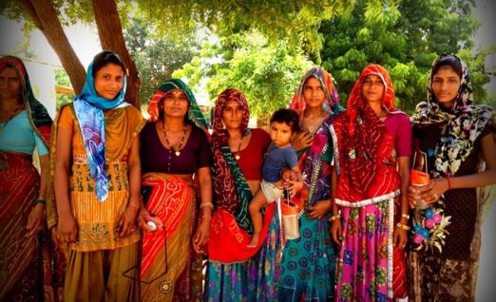
Success story – Asia
Frontier Markets Consulting Private Limited
Frontier Markets is a for profit social enterprise which targets the energy access challenge faced by rural household. Frontier Markets provides villagers in India with access, training, and servicing for clean-energy products.
They offer a distribution model, collaborating with local entrepreneurs and they are also focused on identifying women leaders and woman-focused NGOs.
Technology:
Solar
Location:
India
Investment amount:
US$ 340,000

Slide 13
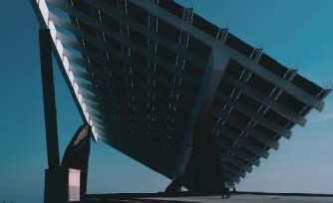
Success story – Asia
Rooftop Solar Plant Project
The Rooftop Solar Plant Project converted the rooftops of 27 Big C supermarkets, part of one of Thailand’s biggest retail chains, into solar plants. In June 2017, Sharp Solar Solution Asia was selected to build the systems. Discussions continue around the possible expansion of the project to Big C’s other 97 stores.
Technology:
Solar
Location:
Thailand
Investment amount:
US$ 12.5 million

Slide 14
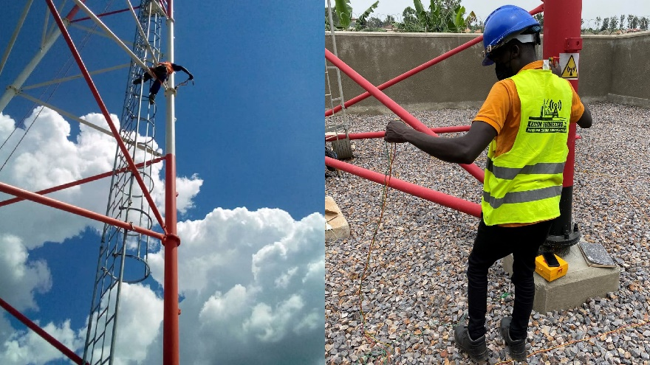
Success Story – East Africa
Ubuntu Towers
The most direct benefit to Ugandans provided by Ubuntu is employment. In addition to dozens of direct employees, the business indirectly employs over 2,000 people, providing them with secure and fair employment. Uganda is a primarily agricultural economy with 70% of people engaged in the sector, so enabling smoother communication and payment to empower farmers has a myriad of positive impacts.
Technology:
Solar
Location:
Uganda
Investment amount:
US$ 15,950,000

Slide 15
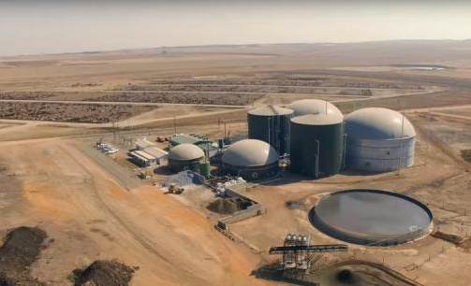
Success story – Southern Africa
Bronkhorstspruit Biogas Project (Pty) Ltd – Bio2Watt
BBP is the first commercial scale biogas project in South Africa. It is an independent commercial enterprise that will contribute to diversifying the South African energy mix away from coal. The plant came on stream in August 2015 and will generate 4.4 MW at full design capacity. The project will result in the creation of long-term direct and indirect employment in peri-urban South Africa, which currently experiences high levels of unemployment.
Technology:
Biogas
Location:
South Africa
Investment amount:
US$ 12.5 million

Slide 16
Typical Blended Finance Capital Stack
Senior Debt
DFIs
Climate Facilities Commercial Banks
Institutional Investors
Access to DFIs and Climate Facilities not only potentially helps bridge an equity / debt gap, but also helps attract other lenders
Hedge Funds
Multi-laterals
Subordinated / Junior Debt
Mezzanine
Currently most challenging category to raise for climate funds
DFIs
Family Offices
Institutional Investors
Pension Funds
Equity
First Loss helps mitigate risk for equity & debt investors, but can impose unrealistic conditions on fund manager esp if SFDR 8 or 9 is adopted
Donors
Multi-laterals
Impact Funds
Philanthropies
First Lost Guarantee
TA Facility

Slide 17
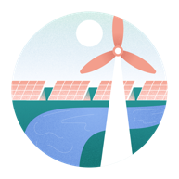


Expanded Target Sectors & Technologies
Clean Energy
Climate Adaptation
Circular Economy
Rural Electrification & Energy Access
  Energy Efficiency & Demand Reduction​
  Sustainable Transport ​
  Clean Cooking ​
  Renewable Energy & Storage
  Distributed Generation
  Agriculture & Agribusiness​
  Cooling ​
  Forestry / Carbon Credits​
  Water & Sanitation​
  Climate Resilient Infrastructure (incl. Tourism)
  Alternative Proteins
  Waste Treatment​
  Resource Efficiency
  Sustainable Materials (new materials, plastics, packaging) ​
  Recycling

Slide 18
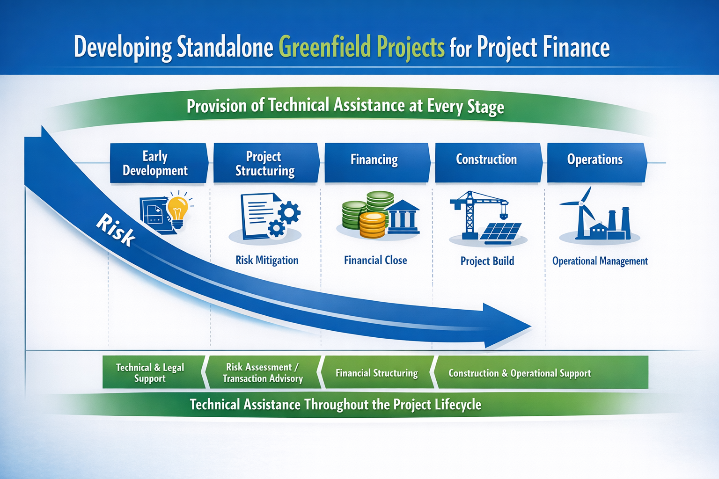
Raising Project Finance for an IPP

