Slide 1



Unlocking Wind and Solar Deployment –
A Diagnostic Tool to Overcome Renewable Energy Policy Barriers
Change the background picture:
Right-click on the picture
→ Send to Back
Now, the coloured layer has been moved to the background
Right-click on the photo in the foreground
→ Change picture
Choose picture
Right-click on your new photo
→ Crop
Scale your photo as you like it
When done: right-click on the photo
→ Send to Back
Done ☺
Last Name Name
10th September 2024
Bangkok, APEC Workshop - RE Policies and Investments: Are We on the Right Track?
Dimitri Pescia, Director Power System Transformation
31st March 2026

Slide 2


Think Tank and Policy Lab
~180 energy transition experts
Independent and non-partisan with diverse financing structure
Our vision: a prosperous and carbon-neutral global economy by 2050
Agora Energiewende is part of a family of think tanks that cover all GHG emitting sectors (energy, industry, agriculture, transport)
Science-based solutions and policy advice to deliver clean power, heat, industries, and agriculture – in Germany, Europe, and globally
Programs in ~20 economies, with offices in Berlin, Brussels, Beijing and Bangkok

Slide 3
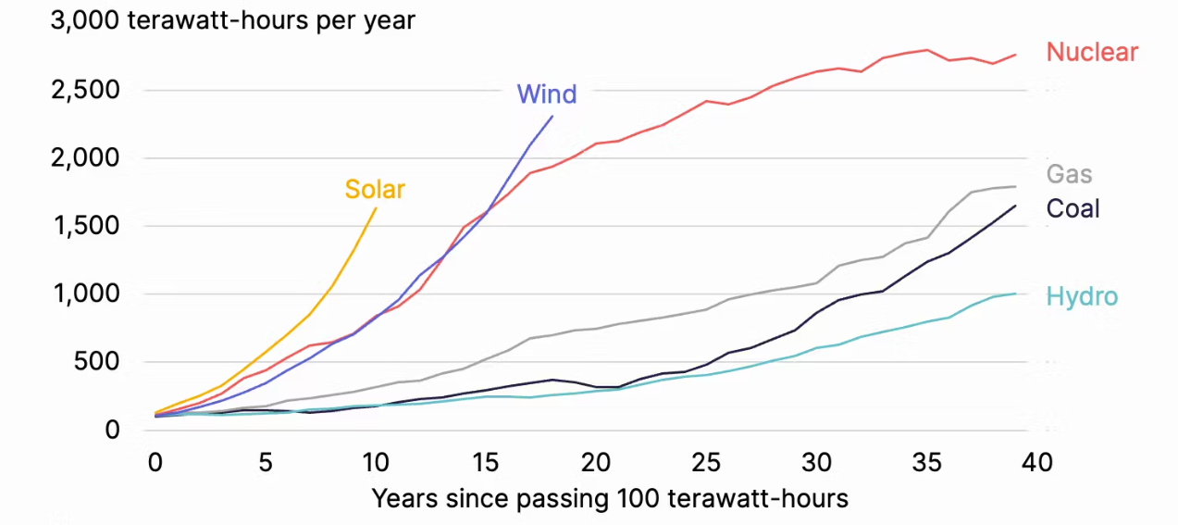
Wind and solar power are disruptive technologies, growing faster than any other generation source in history
Annual electricity generation from various power plant technologies after exceeding 100 TWh in a year

Slide 4
Wind and solar differ fundamentally from conventional generation, introducing distinct challenges for power system integration
5 characteristics of variable renewables, like solar and wind power, that challenge traditional power system operations & planning
1
2
3
4
5
Variability
Subject to Uncertainty
Non-synchronous
Location constrained
Capital intensive
Modular
Germany
g
g
OPEX
A
B
CAPEX
g
g
Time-based effects
Location-based effects
Risk profile

Slide 5
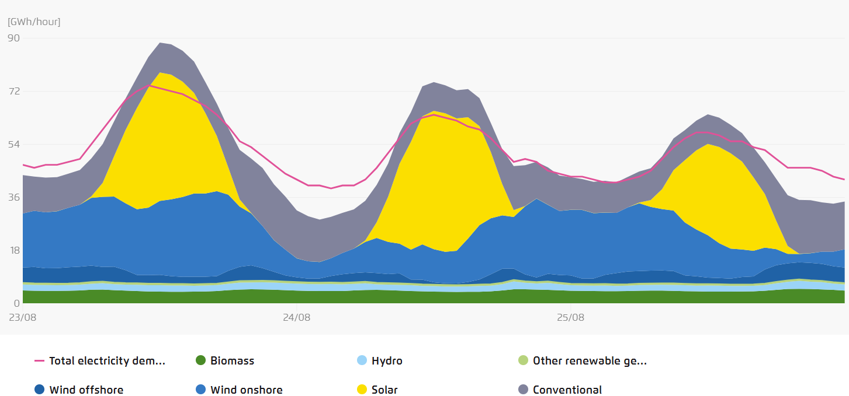
Flexibility is the new paradigm of power systems. Baseload operation is an obsolete concept, as power plants provide most of the flexibility needs.
Power generation and demand in Germany (August 2024)
Power generation from nuclear, hard coal and lignite power plants (5 days in March 2018)
RES: 108% of demand,
Solar and wind: 81% of generation

Slide 6
Despite record cost declines, solar and wind deployment isn’t on track to meet net zero targets, making stronger policy frameworks vital to unlock potential
Share of wind and solar power (%) in total power production in various economies
Shift in deployment barriers
Subsidies and financial incentives are no longer primary barriers
Streamlined permitting and transparent procurement can lower risks and improve the bankability of solar and wind energy projects
Grid modernization and system flexibility mechanisms are vital to absorb RE generation
Fossil-fuel phase out and just transition policies as well as clear targets can indirectly impact solar and wind deployment

Slide 7

Agora’s Renewable Energy Policy Framework provides a qualitative assessment of key barriers and opportunities for solar and wind energy deployment
  Applied to eight Asian economies: Viet Nam; Japan; The Republic of the Philippines; Malaysia; Pakistan; The Republic of Korea; Thailand; and Indonesia
  Each assessment has been validated by local think-tanks and experts
  The Renewable Energy Policy Framework (REPF) has eight direct and indirect focus areas, twenty-four indicators and over seventy sub-indicators affecting solar and wind deployment
  It will be presented in a publicly available platform with regular updates to reflect policy changes
Indirect focus areas
Direct
focus areas
Grids
Fossil fuel
phase-out
Planning and
permitting
Power system flexibility for RE
Risk mitigation and procurement incentives
Just
transition
Targets

Slide 8
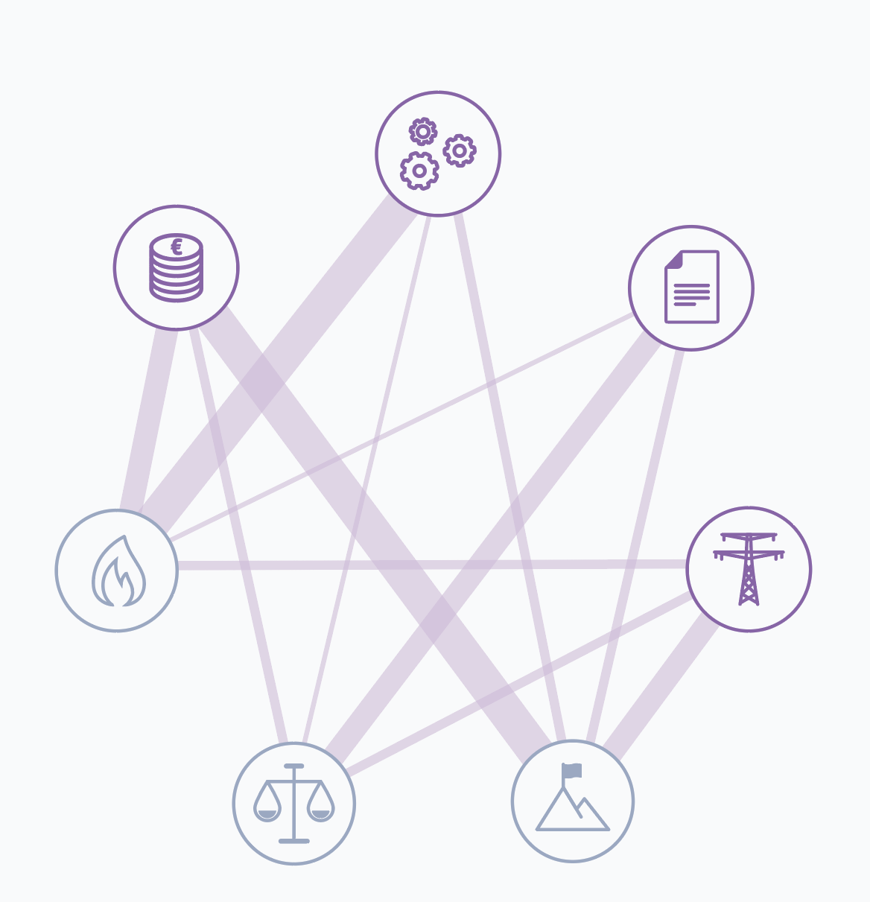
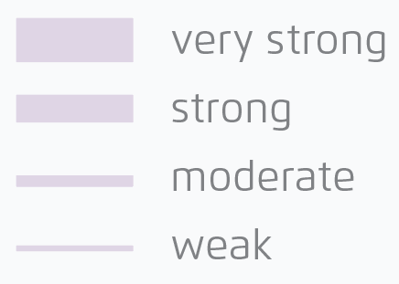
Interactions between different focus areas reflect the complexity of the solar and wind policy landscape, with a need for prioritisation and managing trade-offs
Power system flexibility for RE
Dispatch regulation
RE forecasting
Regulatory measures for flexibility and system integration
Market based incentives for flexibility and system integration
Risk mitigation and procurement incentives
PPA design and risk mitigation
Incentive for Large scale RE
Incentive for DG/rooftop solar
Other fiscal incentives
Carbon pricing
Planning and permitting
Spatial planning for RE
Permitting and environmental (and social) impact assessment
Fossil fuel phase-out
Grids
Phase out strategies for fossil fuels
Grid development plan
Grid access and usage
Grid connection procedures
Smart grids for RE integration
Just transition
Relationship
Siting and consultation
Special incentives for community owned projects
Co-benefits
Re-skilling and up-skilling
Regional transition plans
Targets
Net zero commitment
Targets for RE
Monitoring and governance

Slide 9
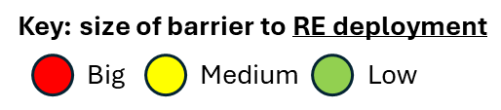
Policy assessment (REPF*) for the Republic of the Philippines
N/A
1. Risk Mitigation and Procurement Incentives |  | 2. Planning and Permitting |  | 3. Power system flexibility for RE integration |  | 4. Grids |  | A. Fossil Fuel Phase Out |  | B. Targets |  | C. Just Transition
1.1. PPA design and risk mitigation |  | 2.1: Spatial Planning for RE |  | 3.1: Dispatch regulation |  | 4.1: Grid development plan |  | A1: Phase out strategies for fossil fuels |  | B1: Net zero commitment |  | C1: Siting and consultation
1.2: Incentive for large scale RE |  | 2.2: Permitting and ESIAs |  | 3.2: RE forecasting |  | 4.2: Grid access and usage |  |  |  | B2: Targets for RE |  | C2: Special incentives for community owned projects
1.3: Incentive for DG/rooftop solar |  |  |  | 3.3: Regulatory measures for flexibility and system integration |  | 4.3: Grid connection procedures |  |  |  | B3: Monitoring and governance |  | C3: Co-Benefits
1.4: Other fiscal incentives |  |  |  | 3.4: Market based incentives for flexibility and system integration |  | 4.4: Smart grids for RE integration |  |  |  |  |  | C4: Re-Skilling and Up-Skilling
1.5: Carbon pricing |  |  |  |  |  |  |  |  |  |  |  | C5: Regional transition plans
Take-aways
Large solar and wind projects face permitting delays with a need for transmission network development to keep pace with RE expansion
Coal power contracting structures must build in flexibility: Power Supply Agreement clauses (minimum offtake and capacity payments) incentivize baseload plants and undermine RE integration
Procurement reform is the key lever for change: Revising existing PSAs and procurement practices is essential to unlock a more flexible and RE-compatible power system in the Philippines
*REPF – Renewable Energy Policy Framework
Notes:
Barrier changes from update: 3.1: Dispatch regulation (Medium -> Low)

Slide 10
Policy assessment (REPF*) for the Republic of Korea
N/A
1. Risk Mitigation and Procurement Incentives |  | 2. Planning and Permitting |  | 3. Power system flexibility for RE integration |  | 4. Grids |  | A. Fossil Fuel Phase Out |  | B. Targets |  | C. Just Transition
1.1. PPA design and risk mitigation | s | 2.1: Spatial Planning for RE |  | 3.1: Dispatch regulation |  | 4.1: Grid development plan |  | A1: Phase out strategies for fossil fuels |  | B1: Net zero commitment |  | C1: Siting and consultation
1.2: Incentive for large scale RE |  | 2.2: Permitting |  | 3.2: RE forecasting |  | 4.2: Grid access and usage |  |  |  | B2: Targets for RE |  | C2: Special incentives for community owned projects
1.3: incentive for DG/rooftop solar |  |  |  | 3.3: Regulatory measures for flexibility and system integration |  | 4.3: Grid connection procedures |  |  |  | B3: Monitoring and governance |  | C3: Co-Benefits
1.4: Other fiscal incentives |  |  |  | 3.4: Market based incentives for flexibility and system integration |  | 4.4: Smart grids for RE integration |  |  |  |  |  | C4: Re-Skilling and Up-Skilling
1.5: Carbon pricing |  |  |  |  |  |  |  |  |  |  |  | C5: Regional transition plans
Take-aways
Insufficient RPS quotas for utilities: Mandatory RE targets (15% by 2026) can be more ambitious to drive deployment
Transmission infrastructure expansion needs to align with generation growth, causing significant RE curtailment
Spatial planning: RE siting must be systematically integrated into municipal land-use plans, thereby reducing community opposition to RE projects
The new administration has signalled a commitment towards the energy transition and is developing several measures to address these barriers
*REPF – Renewable Energy Policy Framework
Notes:
Barrier changes from update: A1: Phase out strategies for fossil fuels (High->Low)
B1 & B2 : (High->Medium)

Slide 11
Policy assessment (REPF*) for Japan
N/A
1. Risk Mitigation and Procurement Incentives |  | 2. Planning and Permitting |  | 3. Power system flexibility for RE integration |  | 4. Grids |  | A. Fossil Fuel Phase Out |  | B. Targets |  | C. Just Transition
1.1. PPA design and risk mitigation |  | 2.1: Spatial Planning for RE |  | 3.1: Dispatch regulation |  | 4.1: Grid development plan |  | A1: Phase out strategies for fossil fuels |  | B1: Net zero commitment |  | C1: Siting and consultation
1.2: Incentive for large scale RE |  | 2.2: Permitting and ESIAs |  | 3.2: RE forecasting |  | 4.2: Grid access and usage |  |  |  | B2: Targets for RE |  | C2: Special incentives for community owned projects
1.3: Incentive for DG/rooftop solar |  |  |  | 3.3: Regulatory measures for flexibility and system integration |  | 4.3: Grid connection procedures |  |  |  | B3: Monitoring and governance |  | C3: Co-Benefits
1.4: Other fiscal incentives |  |  |  | 3.4: Market based incentives for flexibility and system integration |  | 4.4: Smart grids for RE integration |  |  |  |  |  | C4: Re-Skilling and Up-Skilling
1.5: Carbon pricing |  |  |  |  |  |  |  |  |  |  |  | C5: Regional transition plans
Take-aways
The lack of economic dispatch and available grid capacity leads to high curtailment rates and reduces the bankability of RE projects
Land acquisition and permitting bottlenecks drive up costs and timelines. Solar and wind prioritisation in national spatial planning and one-stop-shop permitting agencies could unlock significant cost reductions
The 40–50% renewable electricity goal by 2040 could be more ambitious to leverage cost reductions in RE and battery storage
The net-zero strategy overemphasizes the role of hydrogen, and underestimates the potential of direct electrification

Slide 12
Key Takeaways
1
The global energy transition is accelerating, driven increasingly by economic and security imperatives rather than climate goals.
As wind and solar reshape power systems worldwide, flexibility has overtaken baseload as the guiding principle for planning, investment, deployment and operation.
To navigate this transformation effectively, a holistic policy framework is essential—one that designs supportive measures, prioritizes interventions, and manages inevitable trade-offs.
2
3

Slide 13
Discussion Questions
What are the most important priority barriers in your economies? (e.g. risk mitigation and procurement incentives, planning and permitting, grid capacity and modernization, power system flexibility for renewable energy integration…)
Which lessons can be shared from your economy’s experience on how these barriers have been alleviated?
Do you have specific requests regarding the design of our Policy Assessment Framework to ensure effectiveness and usefulness?
1
2
3

Slide 14
Thank You!
Change the background picture:
Right-click on the picture
→ Send to Back
Now, the coloured layer has been moved to the background
Right-click on the photo in the foreground
→ Change picture
Choose picture
Right-click on your new photo
→ Crop
Scale your photo as you like it
When done: right-click on the photo
→ Send to Back
Done ☺
Last Name Name
For any questions, please contact: Dimitri.pescia@agora-energiewende.de
10th September 2024
31st March 2026

