Slide 1

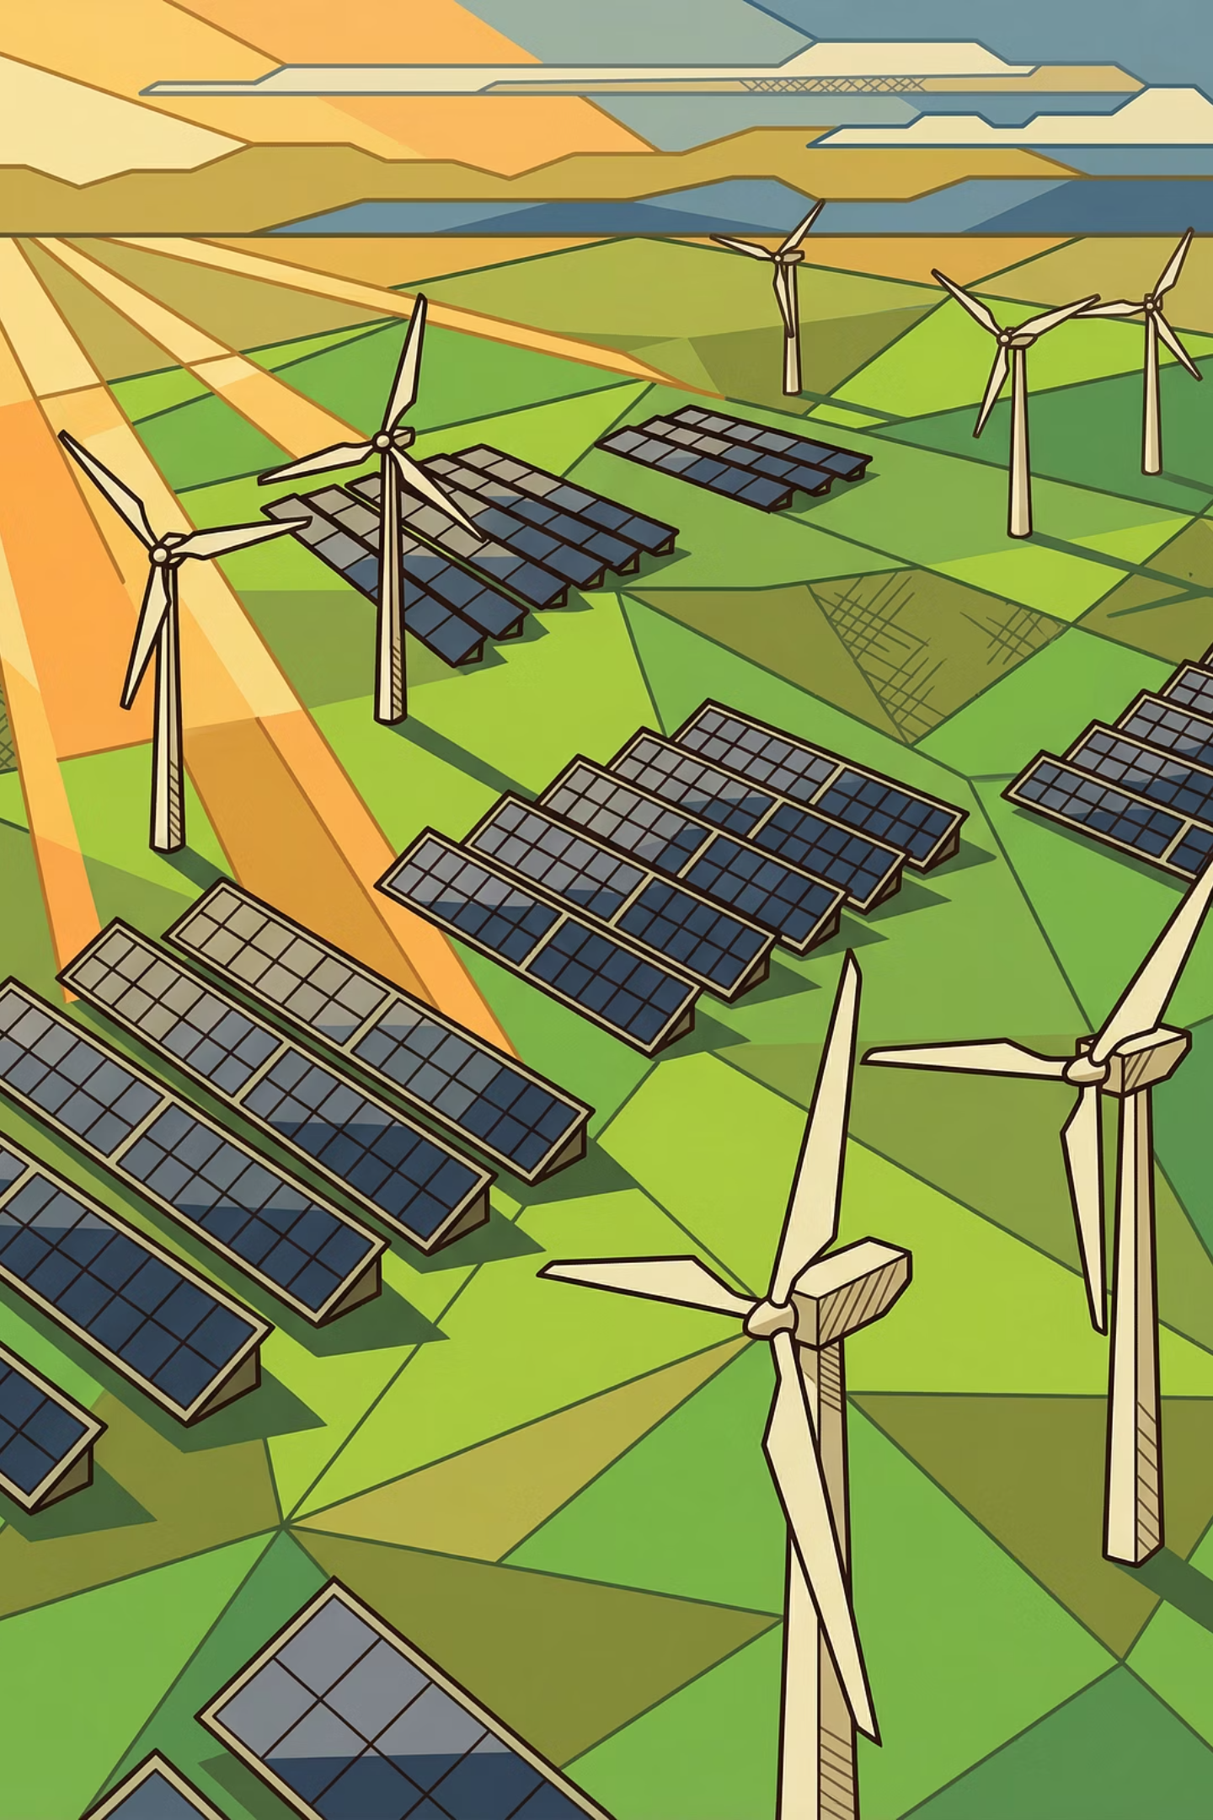

From Policy to Investment
Bridging the Gap in Renewable Energy Scale Up
APEC Workshop - RE Policies and Investments:
Are We on the Right Track?
Bangkok, Thailand
31 March 2026
Dr. Ananth Chikkatur
Co-Founder & CEO
Ananth@xanhterra.com; +84-855-15-2463

Slide 2
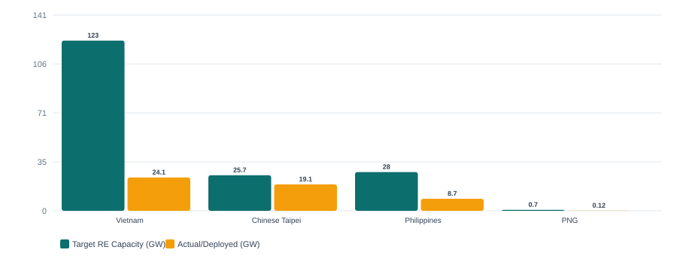
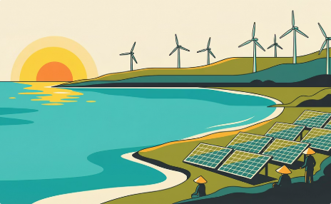
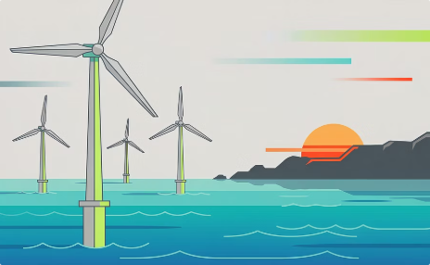
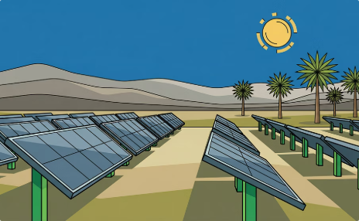
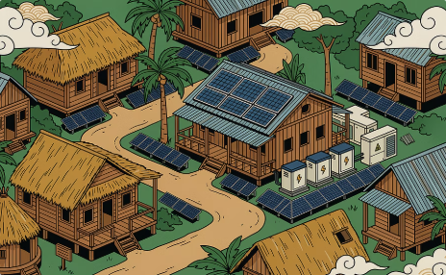

Implementation Gap for Renewable Energy
Viet Nam
26.8% RE share
Target: 28–36% by 2030
Chinese Taipei
~11 GW gap
Projected shortfall by 2030
The Philippines
22% RE gen.
Target: 35% by 2030
PNG
<20% electrified
Target: 70% by 2030
Viet Nam
Chinese Taipei
The Philippines
Papua New Guinea
Targets: 183–236 GW by 2030. Today’s capacity ~90 GW Onshore wind reached only 19% of its original plan by end-2024.
Solar 15.5 GW vs. 20 GW target; offshore wind at 3.6 GW vs. 5.7 GW. Estimated 11 GW cumulative gap projected by 2030.
35% RE target by 2030; currently at ~22% of generation. Coal still dominates at ~60%. 794 MW added in 2024 — but insufficient.
<20% electrification; 900 MW total capacity; diesel-dominated. 70% electrification and 78% RE by 2030 requires major transformation.
The Gap is not a failure of Ambition or Policy Targets — it requires greater focus on Design & Bankability features
2
Sources: PDP-8 Rev. (2025), MOEAC (2025), DOE Philippines (2025), PNG NEROP

Slide 3





Five Structural Barriers
What separates policy announcements from bankable projects
1
Pricing & Revenue Certainty
Post-FiT vacuum leaves no long-term price signals for project finance
2
Grid Access & Off-take Risk
Transmission lags generation; curtailment undermines financial viability
3
Bankability of PPAs
Model PPAs lack lender protections: limited or no output guarantees, unclear termination compensation, limited assignment rights
4
Land, Permitting & Planning
Overlapping regulations and slow environmental assessments delay projects for years
5
Institutional & Utility Readiness
Utility financial health, market operator capacity and investor selection frameworks affect confidence
These barriers are shared across APEC economies — differing in intensity, but similar in structure.
3

Slide 4

Viet Nam: From FiT Boom to Market-Based Procurement
A practical case study in bridging the gap — including both missteps and hard-won innovations.
Phase 1 — FiT Boom (2017–2021)
1
~17 GW of solar and wind rapidly built out.
Result: grid overload, curtailment, EVN financial strain.
Volume without sufficient grid build out created systemic risk.
2
Phase 2 — Policy Vacuum (2021–2024)
Near-total halt as FiT was withdrawn before a replacement was ready. Transitional projects forced to have lower tariffs.
A three-year gap destroys investor confidence.
Phase 3 — Market Reform (2024–2026)
3
Electricity Law 2024; Decrees 57 & 58/2025; Revised PDP-8; Resolution 70 on energy security; National Assembly Resolution 253 Innovation and incentives for 2026–2030 acceleration.
Key Innovations in Phase 3 (2024–2026)
DPPA dual pathway
Time-limited Special Mechanisms
Physical (private wire) + Financial (virtual via wholesale market) via a Contract for Differences (CfD) mechanism
Accelerated permitting, land allocation, and investment incentives specifically for 2026–2030 energy projects
Minimum contracted output (Qc)
EVN role evolution
70% for new energy, 80% for offshore wind during loan repayment
Transitioning from sole buyer to market enabler
Market-based mechanisms work — but only when designed with bankability as the central requirement.
4

Slide 5
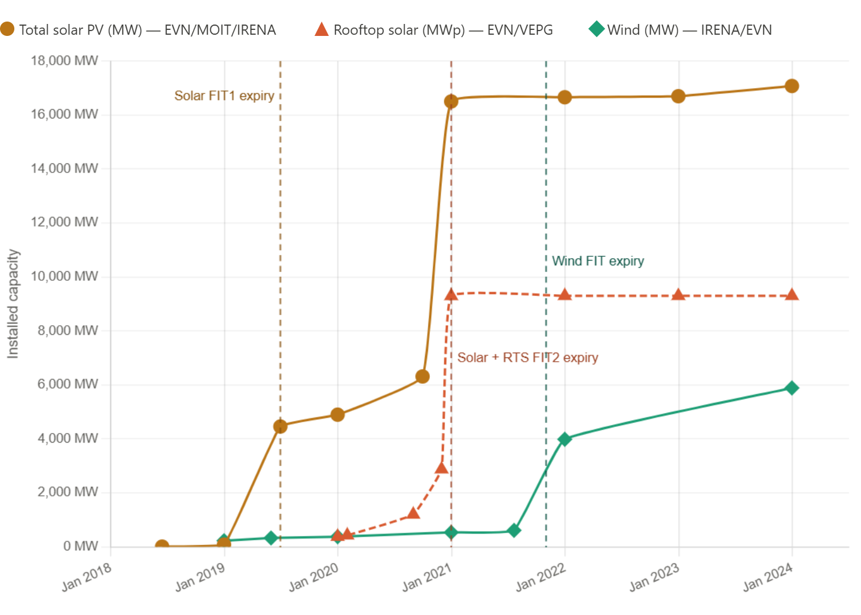
FiT-Driven RE Capacity in Viet Nam
5

Slide 6

Viet Nam’s Direct Power Purchase Agreement (DPPA)
DPPA between RE GENCO and Large Electricity Consumers
Physical PPAs
Financial Virtual PPAs (Private Contract)
Via Private Wire
Via National Power Grid & Viet Nam Wholesale Electricity Market (VWEM)
Physical DPPA (Private Wire)
Generator and factory connected by a dedicated private wire
Similar to rooftop solar — limited scalability
Requires physical infrastructure build-out
Restricted geographic proximity
Virtual DPPA (via Grid)
Settlement through the wholesale electricity market
No change to physical electricity supply or infrastructure
Scalable: access large RE projects (10+ MW) anywhere on the grid
Primary pathway for 100% RE targets
Virtual DPPA uses the existing grid, requires no infrastructure changes, and is the commercially viable path for large-scale RE procurement. Whereas Physical DPPA is constrained by geography and scale — similar to rooftop solar.
6

Slide 7
Three Principles for Bridging the Gap
1
Design for Bankability, Not Only Ambition
Every policy, PPA, pricing mechanism must answer: Can a developer secure project finance on this basis? Minimum purchase commitments, lender protections, clear dispute resolution are the foundations of a deployable policy.
2
Match the Mechanism to the Market Stage
Early-stage (PNG): standardized contracts, hybrid mini-grids, concessional finance.
Scaling (The Philippines, Viet Nam): competitive auctions, DPPA, grid investment.
Advanced (Chinese Taipei): system flexibility, offshore wind discipline, demand-side markets.
3
Create Demand-Side Pull, Not Only Supply-Side Push
Most effective RE scaling occurs when corporates actively seek RE for competitiveness.
Two-part tariffs, DPPAs, and industrial park aggregation transform RE procurement from obligation into business decisions.
7

Slide 8


Implications for Papua New Guinea
<20% electrification | ~900 MW total | Diesel-dependent | 70% electrification target by 2030
Standardized Procurement
Develop simple mini-PPA templates for solar-diesel-battery hybrid mini-grids with transparent tariff structures. Avoid premature market complexity.
Solar + Storage Hybrids
Prioritize provincial centers where diesel costs are highest. World Bank NEAT Project ($204M, Nov 2024) anchors this approach.
Institutional Sequencing
Build PNG Power Limited capacity before introducing competitive procurement. ADB-funded Power Sector Master Plan is an essential prerequisite.
Leverage Mining Sector
Develop mechanisms for captive generators in mining companies (~300 MW already exist) to provide power to the grid as grid-connected IPPs. For example, PPAs could provide credible risk allocation and payment certainty.
8

Slide 9


Implications for The Philippines
35% RE target by 2030 | 22% RE gen. (mid-2025) | 100% foreign ownership | 178 GW offshore wind potential
Scale Corporate RE Procurement
Simplify RCOA compliance, improve price transparency, and enable industrial park aggregation for manufacturing, BPO centers, and data centers.
Accelerate Grid Infrastructure
Continue with grid expansion to support RE and third-party grid concessions to attract private capital. Only 29% of planned transmission completed by 2024
Structured Offshore Wind Approach
Incorporate lessons from Chinese Taipei & Viet Nam into the GEA-5: clear contracts, realistic timelines, investor-friendly terms. GEA-5 targets 3,300 MW.
Tariff Reform as Market Signal
Consider two-part retail tariffs (similar to Viet Nam) to make rooftop solar and BESS more compelling for industrial consumers without additional subsidies.
9

Slide 10

Implications for Chinese Taipei
"532" energy mix | 15.5 GW solar vs 20 GW target | 3.6 GW wind vs 5.7 GW target | ~11 GW gap by 2030
Diversify Solar Pathways
Develop policies to encourage C&I rooftop via third-party leasing that can scale fast. New rooftop mandate (+660 MW/yr) is a good start. Ground-mounted solar has achieved ~50% of its 12 GW target.
Recalibrate Offshore Wind + Local Content
Balance industrial policy with market openness in order to achieve the Phase III targets 15 GW (2026–2035); e.g., Viet Nam's Decree 58 allows up to 95% foreign ownership for offshore wind while maintaining security review mechanisms.
Build Corporate RE Procurement
Amend the Electricity Business Act to enable direct RE sales to consumers. Viet Nam & The Philippines show how corporate demand for RE can accelerate deployment faster than auctions alone.
Grid Flexibility & Energy Storage
Implement regulations to support system integration, particularly when RE penetration is at 20%+. Viet Nam’s PDP-8 targets 10–16 GW BESS by 2030 and has developed several mechanism to incentivize BESS.
10

Slide 11

Closing Reflection … Discussion
The gap between renewable energy policy and deployment is, at its core, a gap in implementation design and bankability.
PNG:
Basic electrification & institutional capacity
The Philippines:
Execution speed & grid modernization
Chinese Taipei:
Land constraints & social acceptance
Viet Nam:
Post-FiT market reconstruction
Common solutions: Credible pricing • Bankable contracts • Grid readiness • Demand-side engagement
Discussion: How can APEC build structured peer-learning — not only at the policy level, but among developers, financiers, and grid operators — to accelerate implementation knowledge transfer?
11

Slide 12
Contact
Strategic Intelligence for the Energy Transition era
www.xanhterra.com
Dr. Ananth Chikkatur
Co-Founder & CEO
Ananth@xanhterra.com
+84-855152463 (WhatsApp / Zalo)

