Slide 1

Scaling New and Renewable Energy Deployment
APEC Workshop - RE Policies and Investments: Are We on the Right Track?
31 March 2026 | Bangkok
Jennifer E. Leisch, Ph.D. | Jennifer.Leisch@FoundationNLR.org
Foundation for the National Laboratory of the Rockies

Slide 2
Approaches to Scale
Corporate Power Purchase Agreements
Renewable Energy Zone Transmission Planning
Industrial Parks and Distributed Energy
Auctions and Competitive Procurement
Renewable energy scale is no longer a technology challenge
The constraint is how projects are structured, financed, and delivered
This can greatly depend on policy and regulatory design
There is no one-size fits all approach - different markets require different models
Several approaches to scale can complement or be used in one market

Slide 3
Corporate PPAs: Demand-Driven Deployment
A contract where a developer sells electricity (and its attributes) to a C&I buyer (corporate), structured as either physical or virtual based on the buyer’s location, goals, and risk tolerance.
⚙️ Why Corporate PPAs Work
Bankability - Long-term contracts enable project financing
Key Considerations:
Structure & market — physical vs. virtual PPA, driven by location and regulatory context
Price & risk — fixed pricing vs exposure to market volatility, including basis and negative pricing risk
Volume & reliability — intermittency, load matching, and need for storage or firming solutions
Contract terms — tenor, credit requirements, and key provisions (curtailment, flexibility)
Strategic fit — alignment with decarbonization goals, financial objectives, and risk tolerance
Virtual PPA
Notes:
Corporate demand is becoming a primary driver of new capacity. “Corporate PPAs have evolved from a niche procurement tool into a primary driver of renewable deployment—now shaping how energy systems are built, financed, and optimized, particularly in response to data center and AI-driven load growth.”

Slide 4
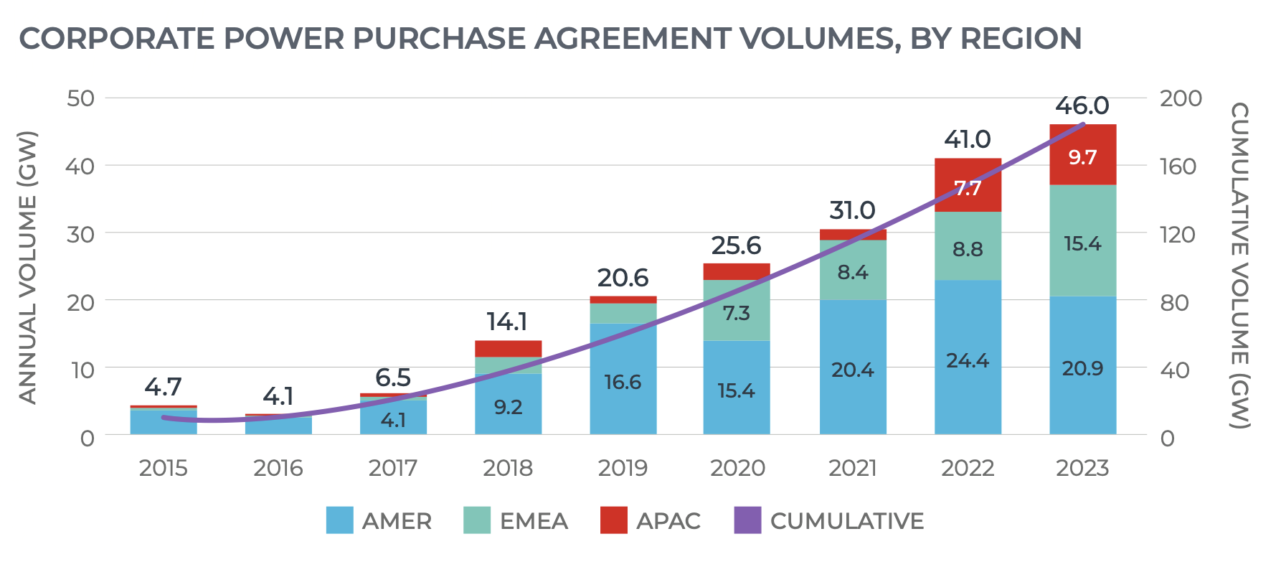
Case Study: Corporate PPA Market Trends
~300+ GW total contracted corporate PPA capacity globally
Source: Bloomberg NEF
Market Evolution from standalone solar or wind; Annual energy matching
To: Hybrid portfolios (solar + wind + storage); 24/7 hourly matching (time + location specific)
Emerging Challenges
Price volatility & negative pricing risk
Interconnection delays
Increasing contract complexity
Need for firming (storage, dispatchable supply)
Wheeling Charges
Accounting and 24/7
Market Reality (2024–2026)
2025 Slowdown
Corporate PPAs ~25% of global wind & solar additions (ex-China)
Multi-GW annual procurement led by hyperscalers
Market size projected to ~2x by 2030
Increasing demand for 24/7 carbon-free energy (CFE)

Slide 5
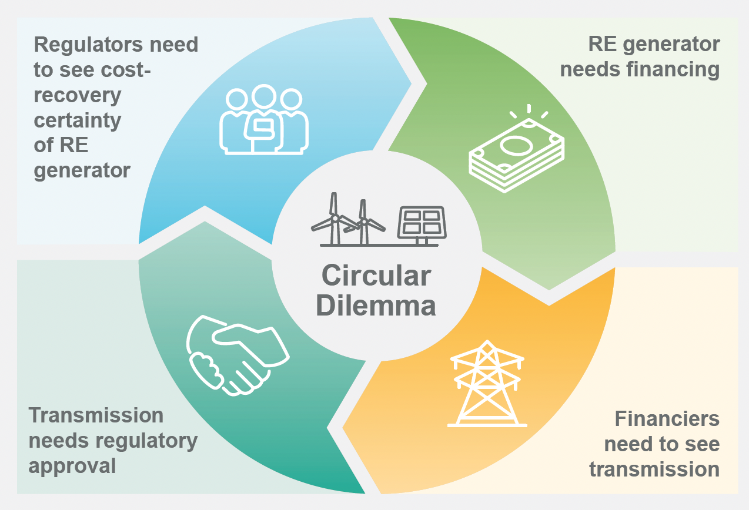
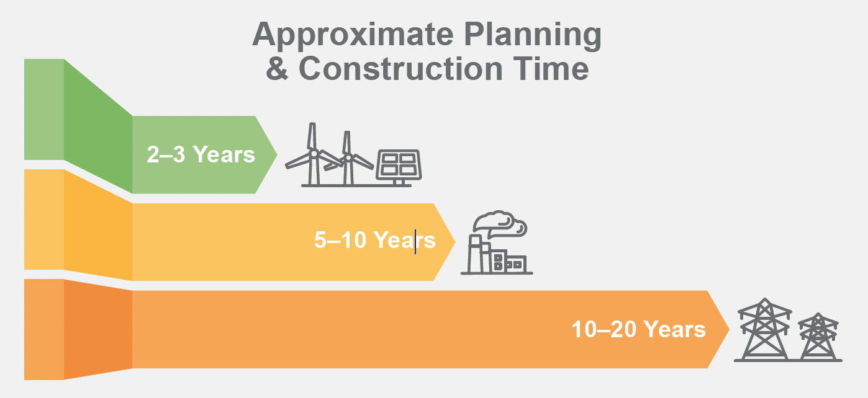
Renewable Energy Zones: Infrastructure-Led Scale
Renewable Energy Zones (REZ):
Infrastructure-led Scale
Proactive transmission planning for large scale RE development
Identify high-resource zones
Build transmission + permitting readiness in advance
Coordinate multiple projects in a single region
Reduces development risk and speeds deployment
Addresses the mismatch between construction time and transmission planning
Source: Ready for Renewables: Grid Planning and Competitive Renewable Energy Zones (CREZ) in the Philippines, NREL/TP-7A40-76235 • September 2020
Notes:
A CREZ is a geographic area with high concentrations of cost-effective RE and strong developer interest. CREZ data informs the selection of new and enhanced transmission lines, encouraging new development toward the best RE resource areas. While there is no requirement to site new RE projects in a CREZ, access to transmission is an advantage. A CREZ itself does not have specific borders. Instead, it is defined by proximity to transmission.
The CREZ process is a proactive transmission planning approach that supports investment in transmission expansion and/ or upgrades for large-scale RE development. Undertaking the CREZ process can increase the share of all RE while maintaining system reliability and economics. It also leverages economies-of-scale development for wind and solar while creating new opportunities for other types of RE due to increased transmission access.

Slide 6
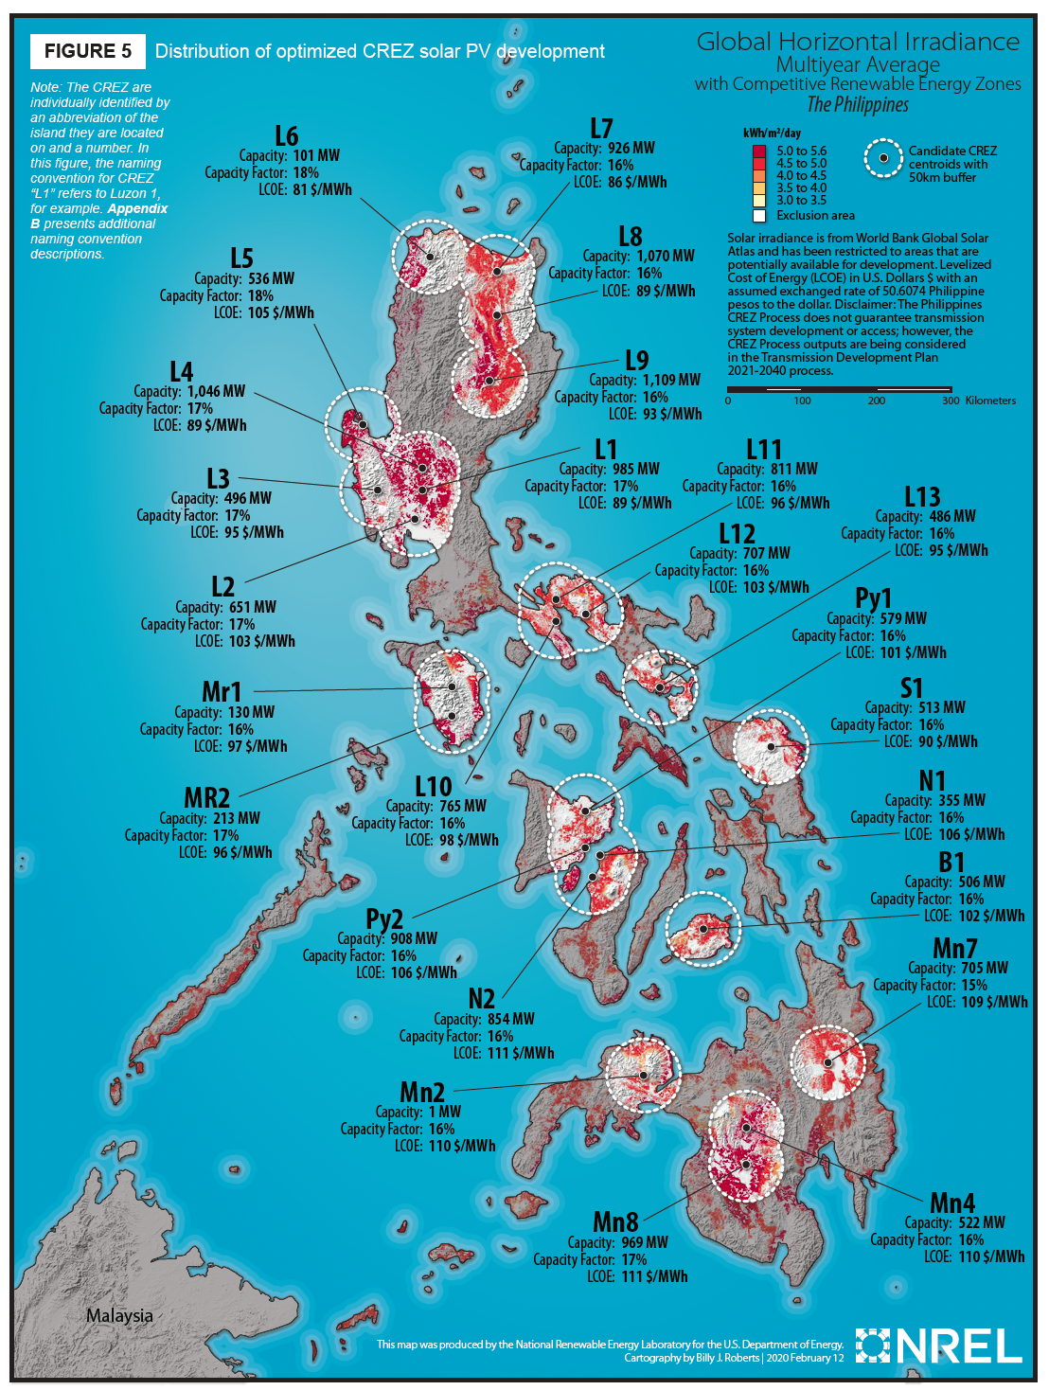
Case Study:
Philippines Competitive RE Zones (CREZ)
Archipelagic system → complex grid constraints
Identified 25 zones with > 150GW Wind and Solar potential
Integrating these into the National Transmission Development Plan, and identifying upgrades and construction needed to support further development
CREZ is an enabler of policies like the RE Targets and Green Energy Auction Program
Coordinated planning reduces bottlenecks and project risk, supports economies of scale

Slide 7
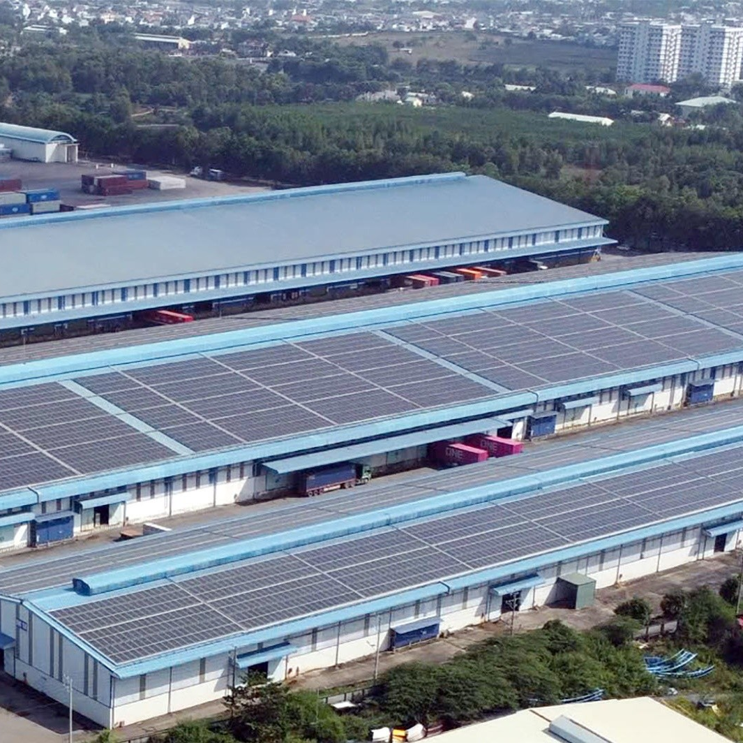
Industrial Parks: Distributed Energy Aggregation
Concentrated industrial demand enables aggregated energy solutions
On-site or near-site solar, storage, and microgrids
Delivered via energy-as-a-service models or owned by the IP directly
Reduces grid dependence and accelerates deployment
Demand aggregation, partnerships is the key to scaling distributed energy
Amata Bien Hoa Industrial Park
https://vietnamenergy.vn/rooftop-solar-and-energy-storage-development-in-industrial-parks-field-insights-from-dong-nai-and-bac-ninh-35553.html

Slide 8
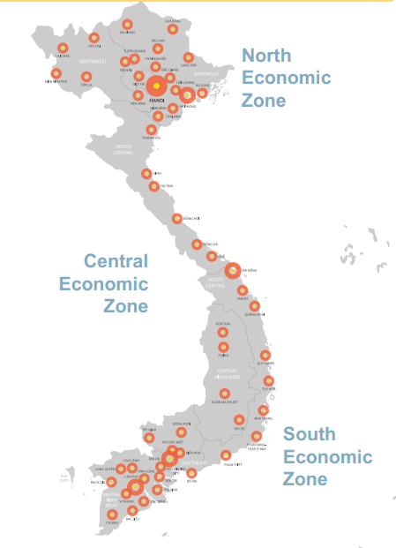
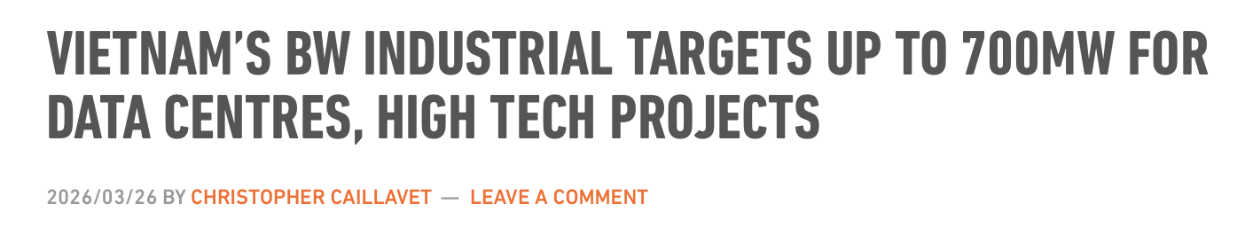
Case Study:
Viet Nam’s Industrial Parks
Industrial clusters turn fragmented demand into bankable scale
Rapid expansion of export-oriented industrial parks
Developers targeting entire parks, not individual tenants
Rooftop solar + shared infrastructure models
Driven by multinational supply chain requirements
Challenges:
Construction Standards
Roof Ownership
Regulatory Framework
Viet Nam
40,000 companies
> 400 industrial zones
Rooftop solar potential of 12–20 GWp
Source: Savills https://industrial.savills.com.vn/2023/08/vietnam-industrial-zone/

Slide 9

Auctions: Scaling Through Competitive Procurement
Governments or utilities procure renewable capacity via competitive tenders
Auctions have overtaken as the dominant global mechanism for large scale renewables deployment (ex-China)
Auctions drive price discovery and cost reduction
Winning bidders receive long-term contracts (typically 15–25 years); Enables project finance
Trends:
Scale: Multi-GW auctions becoming standard
Technology mix: Moving beyond solar/wind → storage, hybrid
Design evolution: More contract-for-difference (CfD), hybrid auctions, and capacity-based mechanisms, other objectives
Context Matters: There is no one-size-fits-all auction design
Notes:
Challenges:
Balancing objectives (not just price)
Risk Allocation (offtaker, currency)
Interconnection Readiness
Bidder Qualification

Slide 10
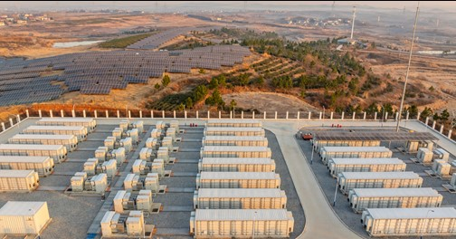
Case Study:
Australia Capacity Investment Scheme
Capacity Investment Scheme
Federal government-led competitive auction program
Targets wind, solar, and long-duration storage
Uses two-sided Contracts for Difference (CfD)
  Revenue floor → downside protection
  Revenue cap → shared upside
Why It Works
Government-backed revenue floor lowers financing risk
Co-optimizes generation + storage, not just cheapest MWh
Multi-GW procurements aligned with coal retirements
Key Innovation
➡️ Shift from “lowest price wins” → “system value wins”
Balances price, reliability, and timing
Mimics real grid needs vs theoretical LCOE competition
📊 Recent Results (2024–2025)
~6 GW awarded (first national tender)
  ~4 GW wind + solar
  ~2 GW storage
19 projects selected
Additional multi-GW state rounds (NSW, Victoria)
Total: 10+ GW contracted or in procurement

Slide 11
Key Takeaways
There is no one size fits all approach → the market matters
Corporate PPAs → create demand, provide bankability
Auctions → structure supply, provide cost discovery
RE Zones → address the chicken-or-egg infrastructure dilemma
Industrial parks → aggregate distributed demand to create scale
Corporate Power Purchase Agreements
Renewable Energy Zone Transmission Planning
Industrial Parks and Distributed Energy
Auctions and Competitive Procurement

Slide 12
Thank You
APEC Workshop - RE Policies and Investments: Are We on the Right Track?
31 March 2026 | Bangkok
Jennifer E. Leisch, Ph.D. | Jennifer.Leisch@FoundationNLR.org
Foundation for the National Laboratory of the Rockies

