Slide 1
APEC Capacity Building Workshop for New and Renewable Energy Policy – Setting the scene
31 March 2026 , Bangkok, Thailand
Daniel BURLUTSKY, Researcher, APERC

Slide 2
Table of contents
APEC renewables goals in focus
Progress towards these goals
Opportunities for green energy
Challenges faced by APEC economies
Conclusion

Slide 3
The policy background – the goals in focus
Doubling the share of renewable energy in the APEC energy mix, including in power generation, by 2030 relative to 2010 levels
  Beijing Declaration at the EMM 11 held in Sep 2014 in People’s Republic of China.
Tripling renewable capacity globally by 2030 (target 11 000 GW)
  Announced at COP28 UAE in 2023. Presumably 2023 is the starting point.
  APEC leaders support this goal under the APEC Leader’s Golden Gate Declaration:
  We will pursue and encourage efforts to triple renewable energy capacity globally through existing targets and policies as well as demonstrate similar ambition with respect to other zero and low emissions technologies including abatement and removal technologies in line with domestic circumstances by 2030.

Slide 4
Progress made on doubling the renewable energy mix
Strong progress has been made by APEC economies towards doubling the share of renewables in their energy mix.
Latest EGEDA data is from 2023, so it is entirely possible the target has already been met.
Growth in renewables being driven by ambitious net zero targets adopted by most APEC economies and decarbonisation of power sectors.
Renewables as a percentage of final energy consumption
Source: EGEDA data (2025)

Slide 5
Most APEC economies have adopted ambitious decarbonization targets
Economy | Reduction target
Australia | Reduce GHG emissions by 43% below 2005 levels by 2030 and a 62-70% reduction by 2035 below 2005 levels.
Brunei Darussalam | Reduce GHG emissions by 20% below BAU levels by 2035.
Canada | Reduce GHG emissions by 40 – 45% below 2005 levels by 2030 and 45–50% below 2005 levels by 2035.
China | Peak CO₂ emissions before 2030. 7% to 10% reduction in total greenhouse gas emissions from their peak by 2035.
Chile | GHG emissions level of 90 million tonnes CO₂e by 2035.
Hong Kong, China | Reduce carbon emissions by 50% before 2035 compared with 2005 levels.
Indonesia | GHG emissions peak by 2030 and then decline to 1.26 and 1.49 gigatonnes of carbon dioxide equivalent (GtCO₂e) by 2035 under two economic growth scenarios.
Japan | Reduce GHG emissions by 46% by 2030 relative to 2013 levels. Increase efforts to further reduce emissions by 60% below 2013 by FY 2035 and 73% by FY 2040.
Korea | Reduce GHG emissions by 53% to 61% by 2035 from 2018 levels.
Malaysia | Reduce GHG emissions by 15–30 million tonnes of equivalent CO₂e by 2035 compared to peak levels.
Mexico | Reduce GHG emissions by 35% by 2030 compared with the 2013 BAU baseline. Reducing GHG emissions to a range between 364 to 404 MtCO2e by 2035 for total economy wide emissions.

Slide 6
Most APEC economies have adopted ambitious decarbonization targets
Economy | Reduction target
New Zealand | Reduce net GHG emissions to 51-55% below gross 2005 levels by 2035.
Papua New Guinea | Carbon neutrality within its energy industries sub-sector by 2030.
Peru | Caping GHG emissions at 179 million tons CO₂e by 2035 and achieving carbon neutrality by 2050.
The Philippines | Reduce GHG emissions by 75% relative to BAU levels by 2030 (2.71% unconditional and 72.29% conditional).
Singapore | Reduce GHG emissions to around 45 - 50 MtCO2e by 2035.
Russia | Limit GHG emissions to 65-67% of the 1990 level by 2035 (including forestry, LULUCF).
Chinese Taipei | Reduce net GHG emissions by 28% (+/- 2%) below 2005 levels by 2030.
Thailand | Reduce net GHG emissions by 47% below 2019 levels by 2035.
United States | Not currently a Party to the Paris Agreement; previous NDC was to reduce economy-wide net GHG emissions by 50–52% below 2005 levels by 2030.
Viet Nam | Reduce GHG emissions by 15.8% relative to BAU levels by 2030. Further reduce by up to 43.5%, subject to international support.

Slide 7
Progress made on tripling renewable capacity - Global
Total renewable energy capacity in 2023 was 3,870 GW.
By 2024 it was 4,448 GW, a 15% annual increase.
To reach 11,000 GW, the world will need to maintain a 16% growth rate.
Strong growth in solar adoption brought on by decreases in module costs, policy support and ease of implementation.
Global RE capacity (GW)
Global RE capacity by type (GW)
Source: Renewable Capacity Statistics 2025

Slide 8
APEC’s contribution to this growth
APEC economies have made strong contributions in meeting this global target.
By 2024, they contributed 65% of global renewable capacity.
Solar and wind once again the dominant drivers of APEC RE capacity growth.
The PRC has installed the dominant share of global solar capacity (nearly 50%).
Renewable capacity (GW)
65%
Solar capacity compared (GW)
RE capacity by type in APEC (GW)
47%
Source: Renewable Capacity Statistics 2025

Slide 9
Opportunities for green energy
Projected generation (TWh) in 9th Outlook REF case
Maximising solar and wind deployment and integration with storage.
Technology specific opportunities for economies – offshore wind, bio-energy, renewable hydrogen, CCUS.
Opportunities to improve energy security.
Competitive Renewable Energy Zones.
Policy frameworks to enable renewable deployment.
Sourcing financing for RE deployment.
Projected generation (TWh) in 9th Outlook TGT case

Slide 10
Challenges APEC economies will face – Policy based
Monopoly utilities and grid operators may hinder RE deployment with potential conflicts of interest.
  Incumbent utilities controlling grids and generation may favor existing assets, delaying renewable connections, limiting competition, and discouraging independent power producers.
Frameworks for RE deployment may exist in some economies but are still improving.
  Some economies have auctions, plans, or incentives. However weak implementation, policy instability, and permitting delays can slow renewable deployment.
Some economies lack clear RE targets with the appropriate regulatory framework.
  Without clear targets, procurement rules, and grid access regulations, renewable investment can be uncertain, slow, and difficult to scale beyond isolated projects.

Slide 11
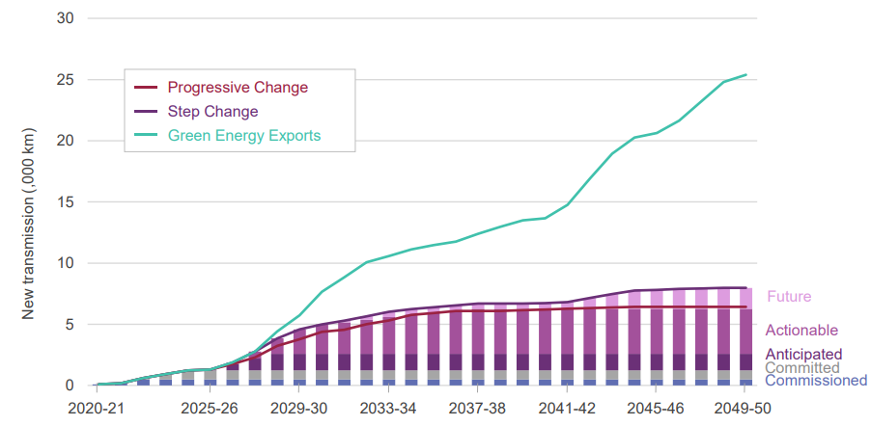
Challenges APEC economies will face – Technical
How to integrate RE into a decarbonising economy.
  RE must be matched with grid upgrades, storage, flexibility, and electrification so clean power can reliably replace fossil fuels.
Limited land availability in some economies.
  Dense populations, agriculture, environmental constraints, and terrain can limit utility-scale RE deployment.
Dealing with grid congestion and technical assistance.
  Many economies need technical support with forecasting, storage, and system operation to prevent straining power grids.
Limited system planning capacity making integration difficult from the outset.
  Weak planning/coordination across power and demand grids can delay renewable integration and create reliability and investment problems.
Transmission capacity required in Australia (,000 KM)
Source: 2024 AEMO Integrated System Plan

Slide 12
Challenges APEC economies will face – Financial
Some economies won’t have an issue with financing though cost blow outs in advance economies might be an issue.
  Inflation, supply chain pressures, labour shortages, and complex projects can drive significant renewable energy cost overruns.
Emerging and early-stage economies will face higher barriers to financing RE projects.
  Higher perceived risk, weaker institutions, limited bankable pipelines, currency risk, and underdeveloped financial markets can complicate RE investment.
Some economies will need to rely heavily on development finance and donor support.
  In some economies, concessional finance, guarantees, and donor support are needed to reduce risk and mobilise investment.

Slide 13
Conclusion
APEC is committed towards doubling the share of renewable energy in its energy mix and contributing towards tripling global renewable capacity by 2030.
Strong progress has already been made to meet these objectives.
Many economies already have ambitious targets to reduce carbon emissions by 2030.
Opportunities and challenges will be faced by APEC economies and concerted policy action will be necessary in response.

Slide 14
Thank you for your kind attention.
https://aperc.or.jp

