Slide 1
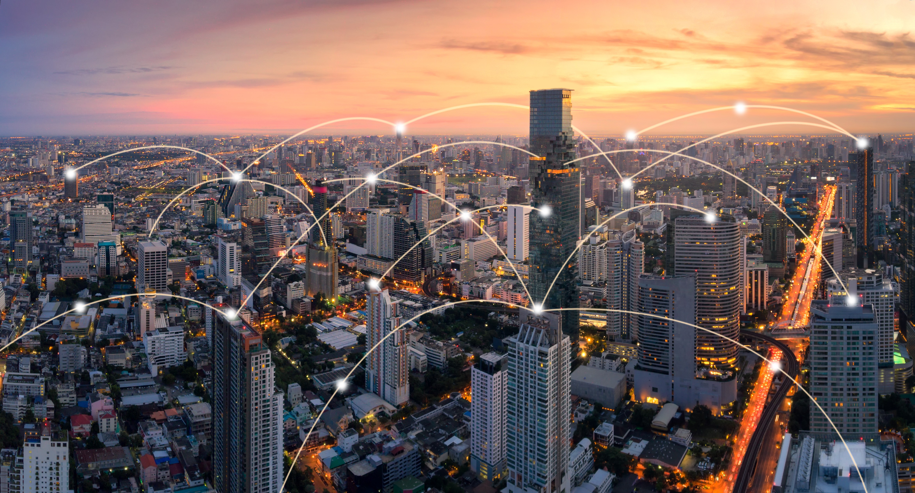
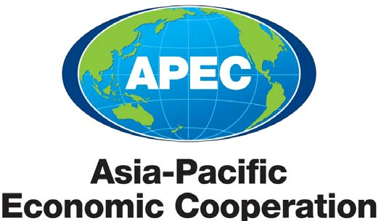
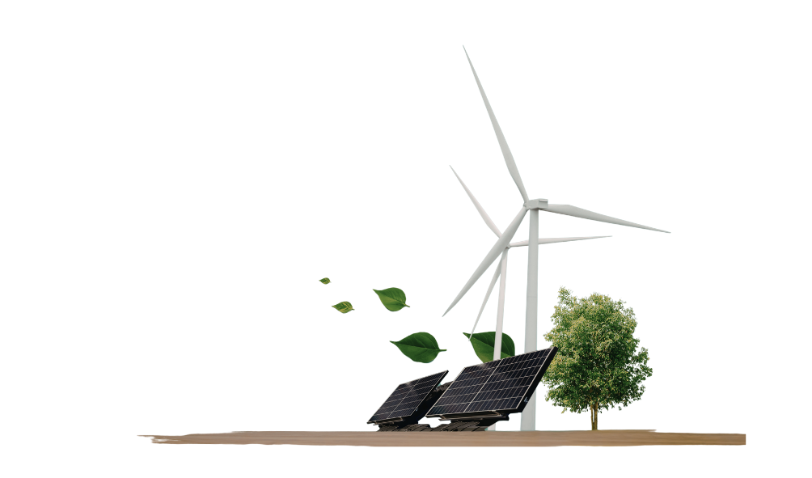
APEC Capacity Building Workshop for New and Renewable Energy Policy
(EWG Project: 104 2025A)
Peter du Pont, Co-CEO Asia Clean Energy Partners
Bangkok, 31 March 2026

Slide 2
Agenda
Objectives of the Workshop
Progress of the Energy Transition in Asia Pacific
  The RE power installation and consumption in APEC economy members
  The major electricity sources in APEC
  RE Policy Readiness
  Energy Investment in Selected Regions

Slide 3

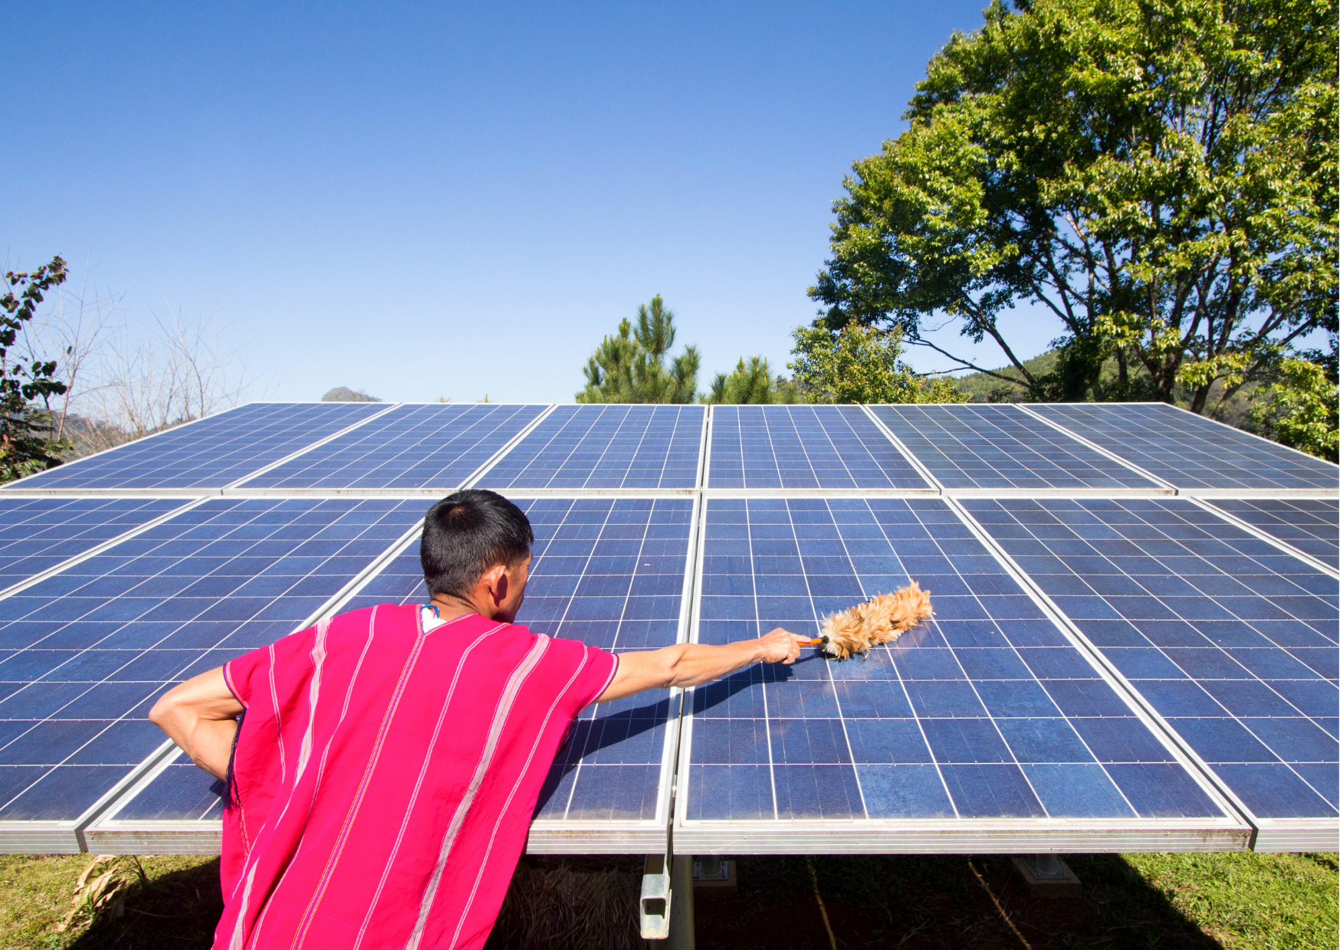
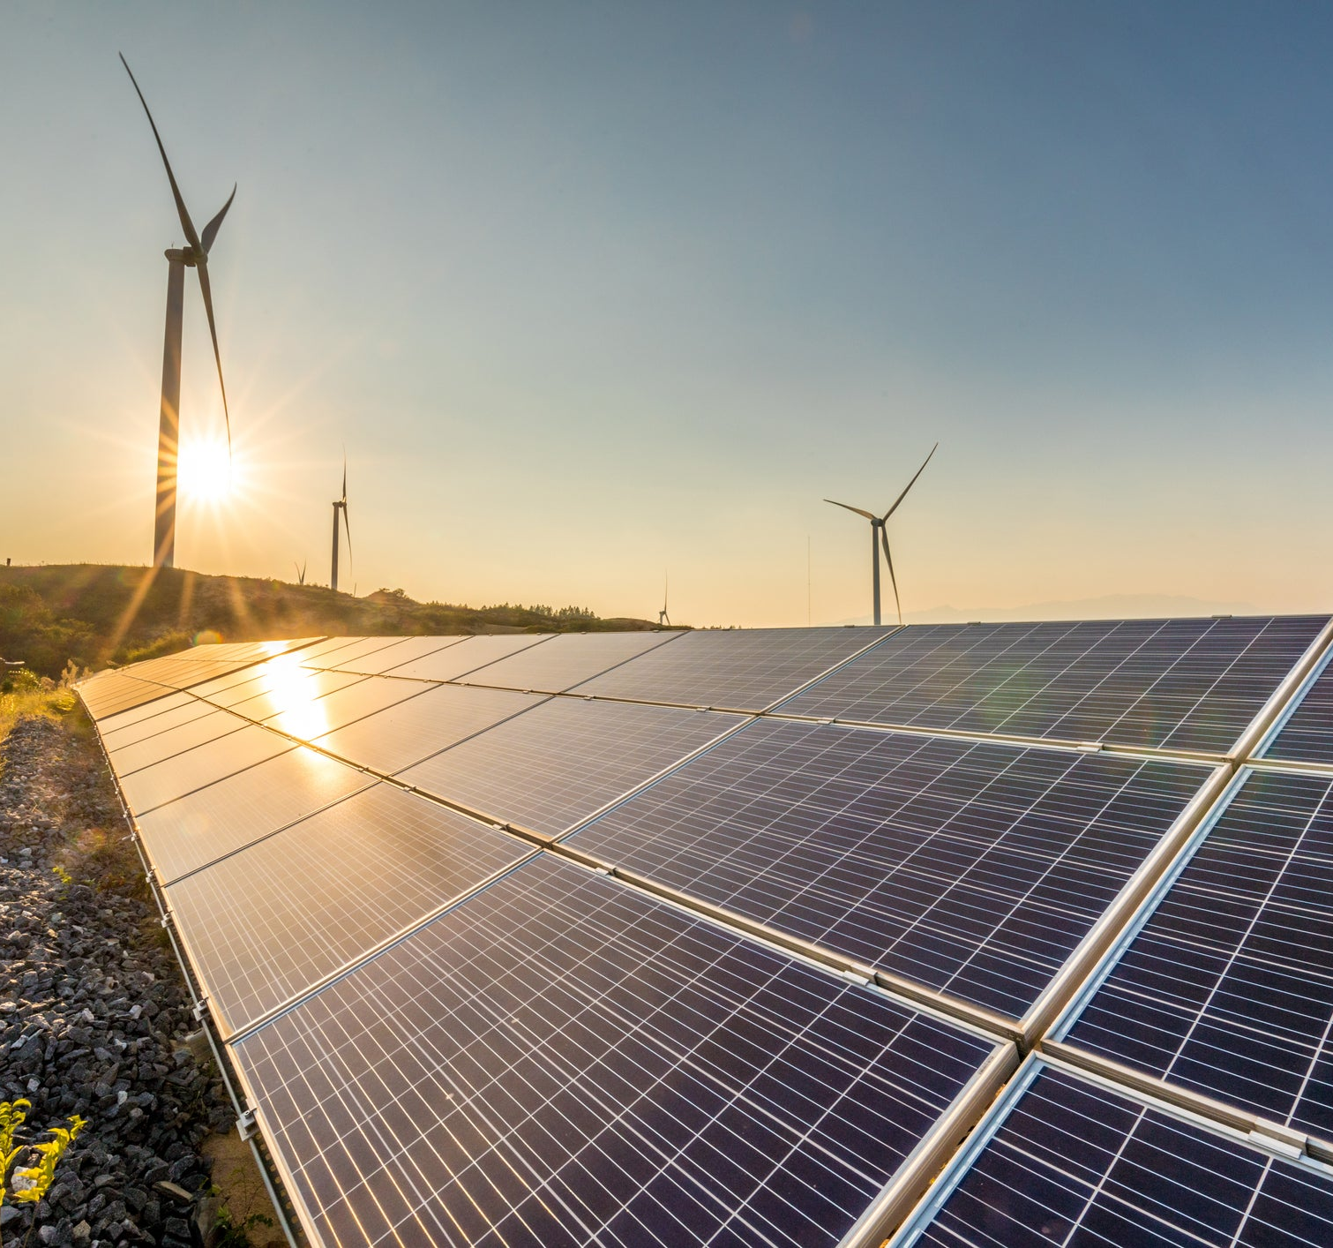

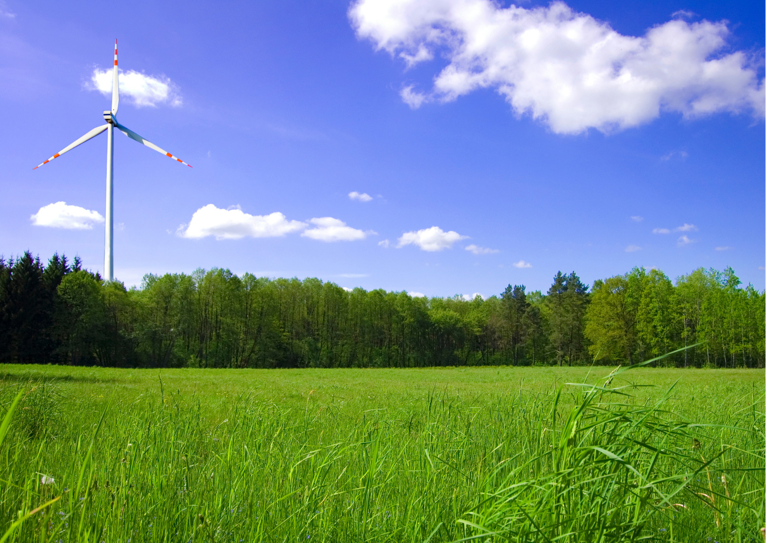
Progress of the Energy Transition in APEC

Slide 4
RE Development In APEC Economies: In 2024, about half of APEC economies have renewable electricity generation shares above the global average, but only a few have renewable installed capacity exceeding the global average.
Share of RE in installed capacity
Designated development zone: High renewable energy
electricity installed capacity (GW) and generation (TWh)
80%
World average RE installed cap: 47.3%
60%
40%
Larger bubbles indicate higher energy consumption per capita and may require greater efforts to accelerate renewable energy capacity expansion and generation.
20%
World average RE power generation: 31.9%
Share of RE in electricity generation
20%
40%
60%
80%
Source: Ember Data Explorer
AUS | BRN | CAN | CHL | CHN | IDN | JPN | KOR | MEX | MYS | NZL | PER | PHL | PNG | RUS | SGP | THA | TWN | USA | VNM
55 | NA | 72 | 69 | 56 | 14 | 40 | 22 | 26 | 22 | 80 | 46 | 32 | 34 | 23 | 10 | 22 | 33 | 33 | 58
35 | < 1% | 64 | 70 | 34 | 18 | 23 | 10 | 21 | 20 | 85 | 59 | 22 | 21 | 18 | 5 | 15 | 11 | 24 | 42
Share of RE in installed capacity
Share of RE in electricity generation

Slide 5
Coal Still Dominates Electricity Generation: Coal remains the dominant source of electricity generation of APEC economy members, while the share of renewable energy in electricity supply was only 30%* in 2024.
Electricity Generation by Source (TWh)
Renewable electricity generation of the APEC economy member is primarily driven by hydropower, followed by wind and solar PV.
Wind is the second-largest source, generating approximately 1.6 thousand TWh in 2024, while solar PV generated a similar level of around 1.6 thousand TWh.
14341 TWh (~70%)
6016 TWh
(~30%)
*Due to limited data availability, generation estimates were derived from 20 economies in the APEC.
Source: Ember Data Explorer

Slide 6



Example of Policy Analysis from IEA: RE integration readiness in Southeast Asia can be grouped into three levels—transformational actions to optimize VRE, enabling actions to enhance flexibility, and foundational actions to establish regulatory frameworks and standards.
Economies that need transformational actions
They should deploy advanced technologies, cross-sector integration, and sophisticated market designs to optimize high-VRE system performance. However, they need to strengthen their capacity to manage grid complexity at high VRE penetration and ensure equitable access to green electricity.
PHL
SGP
Economies that need enabling actions
They have implemented operational capabilities and developed market mechanisms and infrastructure to manage VRE. However, they should further enhance flexibility procurement mechanisms, strengthen grid investment to diversify flexibility resources, and improve the operational flexibility of conventional power plants.
IDN
MYS
VNM
THA
Economies that need foundational actions
They have already established core policies but should further develop regulatory frameworks and technical standards to support more ambitious VRE targets.
BRN
Source: IEA

Slide 7
Energy Investment Trends by Region: Investment in renewable power, grids, and storage increased across most regions; however, total investment in regions such as Latin America and Southeast Asia remained relatively stagnant.
Investment in renewable power, grids, and storage is highly concentrated in China, the United States, and India, which together account for more than 41% of total global energy investment.
In contrast, Latin America and Southeast Asia, representing examples of emerging economies, not only face stagnating energy investment but also have relatively low shares of renewable and grid investment.
In Latin America, renewable power accounts for only 24% of investment, compared to 57% for fossil fuels.
Similarly, in Southeast Asia, renewable power represents 31% of investment, while fossil fuels account for 52%.
Energy Investment in Selected Regions, 2015 vs. 2025 (USD Billion)
41% of the global energy investment is concentrated in China, USA, and India.
Share of investment in RE power, grids, and storage
~31%
Source: IEA

Slide 8
Contact information:
Peter du Pont
Co-CEO, Asia Clean Energy Partners
Bangkok peter.dupont@asiacleanenergypartners.com www.asiacleanenergypartners.com
Thank you!

