Slide 1
Managing AI-Driven Energy Demand: Ensuring Reliability, Affordability and Emissions
Daniel BURLUTSKY
Researcher, APERC
17/11/2025

Slide 2
Outline
AI demand for electricity explained
Managing the energy trilemma
Nuclear as a policy solution
VRE-driven policy solutions
Conclusion

Slide 3
AI demand for electricity explained
3

Slide 4
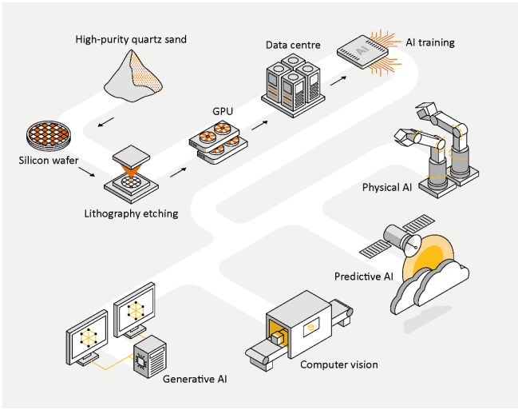
AI demand for electricity
Chip manufacturing is generally energy intensive but consumes only a fraction of total life-cycle emissions of using AI.
Models are “trained” in large data centers. This consumes massive amounts of electricity and is the main source of electricity demand.
AI-focused data centers can require 100 MW or more of generation capacity, consuming as much electricity as 100,000 households.
After training, models are then deployed for real-time tasks (inference use).
Impact of Deepseek?
Basic life-cycle of AI
Source: IEA

Slide 5
Demand for AI is accelerating – APERC projections
Data center and AI electricity demand by subregion (PJ) in TGT
Development of AI data centers is accelerating.
In 2024, data centers consumed around 1.5% of world electricity consumption.
Significant increase predicted from 2025 to 2030. Data center demand is especially strong in the USA, with the current administration seeking to expand AI-related infrastructure significantly.
Decelerating demand is predicted as focus shifts to inference based tasks instead of model training.
Energy demand will vary substantially depending on what AI is used for.
Future AI electricity demand is uncertain!
Data center and AI electricity demand as a percentage of total electricity demand in TGT
Source: APEC Energy Demand and Supply Outlook, 9th edition.

Slide 6
Managing the energy trilemma
6

Slide 7



The energy trilemma
Secure
Sustainable
Affordable

Slide 8
Nature of power demand from AI data centers
Relatively predictable and consistent power demand with stable baseload requirements.
Increased demand in the afternoon due to additional cooling loads.
Servers run 24/7 to train AI models and remain on standby for latency/redundancy.
Makes them attractive counterparties for Power Purchase Agreements for nuclear/VRE.
Nuclear presents a potential low-emission solution however long development and permitting timelines constrain its near-term viability.
An example of a typical AI data center load profile
Peak Demand

Slide 9
Meeting data center demand as VRE dominates
As VRE generation expands, electricity from dispatchable sources will increasingly be cut back in periods when VRE sources reach their peak (mid-day for solar).
Intraday profits are affected, meaning thermal generators will need to reduce their operations.
Thermal generators provide important baseload capacity needed by baseloads.
Core problem: Data centers need continuous 24/7 power whilst VRE is intermittent.
Thermal capacity factors compared to VRE shares across APEC
Source: APEC Energy Demand and Supply Outlook, 9th edition.

Slide 10
Why are falling thermal capacity factors an issue?
Dispatchable sources will need to be ramped up to meet increasing afternoon demand when data center demand is at its highest.
Grid-scale storage can help shift electricity to meet later demand but this is less effective during longer periods of low VRE production.
Other dispatchable sources will need to be present to meet load in days with low VRE output.
But baseload generation sources (coal and Combined-Cycle Gas Turbines) are designed for steady, continuous output and not frequent cycling and cannot be ramped up easily.
Solutions need to be found to meet growing data center demand while ensuring that electricity is secure, sustainable and affordable.
Power (GW) from dispatchable sources in AUS (TGT)
2022
2060 TGT
Source: APEC Energy Demand and Supply Outlook, 9th edition.

Slide 11
Nuclear as a policy solution
11

Slide 12
Nuclear as a policy solution – APERC projections
High efficiency rate and able to provide continuous baseload power with no emissions.
APERC predicts that many economies will scale up nuclear capacity to meet added data center demand.
China and the USA expected to continue dominating nuclear generation within the APEC region in response to growing data center demand.
USA is promoting new reactor deployment and extending the life cycle of existing plants.
Japan projected to restart all suspended reactors by 2040.
Change in nuclear power generation by economy (TWh)
Source: APEC Energy Demand and Supply Outlook, 9th edition.

Slide 13
Example of a PPA
Amazon Web Services (AWS) and Talen Energy signed a PPA to provide 1,920 MW of nuclear capacity from the Susquehanna Steam Electric Station through to 2042.
Both parties will also explore building new SMRs.
Follows a recent trend of technology companies increasingly relying on nuclear to provide baseload power to data centers.
PPAs could avoid the issue of having to deal with low intraday prices as revenue received from AWS is independent of volatile intra-day prices.
Current global sources of electricity for data centers
Source: IEA

Slide 14
Challenges?
Extremely complex engineering systems relative to wind and solar.
Characterised by long permitting times, high capital and fixed costs, essential infrastructure and supply chains and specialized staff requirements.
If power is needed now to meet demand, then a combination of VRE and storage might be the better solution given the development times.
Public acceptable will remain an issue.
Ageing nuclear fleet.
What about new technology like SMRs?
Median global construction times of nuclear plants in years
Source: Boston University

Slide 15
VRE-driven policy solutions
15

Slide 16
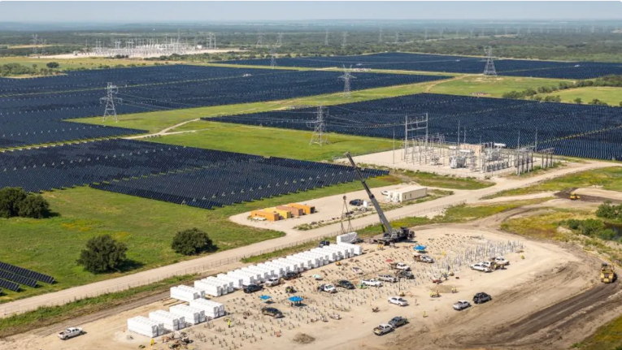
VRE-driven solutions
How could VRE dominated grids be compatible with the growth of data centers?
Using storage/hydrogen backups in addition to VRE.
Demand response solutions/workload shifting; moving energy intensive AI training to align with renewable peaks (during the day).
Locational strategy - building data centers near abundant VRE.
Improving or “reconductoring” power lines – replacing them with carbon fiber cores that can boost transmission and avoid congestion.
Pairing VRE with lower emissions dispatchable sources such as peaking gas that can be easily ramped up.
Google LLC and Intersect Power co-location

Slide 17
Comparing the two approaches
Nuclear dominant | VRE dominant
Advantages over VRE dominant approach: High reliability and power density Capacity factors are high and consistent Minimal land footprint Grid-stabilizing “Always-on” with ability to provide constant power needed by data centers. | Advantages over nuclear: Speed and scalability of deployment (1-2 years) Lower capital and financial risk Data centers can be built around areas with good VRE resources/established capacity Public acceptance is greater Synergy with demand flexibility when paired with storage.
Disadvantages over VRE dominant approach: Long lead times High capital costs Public resistance Can’t ramp quickly. | Disadvantages over nuclear: Intermittent generation Land intensive No mechanical inertia Lifecycle and supply-chain Issues Integration complexity for data centers.

Slide 18
Best approach – the portfolio/hybrid approach
Hybrid supply mix is probably the best approach with nuclear energy to cover baseload power demand and VRE coupled with storage to meet peak demand.
Load flexibility will become increasingly more important as data center demand grows.
Days of low VRE activity can be supplemented by storage, backup generation and/or grid inter-connections.
Hybrid approach means reduced storage needs as nuclear provides a firm baseload power supply.
Many new PPA’s are opting for this hybrid approach:
Data centers in Hokkaido and Kyushu are tied to new offshore wind zones plus nuclear restarts, balancing grid regions.
In 2024, Microsoft signed a long-term PPA with Constellation Energy’s Byron nuclear plant to power its AI data center expansion while still buying wind and solar elsewhere.

Slide 19
Conclusion
Data center demand is set to place additional pressure on electric grids across APEC as AI use continues to grow.
APEC economies must find ways of meeting data center demand in energy grids that are becoming increasingly VRE focused.
However, the core issue is that VRE is intermittent while data centers require stable baseload power.
Nuclear power is a solution and many APEC economies are increasing their nuclear capacity in part due to increased demand from data centers.
Nuclear power has disadvantages and another approach could be coupling VRE with supporting infrastructure such as storage and improved transmisson.
Solving the energy trilemma while meeting data center demand will be complicated.

Slide 20
Thank you.
daniel.burlutsky@aperc.or.jp
https://aperc.or.jp

