Slide 1
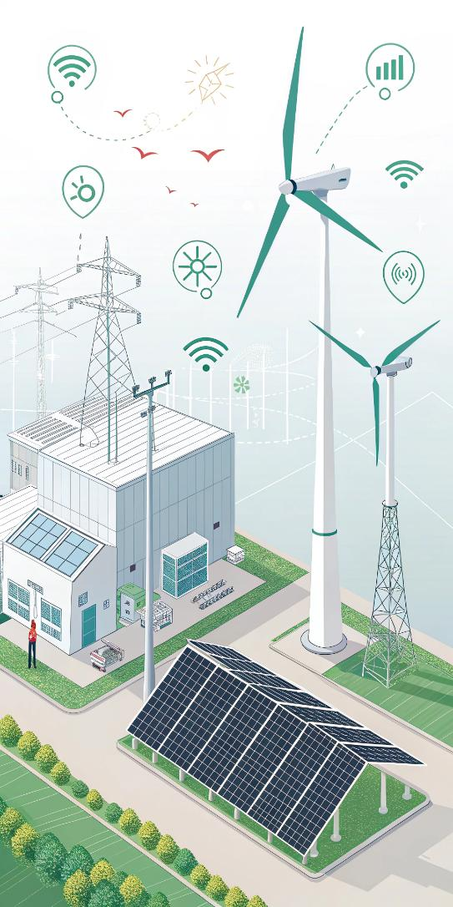
EGNRET Forum on AI-Powered Renewable Energy Innovation
AI-Driven New and Renewable Energy and Decarbonization
Chi-Wen Liao, Ph.D.
Green Energy and Research Laboratories
Industrial Technology Research Institute
2025.11.17
Notes:
Good afternoon, everyone. I'm Chi-Wen Liao from the Green Energy and Research Laboratories at the Industrial Technology Research.
Today, I'll be sharing our insights on AI-driven new and renewable energy development and how AI is advancing decarbonization efforts in the energy sector.

Slide 2
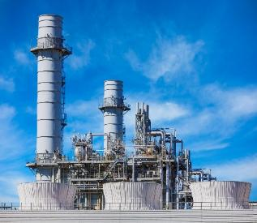
AI in the Energy Sector: Key Trends
Accelerating Electrification –
Electricity's share of end-use energy continues to grow
Digital Transformation –
The energy sector is moving toward digital integration (smart homes, electric vehicles, smart meters, etc.)
Trends in Energy Industry
Growing Market Complexity –
Supply and demand dynamics are becoming increasingly diverse and complex
Cost Optimization Imperative - Driving demand for more efficient and cost-effective production methods
EGNRET Forum on AI-Powered Renewable Energy Innovation
Notes:
So, how can AI help, or rather, why does AI need to help drive the renewable energy industry forward?
We can examine this through four key development trends currently shaping the energy sector:
First, the electrification trend. End-use energy consumption continues to grow, with electricity demand steadily climbing year over year.
Second, the digital transformation trend. With the advancement of connected technologies—smart home systems, electric vehicles, intelligent meters, and grid infrastructure—the energy industry is progressively moving toward comprehensive digitalization and system integration.
Third, increasing industry complexity. As energy systems evolve, they must deliver increasingly diverse and sophisticated solutions to meet varied and complex demand profiles.
And fourth, mounting cost pressures. Rising energy costs are compelling enterprises to seek more efficient, cost-effective production methods and operational approaches.
All of these issues can be optimized through AI—whether it's cost reduction, enhancing system efficiency, improving fuel supply management, enabling predictive maintenance, or cutting emissions.
This is precisely why the convergence of energy and AI represents such a compelling development opportunity.

Slide 3
AI in Energy: Advancing Climate, Security, and Prosperity
Japan recognizes AI as a catalyst for simultaneous progress across three critical goals: energy security, economic growth, and climate action.
Climate Mitigation
Energy Security
Artificial intelligence can accelerate decarbonization by enabling seamless integration of renewable energy sources and boosting system efficiency.
Artificial intelligence can strengthen energy reliability through advanced weather forecasting and optimized production scheduling.
Economic Expansion
AI efficiency gains reduce energy costs while unlocking new business opportunities and market growth.
EGNRET Forum on AI-Powered Renewable Energy Innovation
Notes:
Japan recognizes artificial intelligence as a catalyst for achieving simultaneous progress across three critical objectives: energy security, economic growth, and climate action.
Let me outline how AI drives value in each of these domains:
In climate mitigation, artificial intelligence accelerates decarbonization by enabling seamless integration of renewable energy sources into the grid while boosting overall system efficiency. AI-powered optimization makes it possible to manage the variability of renewables and maximize their contribution to the energy mix.
For energy security, AI strengthens energy reliability through advanced weather forecasting and optimized production scheduling. This means we can better anticipate supply and demand fluctuations, ensuring stable, dependable energy delivery even as we transition to more variable renewable sources.
And in terms of economic expansion, AI efficiency gains directly reduce energy costs while simultaneously unlocking new business opportunities and enabling market growth.
Together, these three pillars demonstrate how AI serves as a fundamental enabler—allowing us to pursue climate goals, energy security, and economic prosperity as mutually reinforcing outcomes.

Slide 4
AI and the Energy – Enable green energy transition
90%+
30%
25%
Artificial Intelligence is emerging as the solving complex challenges that were previously insurmountable.
From predicting wind patterns to optimizing energy storage, AI is transforming renewable energy from an intermittent resource into a reliable, intelligent power system.
Renewable Penetration
AI enables higher renewable energy integration into power grids
90%+
Cost
Reduction
Reduced grid integration costs through predictive analytics
30%
Efficiency
Increase
AI can boost renewable energy efficiency through advanced optimization
25%
EGNRET Forum on AI-Powered Renewable Energy Innovation
‹#›
Notes:
Artificial intelligence is proving to be a critical enabler of the green energy transition, delivering measurable benefits across three key dimensions:
First, renewable penetration. AI enables significantly higher renewable energy integration into power grids—we're seeing potential penetration levels exceeding 90 percent. This is transformative for grid operators who previously faced technical constraints on how much variable renewable energy they could reliably accommodate.
Second, cost reduction. Through predictive analytics, AI reduces grid integration costs by up to 30 percent. By anticipating supply-demand patterns and optimizing dispatch decisions, AI minimizes the expensive infrastructure investments traditionally required to integrate renewables.
And third, efficiency gains. AI can boost renewable energy efficiency by 25 percent through advanced optimization algorithms. This means extracting more value from existing renewable assets—whether optimizing wind turbines, solar panels, or energy storage.
Together, these improvements transform renewable energy into a reliable, cost-effective foundation for our energy systems.

Slide 5
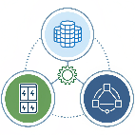
AI-Driven Energy Solutions
Storage Optimization
Power Generation Optimization
Use AI algorithms to optimize battery charging cycles and energy price arbitrage.
Utilize ML to predict solar irradiance and wind, while detecting panel soiling.
Grid Management
Real-time dynamic load balancing and rapid fault detection to prevent outages.
Notes:
AI is now delivering intelligent solutions across every layer of the energy system—from generation to delivery to storage.
In generation optimization, machine learning models can predict solar irradiance up to 72 hours in advance, enabling better dispatch planning. Deep learning algorithms forecast wind patterns with 15-minute granularity, dramatically improving wind power predictability. And computer vision technologies detect panel soiling or turbine damage in real-time, minimizing downtime and maintenance costs.
For grid management, AI enables dynamic load balancing at millisecond speed—essential for maintaining grid stability with high renewable penetration. AI-powered fault detection operates 10 times faster than traditional methods, allowing rapid response to potential disruptions. Additionally, predictive modeling helps prevent outages before they occur, enhancing overall grid resilience.
And in storage optimization, AI algorithms optimize battery charging and discharging cycles to maximize battery lifespan and economic value. These systems perform sophisticated energy price arbitrage, charging when prices are low and discharging during peak demand. Machine learning models also forecast battery health and degradation patterns, enabling proactive maintenance.
This comprehensive AI integration creates a truly intelligent, responsive energy ecosystem.

Slide 6
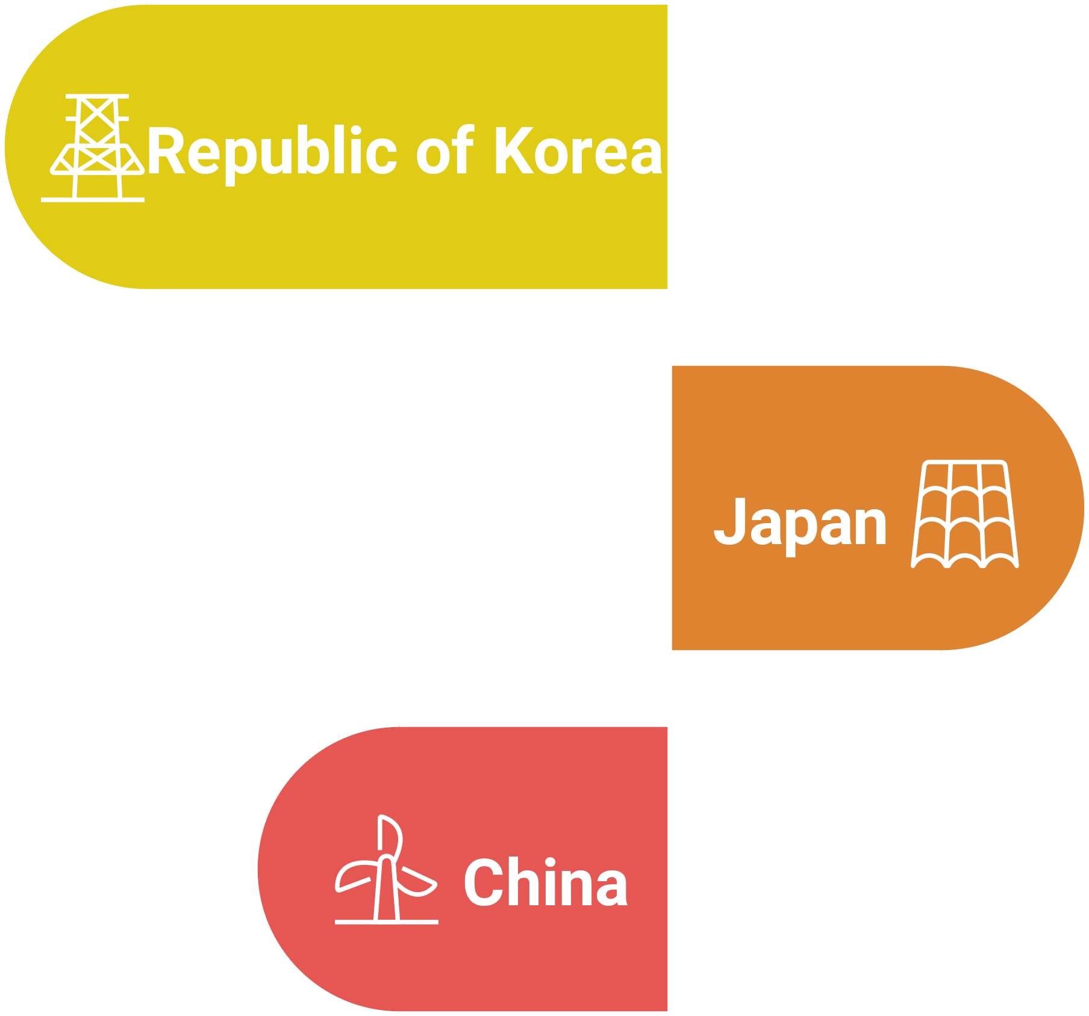
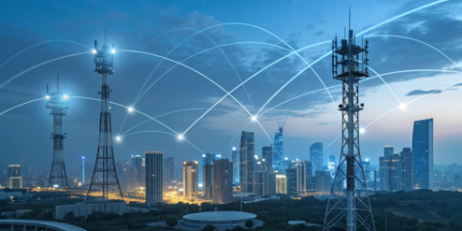
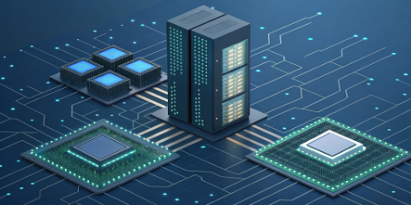
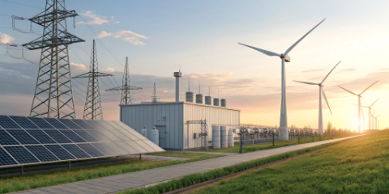
Leading Economies in AI Applications for Energy
Leveraging 5G networks for real-time AI control.
Sub-millisecond latency, edge computing, digital grid twin.
Improved renewable energy integration.
Focusing on precision AI integration for grid stability.
AI coordinates rooftop solar systems, optimizes green hydrogen production, faster grid restoration, and high grid reliability.
Leading in massive AI implementation across renewable infrastructure.
State Grid AI Platform, reduced wind turbine downtime, reduction in renewable energy curtailment, and annual operational savings.
EGNRET Forum on AI-Powered Renewable Energy Innovation
Notes:
Several Asia-Pacific economies are pioneering AI applications in the energy sector, each with distinct strategic approaches.
The Republic of Korea is leveraging 5G networks for real-time AI control of grid operations. Their approach focuses on ultra-low latency—achieving sub-millisecond response times for critical grid operations—and deploying edge computing at substations for instantaneous decision-making. Korea has also developed a national-scale digital grid twin for scenario planning and optimization, resulting in a 35 percent improvement in renewable energy integration capacity.
Japan is focusing on precision AI integration for grid stability. AI systems coordinate over 7 million rooftop solar installations, while machine learning optimizes green hydrogen production processes. Notably, Japan's AI-enabled systems achieve 50 percent faster grid restoration after disasters and maintain 99.99 percent grid reliability even with high renewable penetration—demonstrating that stability and clean energy can go hand in hand.
China leads in massive-scale AI implementation across renewable infrastructure. Their State Grid AI Platform manages 1.1 billion customers—the world's largest grid operation. AI has reduced wind turbine downtime by 25 percent and achieved a 40 percent reduction in renewable energy curtailment, translating to $2.8 billion in annual operational savings.

Slide 7
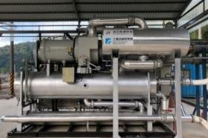
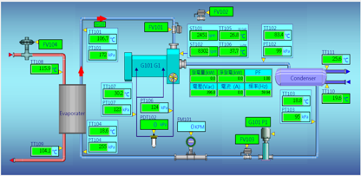
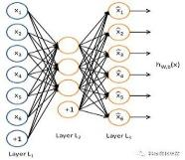

ITRI - Intelligently manage geothermal power
By leveraging artificial intelligence and deep learning technology to intelligently manage failure-prone equipment, overall operations and maintenance costs are reduced while maximizing power plant revenue from electricity sales.
Power generation units and environmental control monitoring data
Neural networks and data analysis
Geothermal Well Parameters
Operating Units
Power generation equipment parameters
Predictive Diagnosis of Heat Exchanger and Condenser Anomalies
Geothermal well health diagnosis
EGNRET Forum on AI-Powered Renewable Energy Innovation
Notes:
Let me share one of ITRI's practical applications of AI in renewable energy: our intelligent geothermal power management system.
Geothermal power plants face unique operational challenges—particularly with failure-prone equipment operating in harsh subsurface conditions. By leveraging artificial intelligence and deep learning technologies, we've developed a comprehensive approach to intelligently manage these critical assets, reducing overall operations and maintenance costs while maximizing power plant revenue.
Here's how the system works: We collect real-time data from operating units, including power generation equipment parameters and environmental control monitoring data, along with geothermal well parameters. This data feeds into neural networks and advanced data analysis algorithms.
The AI system delivers two critical diagnostic capabilities:
First, predictive diagnosis of heat exchanger and condenser anomalies. The system can identify emerging equipment issues before they lead to failures, enabling proactive maintenance that minimizes costly downtime.
Second, geothermal well health diagnosis. By continuously analyzing well parameters, the AI monitors subsurface conditions and reservoir performance, providing early warning of degradation or operational issues.
This transforms geothermal operations into predictive, intelligent asset management.

Slide 8
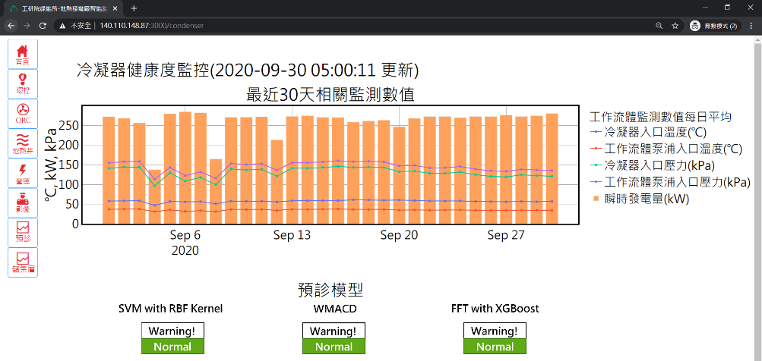
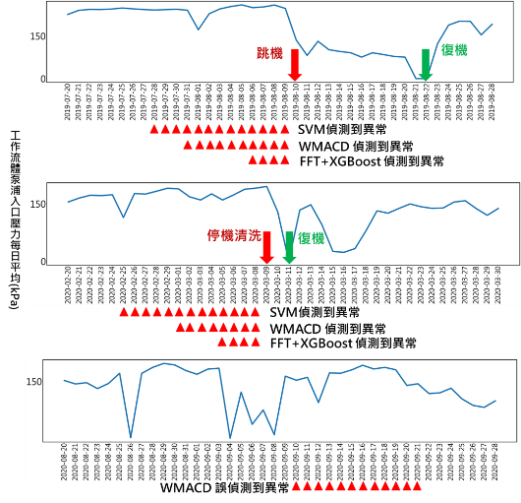
ITRI - Condenser Predictive Diagnosis Model
WMACD (Weighted Moving Average Convergence Divergence): False positive detections
SVM (Support Vector Machine): High predictive success rate
Fast Fourier Transform (FFT) with XGBoost: High predictive success rate
Model deployed on cloud platform with automated diagnostics; results displayed on health monitoring webpage
Inlet temperature
Inlet pressure
Instantaneous electricity generation
Condenser Scheduled Diagnostics
Examples of Anomaly Detection by Predictive Diagnosis Model
EGNRET Forum on AI-Powered Renewable Energy Innovation
Notes:
Our condenser predictive diagnosis system employs three complementary AI approaches, each with distinct characteristics:
WMACD—Weighted Moving Average Convergence Divergence—while useful for trend analysis, can generate false positive detections, requiring validation from other methods.
SVM—Support Vector Machine—delivers high predictive success rates and provides reliable anomaly identification.
And Fast Fourier Transform with XGBoost also achieves high predictive accuracy, particularly effective for complex pattern recognition in equipment behavior.
The system is deployed on a cloud platform with fully automated diagnostics, and results are displayed in real-time on a health monitoring webpage accessible to operators.
The interface shows condenser health monitoring over a 30-day period, tracking critical parameters including inlet temperature, inlet pressure, and instantaneous electricity generation. By comparing results across all three AI methods, operators can distinguish genuine equipment issues from false alarms, enabling more informed decision-making.
This multi-model approach provides robust diagnostics while minimizing unnecessary interventions.

Slide 9
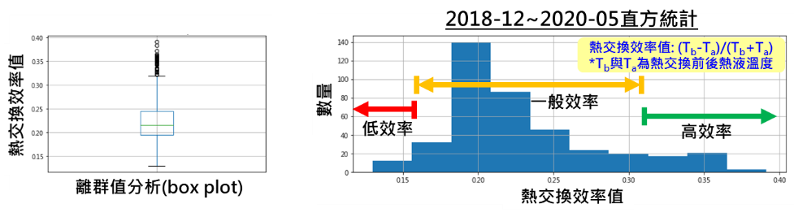
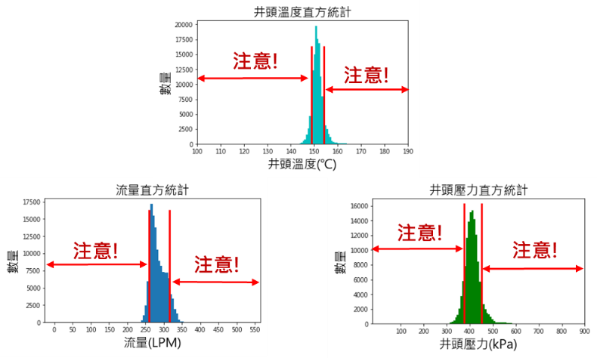
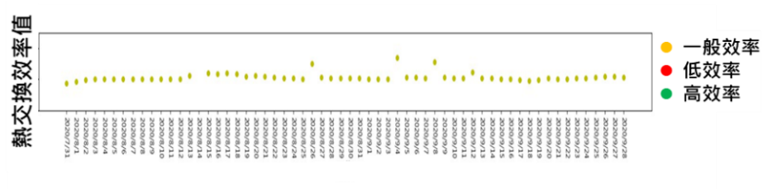
ITRI – Heat Exchanger and Well Diagnosis Model
Heat Exchanger Predictive Model:
Evaluation model based on historical heat exchange efficiency values
Geothermal Well Predictive Model:
Evaluation model utilizing wellhead pressure, temperature, and flow rate data at corresponding valve positions
Heat Exchanger Evaluation Model
Geothermal Well Health Assessment
Heat Exchanger Health Assessment
EGNRET Forum on AI-Powered Renewable Energy Innovation
Notes:
Beyond condenser monitoring, we've developed two additional predictive models for comprehensive geothermal plant diagnostics.
Our Heat Exchanger Predictive Model uses an evaluation approach based on historical heat exchange efficiency values. By analyzing patterns in efficiency data, the system categorizes performance into low, general, and high efficiency ranges. The model continuously monitors heat exchanger health, tracking efficiency trends over time to identify degradation patterns before they impact plant output.
Our Geothermal Well Predictive Model takes a different approach, utilizing real-time wellhead pressure, temperature, and flow rate data at corresponding valve positions. This creates a comprehensive picture of subsurface reservoir conditions and well performance.
When parameters deviate beyond normal operating ranges—marked with warning indicators—the system alerts operators to potential issues such as scaling, declining reservoir pressure, or production decline. These early warnings enable timely intervention.
Together, these diagnostic models provide holistic asset health monitoring—from surface equipment to deep subsurface resources.

Slide 10
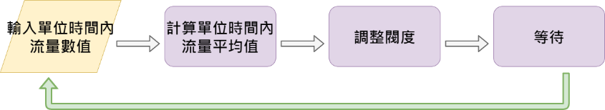
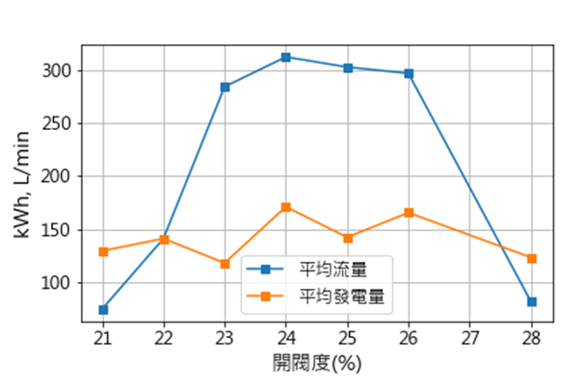
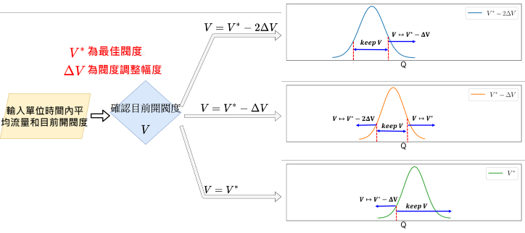
ITRI – Optimal Valve Opening Analysis & Control
Optimal valve opening determined from historical flow and generation data
Analyze historical flow rate and power generation data to determine optimal valve opening and adjustment range
Develop flow control module based on valve opening-flow rate distribution curves and support production well maintenance operations
Average Flow Rate and Power Generation vs. Valve Opening
Optimal Valve Opening Analysis
EGNRET Forum on AI-Powered Renewable Energy Innovation
Valve Control Module
Notes:
A critical aspect of geothermal plant optimization is determining the optimal valve opening to maximize both flow rates and power generation.
Our approach analyzes historical flow rate and power generation data to establish the optimal valve opening position and acceptable adjustment range for each well. There's a clear relationship between valve opening percentage and both average flow rate and power generation, with an optimal operating point that balances these parameters.
Based on this analysis, we've developed an intelligent flow control module that uses valve opening-flow rate distribution curves to support automated operations.
The control module operates through a continuous feedback loop: it monitors real-time flow, compares performance against targets, and adjusts valve opening accordingly. The system employs different control strategies depending on deviation from optimal conditions.
This automated approach maintains wells at their most productive operating point while enabling rapid response to changing reservoir conditions.

Slide 11
ITRI – AI for Energy Management System
Empowering Smart Energy — From Data to Action
Visualize, Optimize, and Control with Intelligent Edge and AIoT Solutions
Data Monitoring:
Data Visualization
Power Tab
Optimal Control:
Chilled Water Plant Control Strategies
Edge Computing: (Nearby Computing)
μ-BEMS (Micro BEMS)
Embedded Controller
Tab Sensor
AIoT:
AI for PdM*
AIoT-EMS for food Retail stores
Energy Management System (EMS)
Predictive maintenance (PdM)
EGNRET Forum on AI-Powered Renewable Energy Innovation
Notes:
Beyond renewable energy generation, ITRI has developed AI solutions that enable commercial and industrial facilities to actively participate in demand response programs.
Our approach follows an integrated pathway: visualize, optimize, and control using intelligent edge computing and AIoT solutions.
First, data monitoring. Our Power Tab platform provides real-time visibility into energy consumption patterns, essential for identifying flexible loads that can respond to grid signals.
Second, optimal control. AI algorithms determine which loads to curtail or shift during demand response events—for example, adjusting chilled water plant operations when the grid needs load reduction.
Third, edge computing. Our μ-BEMS—Micro Energy Management System—enables rapid, localized response to demand signals without relying on cloud connectivity, ensuring fast reaction times.
And fourth, AIoT integration. Our AIoT-EMS solution, deployed in food retail stores, can quickly reduce refrigeration and HVAC loads in response to grid needs while maintaining product safety.

Slide 12
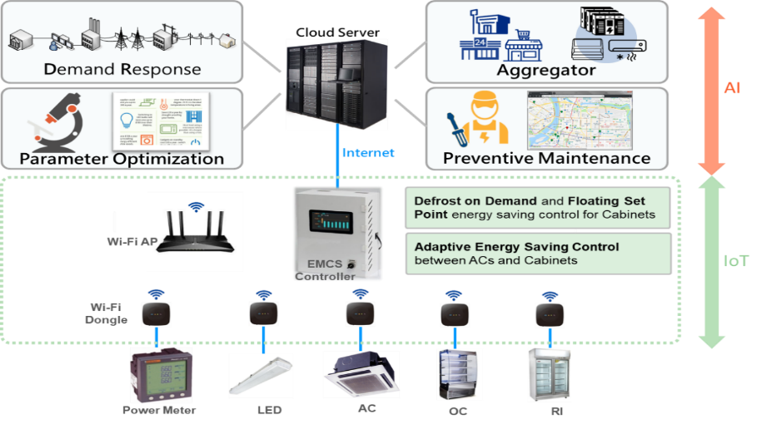
ITRI – AI & IoT Empowered Energy
Integrated demand response, predictive maintenance, and adaptive control for energy savings and system optimization from the cloud to every device
EGNRET Forum on AI-Powered Renewable Energy Innovation
Notes:
This system enables facilities to actively participate in demand response programs—responding to grid signals through intelligent control from cloud to device.
The architecture has three layers:
At the cloud level, AI coordinates demand response by receiving grid signals from aggregators and determining optimal load reduction strategies across the facility.
At the edge level, our EMCS controller executes these commands in real-time through Wi-Fi networks, implementing adaptive controls like defrost-on-demand for refrigerated cabinets and coordinating air conditioning with refrigeration loads to quickly reduce power when the grid needs it.
At the device level, individual equipment—power meters, lighting, air conditioners, and refrigeration units—responds within seconds to meet demand response targets.
This transforms commercial facilities into flexible grid assets.

Slide 13
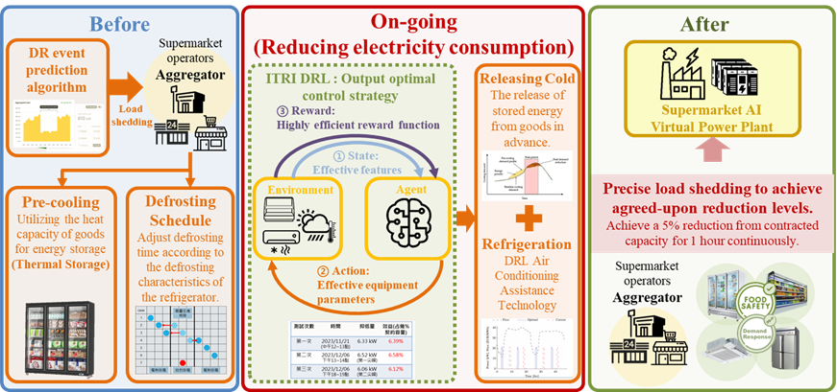
ITRI – AI-driven VPP with intelligent load management
Powering Smart Retail — Precision, Safety, and Efficiency to support grid resilience
dynamic energy management through advanced control strategies
EGNRET Forum on AI-Powered Renewable Energy Innovation
Notes:
This application demonstrates how retail facilities can function as Virtual Power Plants, participating in demand response to support grid resilience.
Our achieved capabilities include DR event prediction algorithms that forecast grid needs and load shedding strategies. We've also developed pre-cooling and intelligent defrosting scheduling technologies that prepare facilities for demand response participation by storing thermal energy in advance.
Our ongoing efforts focus on reducing electricity consumption through ITRI's deep reinforcement learning system. This AI optimizes equipment parameters in real-time, coordinating the release of stored cooling capacity with air conditioning load curtailment through advanced control strategies.
Looking ahead, our goal is to establish Supermarket AI Virtual Power Plants capable of precise load shedding to meet aggregator requirements—achieving contracted capacity reductions, such as 5 percent for one-hour periods, while maintaining product safety and quality.

Slide 14













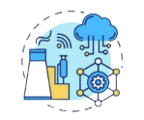
ITRI – AI-driven Cloud-Based Carbon Management
Containerized microservices architecture with auto-scaling nodes based on computing requirements
One-Stop Cloud-Based Carbon Management
External
Internal
Carbon Footprint Assessment
Energy Technology Implementation
Data-driven carbon emission forecasting and hotspot analysis
Emissions Forecasting and Hotspot Analytics
Portal
Carbon Footprint Optimization
Agricultural Carbon Sink
Database
Carbon Abatement for Livestock and Agricultural
Factory Operations ERP/MES
Smart Manufacturing Energy Efficiency
Novel Materials
Green Materials and Carbon Reduction Analysis
Digital V&V
IoT at Equipment Level
Manufacturing Process Carbon Data Collection and Integration
GHG and Carbon Footprint Verification
EGNRET Forum on AI-Powered Renewable Energy Innovation
Notes:
ITRI has developed a comprehensive cloud-based platform for carbon management—supporting the transition to low-carbon energy systems through intelligent data collection, analysis, and optimization.
This one-stop platform integrates several key capabilities:
Carbon footprint assessment and verification, which evaluates emissions across energy systems and validates reduction efforts through standardized GHG accounting protocols.
Data-driven emissions forecasting and hotspot analysis, using AI to predict future carbon emissions and identify the highest-impact areas for reduction—particularly valuable for optimizing renewable energy integration strategies.
Carbon footprint optimization, which analyzes pathways to minimize emissions through renewable energy adoption, novel low-carbon materials, and agricultural carbon sinks that offset residual emissions.
And real-time carbon data collection from IoT-enabled equipment and manufacturing processes, providing the granular information needed to track decarbonization progress.
Built on a scalable cloud architecture, this platform enables enterprises to comprehensively manage their carbon transition.

Slide 15
Future Key Trends
Energy Technology Innovation
Advanced Smart Grid
AI accelerates R&D in new battery materials, green hydrogen, renewable energy systems, and carbon management
AI-powered real-time grid control and storage management
Critical for grid stability as renewable energy integration surpasses 30%
AI Governance
Digital Twins
Enhanced data sharing protocols
Robust model validation and cybersecurity
Improved AI explainability and transparency
Real-time synchronization with microsecond precision AI runs millions of "what-if" scenarios for planning
EGNRET Forum on AI-Powered Renewable Energy Innovation
Notes:
Today, we've explored how AI is fundamentally transforming renewable energy innovation. ITRI's work demonstrates practical applications across this spectrum: intelligent geothermal plant management, AI-powered energy management systems, virtual power plant capabilities, and comprehensive carbon management platforms. These solutions show that AI is not just a future possibility, but a present-day enabler of the clean energy transition.
Looking ahead, we see four critical trends shaping the future:
Energy technology innovation, where AI will accelerate R&D in advanced battery materials, green hydrogen production, next-generation renewable systems, and integrated carbon management solutions.
Advanced smart grids, where AI-powered real-time control and storage management will become essential as renewable energy integration surpasses 30 percent—ensuring grid stability in an increasingly variable energy landscape.
Digital twins, providing real-time system synchronization and enabling millions of "what-if" scenarios for optimal planning and operations.
And AI governance, establishing robust frameworks for data sharing, model validation, cybersecurity, and AI explainability—ensuring these powerful tools serve the public interest responsibly.
The convergence of AI and renewable energy represents a tremendous opportunity for the Asia-Pacific region. Through continued collaboration and innovation, we can accelerate our shared clean energy future.
Thank you.

Slide 16
THANK YOU FOR YOUR ATTENTION

