Slide 1
Energy and artificial intelligence
Siddharth Singh, Office of the Chief Energy Economist
17 November 2025
AI-Powered Renewable Energy Innovation, Seoul, Korea

Slide 2
Data centre electricity demand surges
Data centre electricity demand (TWh)
Increase in electricity demand by sector,
2024-2030
1 200
Industry
(excl. heavy)
900
Electric transport
Appliances
AI-optimised
servers
Space cooling
600
Data centres
Heating
300
Heavy industry
Conventional
servers
Other
500
1 000
1 500
2010
2015
2020
2025
2030
2035
TWh
Data centre electricity demand more than doubles to 2030 and almost triples by 2035, driven by AI.
Data centres are among the key contributors to electricity demand growth.

Slide 3
2 000
A diverse range of sources will be needed to meet demand
Electricity generation to meet data centre demand (TWh)
1 400
1 050
Renewables
700
Nuclear
350
Natural gas
Coal
2010
2015
2020
2025
2030
2035
Globally, over half of the electricity demand growth is met by renewables over the next decade;
In the United States and China (the two largest data centre markets) gas and coal respectively are major contributors.

Slide 4
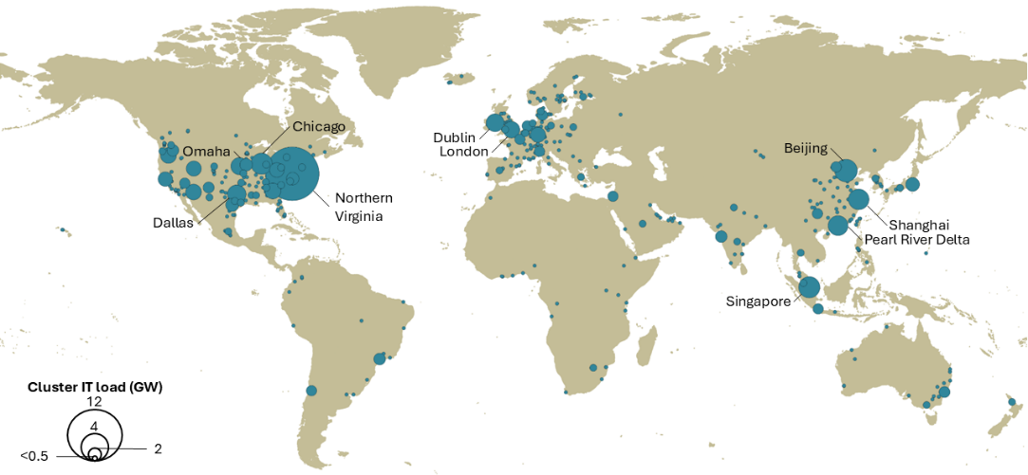
Data centre clusters have been emerging in large economies
Global map of large data centre clusters, 2024
Global aggregates mask the local challenges faced due to the clustering of data centres.
In Ireland, over 20% of electricity demand goes to data centres. In Virgina, it is over 25%.

Slide 5
AI thrives on the complexity of the energy sector
Key energy indicators, 2024
(Exajoules)
Electricity sector indicators
Connected devices
(Billions)
Share of solar and wind
in generation
600
30%
30
Renewables
Natural
gas
Other
Share of
electricity in
energy
consumption
400
20%
20
Buildings
Coal
Transport
200
10%
10
Oil
Industry
Energy
supply
Energy
consumption
2000
2020
2030
2010
2023
2030
The energy system is highly complex, with multiple sources of energy and technologies feeding consumer demands.
Energy systems are also now increasingly getting electrified, digitized and connected.

Slide 6
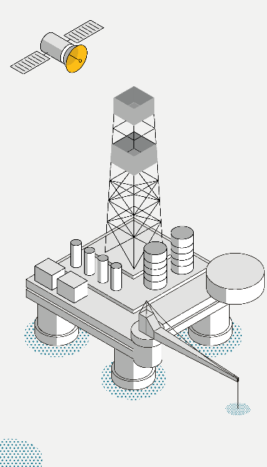
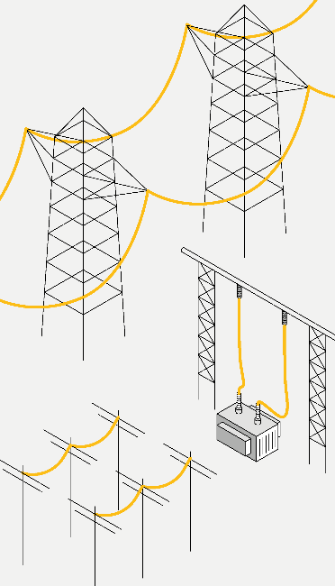
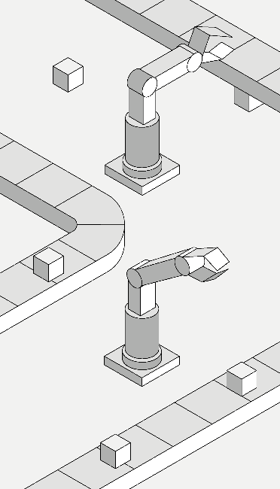
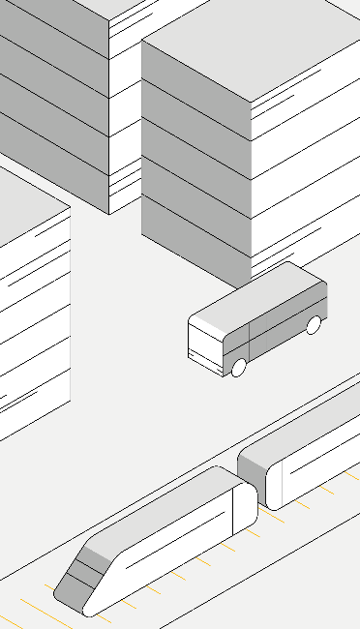
AI could transform energy, but key barriers must be overcome
Oil and gas
Electricity
Industry
Cities
AI applications across the energy sector can increase competitiveness, enhance resilience and spur innovation;
but widespread adoption requires overcoming barriers related to missing incentives, skills and digital infrastructure.

Slide 7
AI has vast potential in optimising energy operations
Savings potential from the widespread adoption of AI-based optimisation, 2035
EJ
Energy savings
2.0
8%
Savings as a share of sectoral energy consumption
(right axis)
1.5
6%
1.0
4%
0.5
2%
Cars
Trucks
Iron
&
steel
Aviation
Cement
Buses
Rail
Widespread adoption of known AI applications has the potential to save 13.5 EJ in 2035, which is larger than the total energy consumption in Indonesia today. AI can be used for a range of other optimisations.

Slide 8
The net impact of AI on emissions depends on how it is used
Emissions from electricity consumption, 2035
Mt CO2
500
250
Data centres
Emissions from electricity consumption in data centres could rise to 500 Mt, or 1.5% of total energy emissions.

Slide 9
The impact on emissions depends on the uptake of AI in energy
Emissions from electricity
consumption, 2035
Impact of AI on emissions, 2035
Mt CO₂
500
AI-enabled
reductions
Data centres
Rebound
effects
-500
-1 000
-1 500
Emissions from electricity consumption in data centres could rise to 500 Mt, or 1.5% of total energy emissions.
The emissions reductions potential of AI could outweigh this increase, but requires overcoming barriers.

Slide 10
Barriers will need to be overcome for AI applications in energy
Share of firms not using AI by cited reason (2024)
Share of digitised HVAC systems in advanced economies (2024)
Weekly cyberattacks
on energy utilities
60%
1600
AI not
useful
1200
Legal
40%
concerns
800
Privacy
concerns
20%
400
Missing
expertise
5%
10%
15%
20%
25%
Services
Residential
2020
2024
Missing skills, digital infrastructure and a conducive regulatory environment are among the barriers that are
holding back the adoption of AI related solutions in the energy sector.

Slide 11
How AI can help accelerate energy innovation
Traditional and AI-accelerated drug discovery performance
AlphaFold AI
100 000 000
200 million modelled
Number
of proteins
using AI in 1 year
10 000 000
1 000 000
100 000
Experimental methods
10 000
200 000 experimental
results in 50 years
1 000
100
1982
1990
2000
2010
2020
2024
AI modelling accelerated the pace of protein structure analysis by around 45 000 times;
AI has implications for the energy sector as well

