Slide 1
ECONOMY UPDATES Hong Kong, China November 2025
The 65th meeting of the APEC Expert Group on Energy Efficiency & Conservation
and
The 63rd meeting of the APEC Expert Group on New and Renewable Energy Technologies
Hong Kong, China

Slide 2
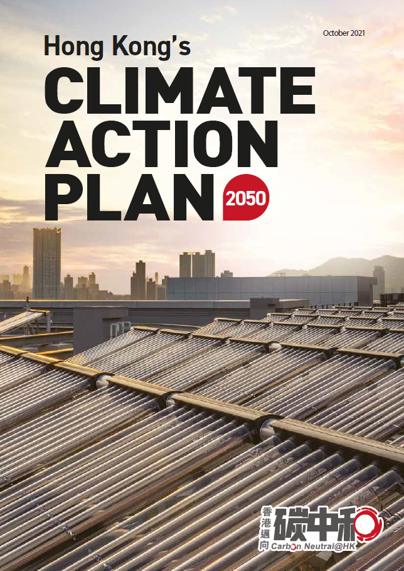
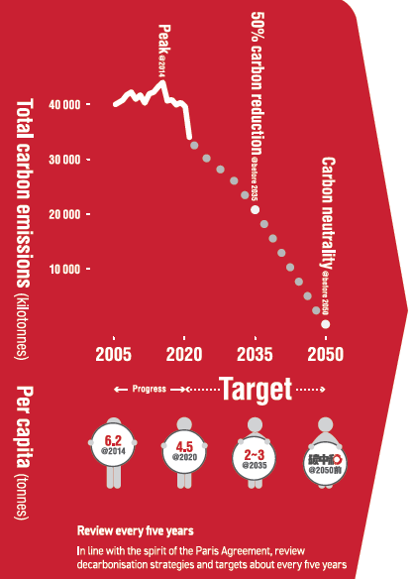
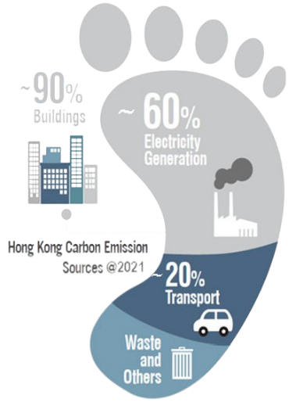
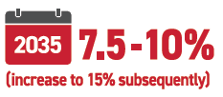
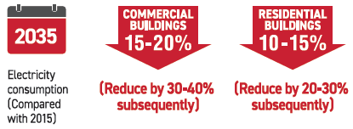

Utilisation of Clean Energy and Energy Efficiency Enhancement
Renewable Energy (RE)
Electricity Saving in Buildings

Slide 3


Annual Publication of Hong Kong Energy End-use Data

Slide 4
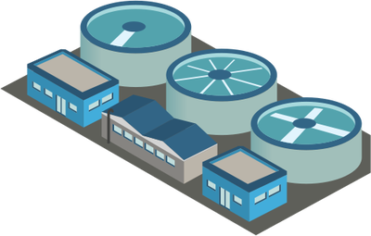
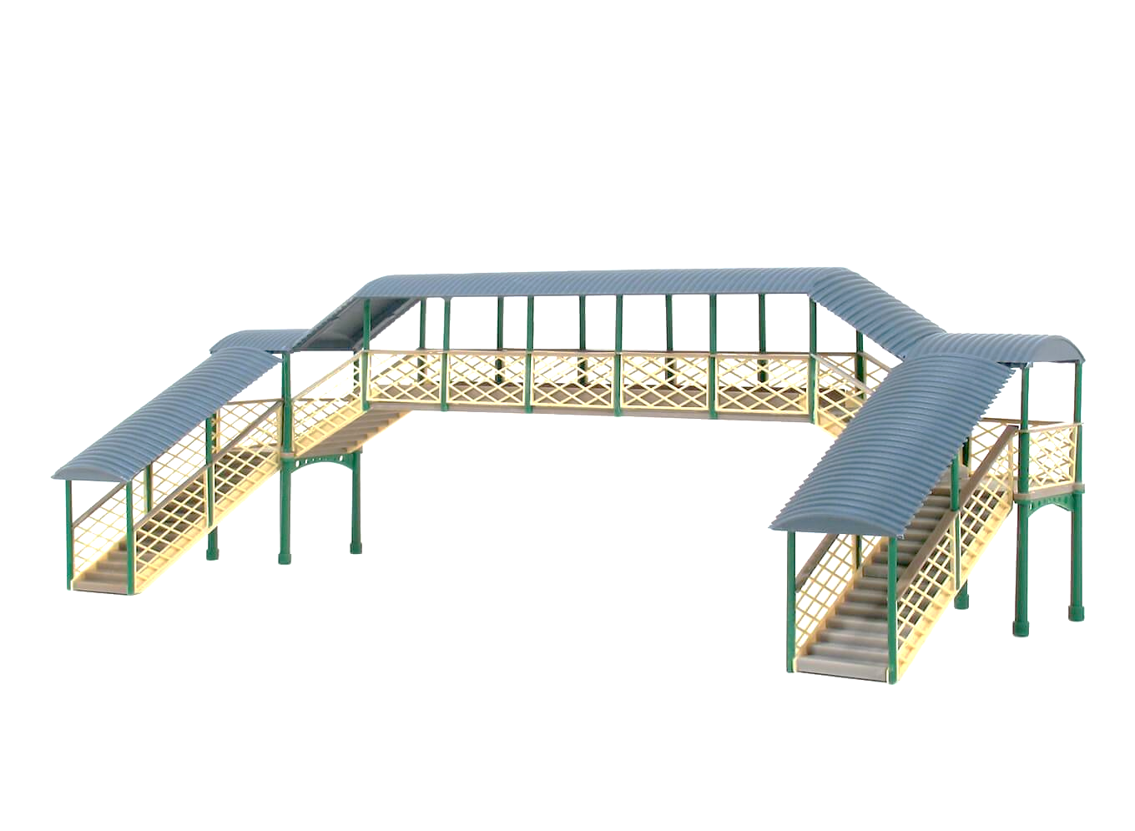
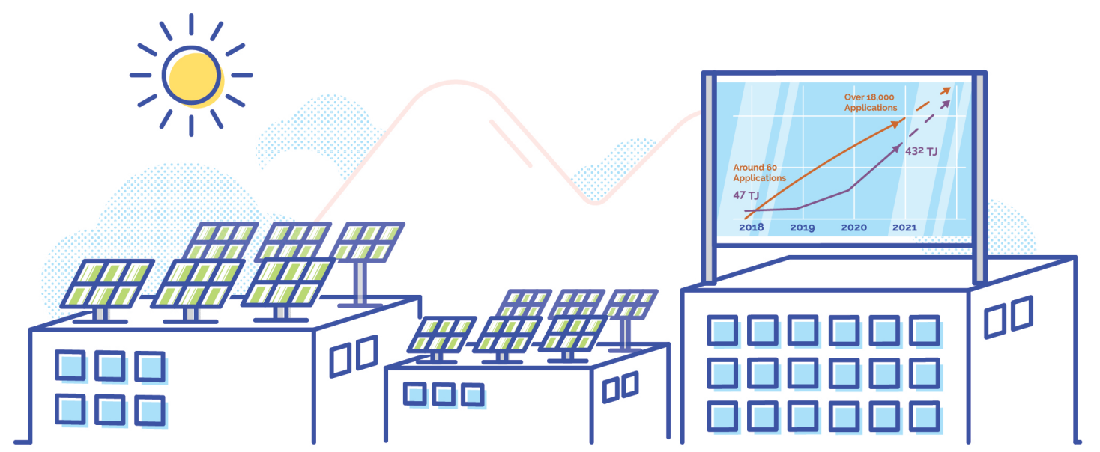
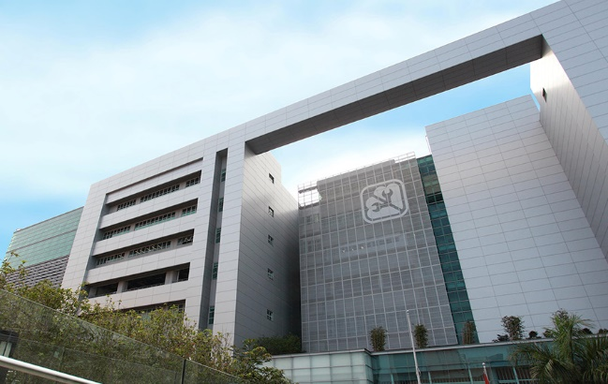


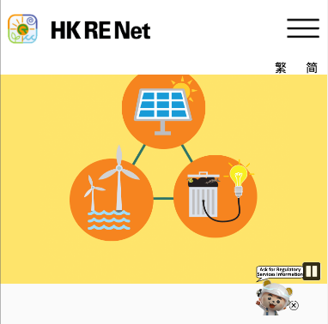



Current RE Initiatives
BIPV Pilot
Scheme
RE at Non-Building Facilities
Feed-in-Tariff
Open carpark
RE Net
0

Slide 5



Green Energy Target for Government Premises
6.9%
Actual result
9.2 %
Actual result
7.8 %
Actual result
6.4 %**
Actual result
6 %
Target
5 %
Target
5 %
Target
6 %
Target
**Energy performance up to 2023/24
2003/04
2006/07
2009/10
2013/14
2015/16
2019/20
2020/21
2024/25
2002/03
2007/08
2013/14
2018/19

Slide 6


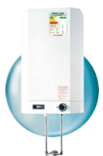
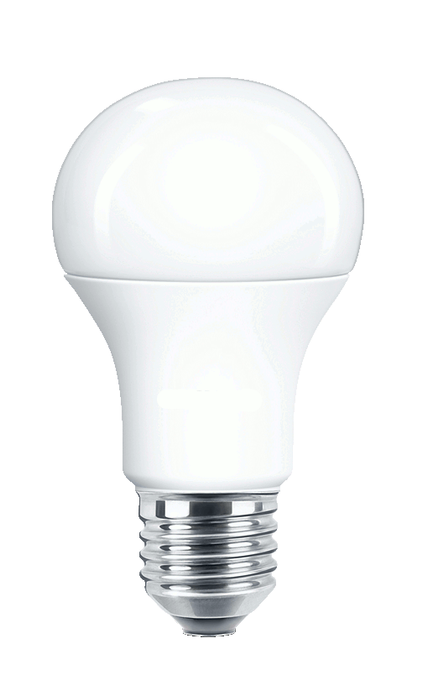
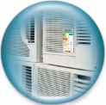


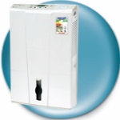
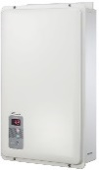


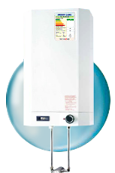




Development of the Mandatory Energy Efficiency Labelling Scheme (MEELS)
2025 3rd Upgrading of Standards
MEELS Energy Coverage in Residential Sector
80% (11 products) (Phase IV)
49% (8 products) (in first 3 Phases)
2021 2nd Upgrading of Standards
2015 1st Upgrading of Standards
2024 Phase IV
2019 Phase III
Overall MEELS:
Annual Energy Saving (electricity as unit): 1,353 GWh
Annual CO₂ Emission: 911,850 tonnes
2011 Phase II
2009 - Phase I

Slide 7
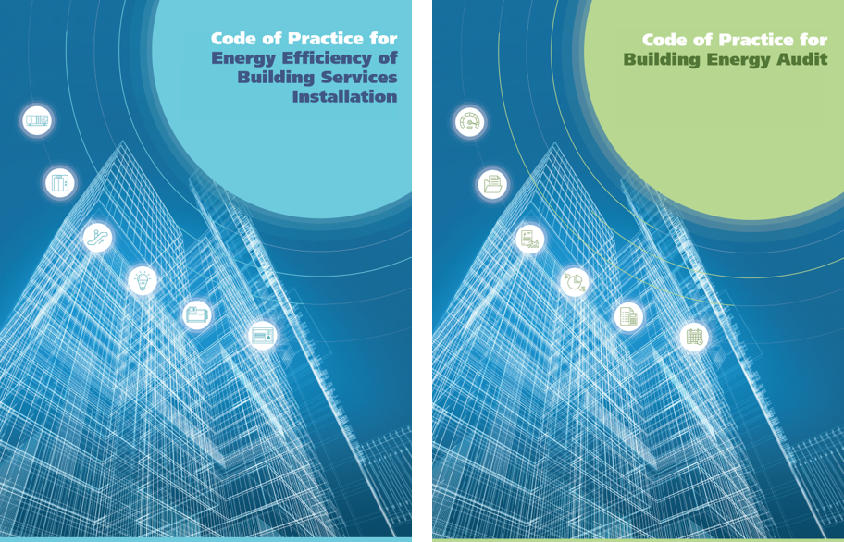

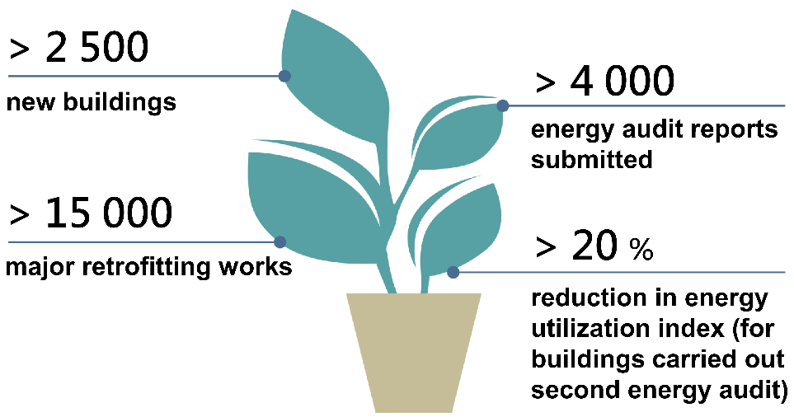




Governing Energy Efficiency of Buildings
Buildings Energy Efficiency Ordinance
Achievement by 2024
20% uplifts compare to standard in 2015
Enhancement in 2025
Estimated electricity saving of about 5.4 billion kWh/year by 2035
Amended the Ordinance for:
Extending the coverage of more building types
Shorten interval of energy audit
Enhance data transparency

Slide 8
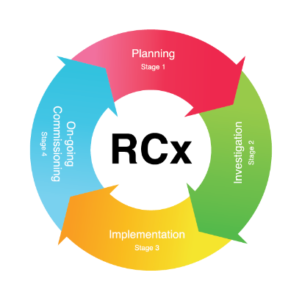

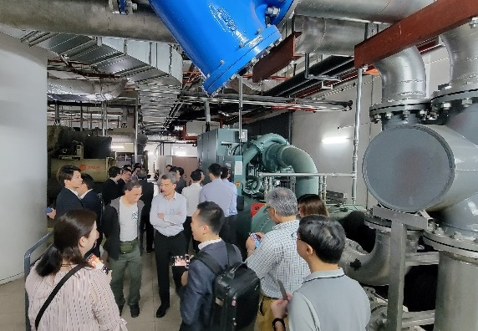
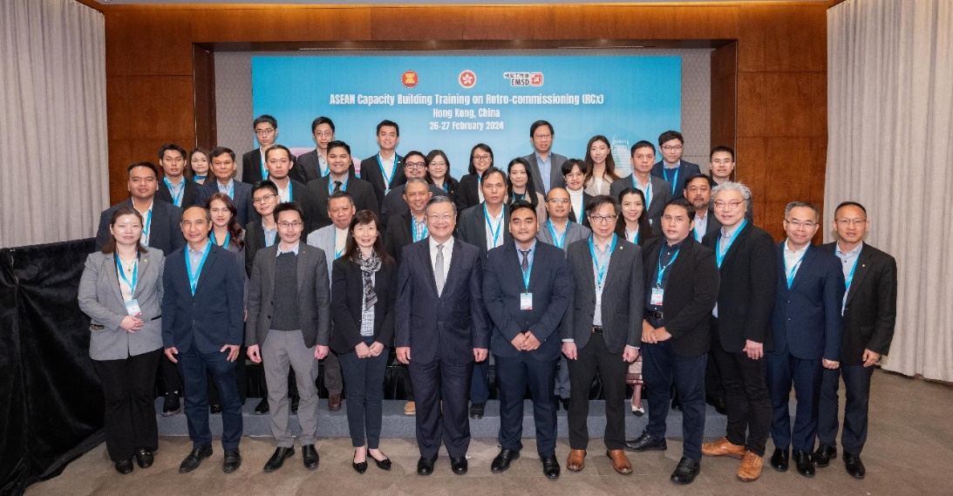

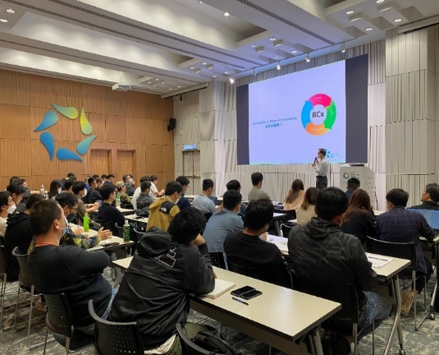
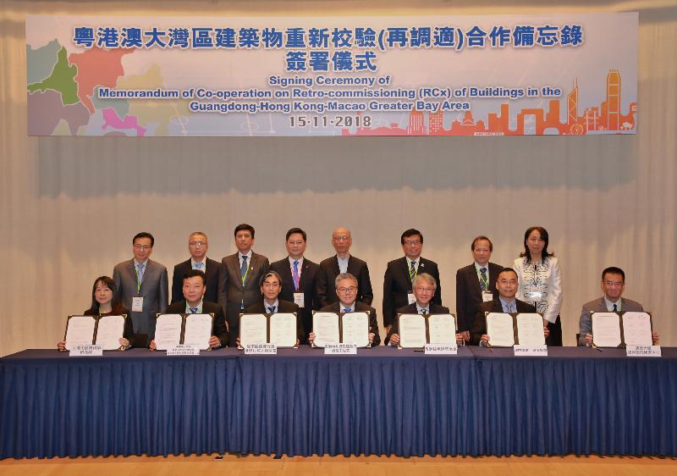
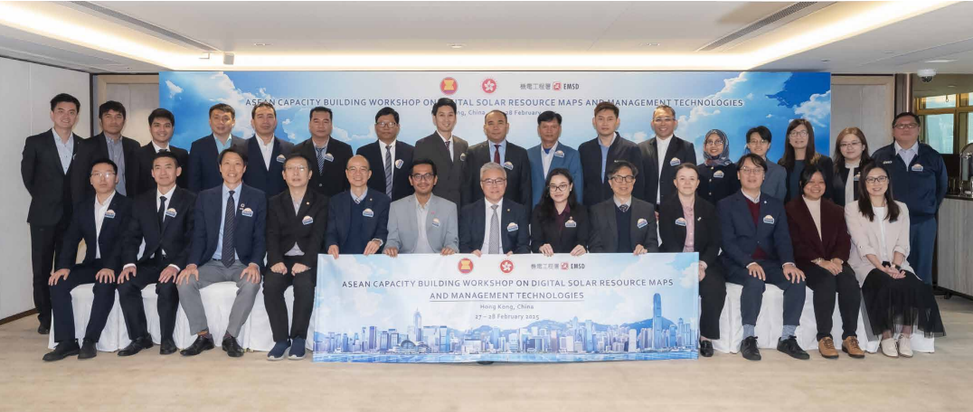
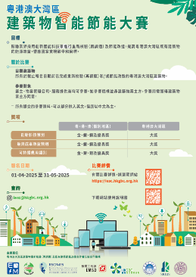
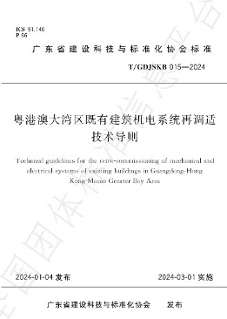
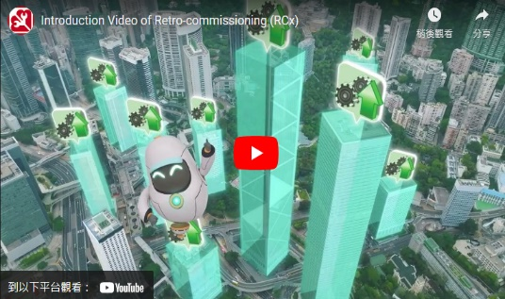
Retro-commissioning (RCx)

Slide 9

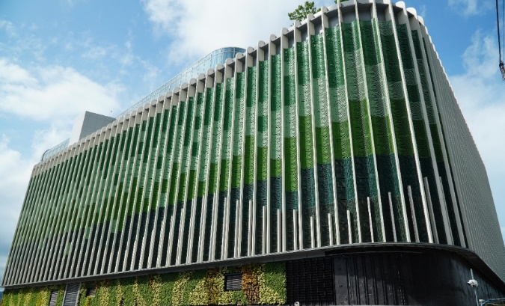
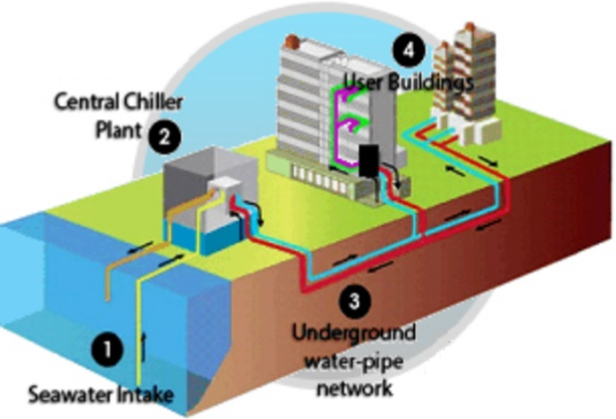
Development of DCS(1)
Government-led DCS in HK
Kai Tak DCS
Kwu Tung North, 2 Plants(190MWr)
Scheduled Operation: Q2 2026
Hung Shui Kiu Town Centre (106MW)
Scheduled Operation: end 2030
Nos. of Plant | 3 nos. (total 462 MWr)
A/C floor area | 2.54 million m²
System Efficiency | DCS consumes 35% less electricity as compared to traditional air-cooled A/C systems.
Energy Saving | Up to end 2024, saved ≈ 78 million KWhr electricity, i.e. the annual consumption of 23,800 three=person households. Reduced carbon emission ≈ 50,000 tons
Kai Tak, 3 Plants (462MWr)
Operated since: Q4 2013
Tung Chung East (123MWr)
Scheduled Operation: Q4 2027
DCS in operation
DCS in construction

Slide 10

Development of DCS(2)
Implementation mode for future DCS Projects
Encouraging Private Participation: The HK Government is exploring ways to incentivize non-government organizations and private developers to participate in constructing DCS.
Floor Area Exemption: The floor area occupied by these DCS system and related facilities will receive exemption.
Tax Incentives: The HK Government is exploring improvements to existing tax incentive arrangements.
Technical Support: EMSD will provide technical support.

Slide 11
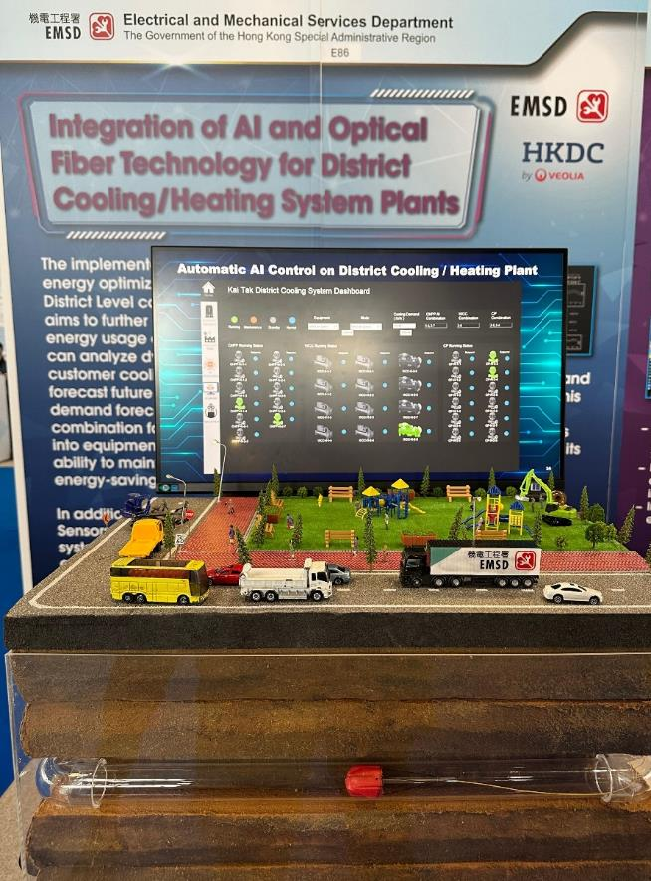
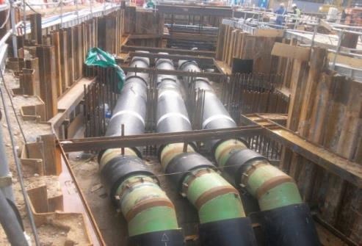


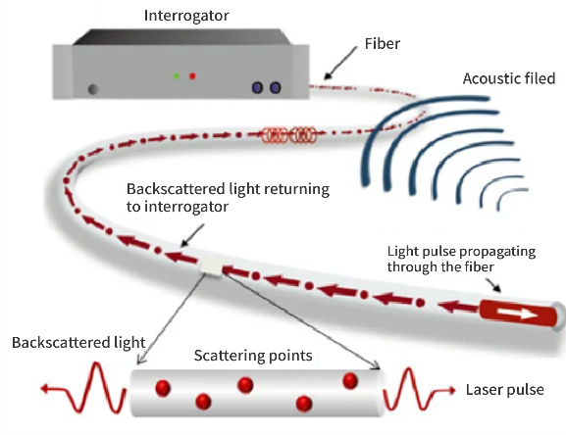
Development of DCS with AI
AI Optimisation Control
Enhance plant efficiency without scarify of plant reliability
Weather Data
Cooling / Heating Load Forecase
Data Training Models
Data Analysis
Generate Equipment Combinations
Event Schedules
Pipe Health Monitoring
Optic fiber to real-time monitor for underground pipe work
Pipe Pressure
Water Temperature
Real-time Monitoring
Leakage Detection

Slide 12


Project Update
Project No.: EWG_101_2025A
Project Title: APEC Practical Training on District Cooling and Heating Systems (DCHS)
Duration: 2-day (included 0.5 days site visit)
Tentative date: Q1 in 2026
Location: Hong Kong, China
Content cover:
1. effective long-term land use and infrastructure planning.
2. effective system design and operation
3. policies development, incentives and innovation technologies adoption.

Slide 13




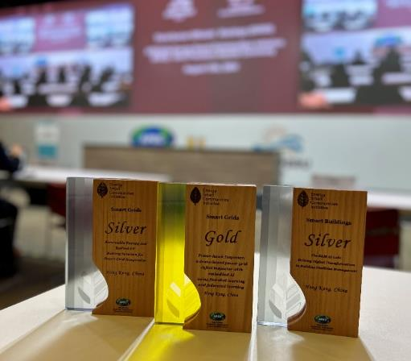


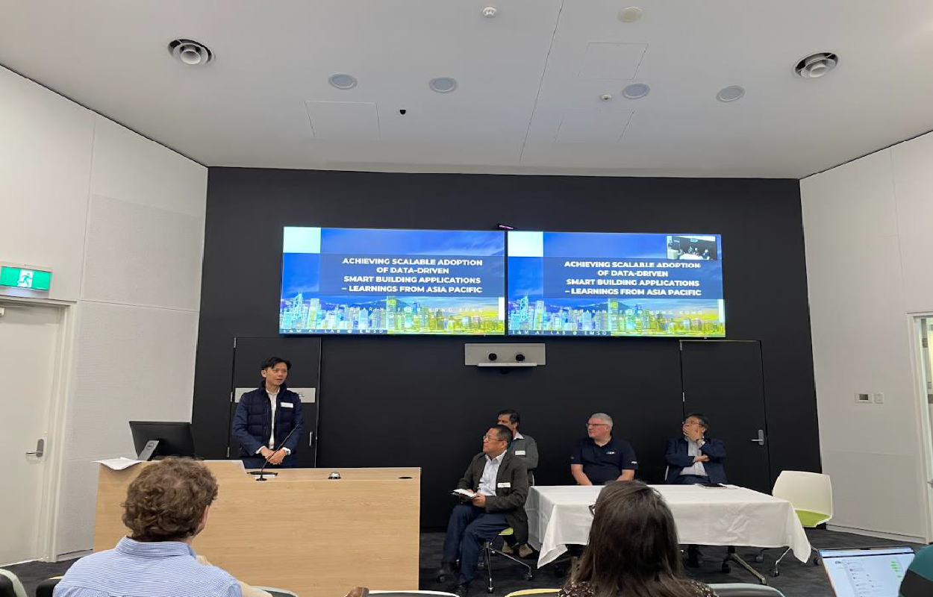
Artificial Intelligence
202
IEA Energy in Buildings and Communities Programme

Slide 14

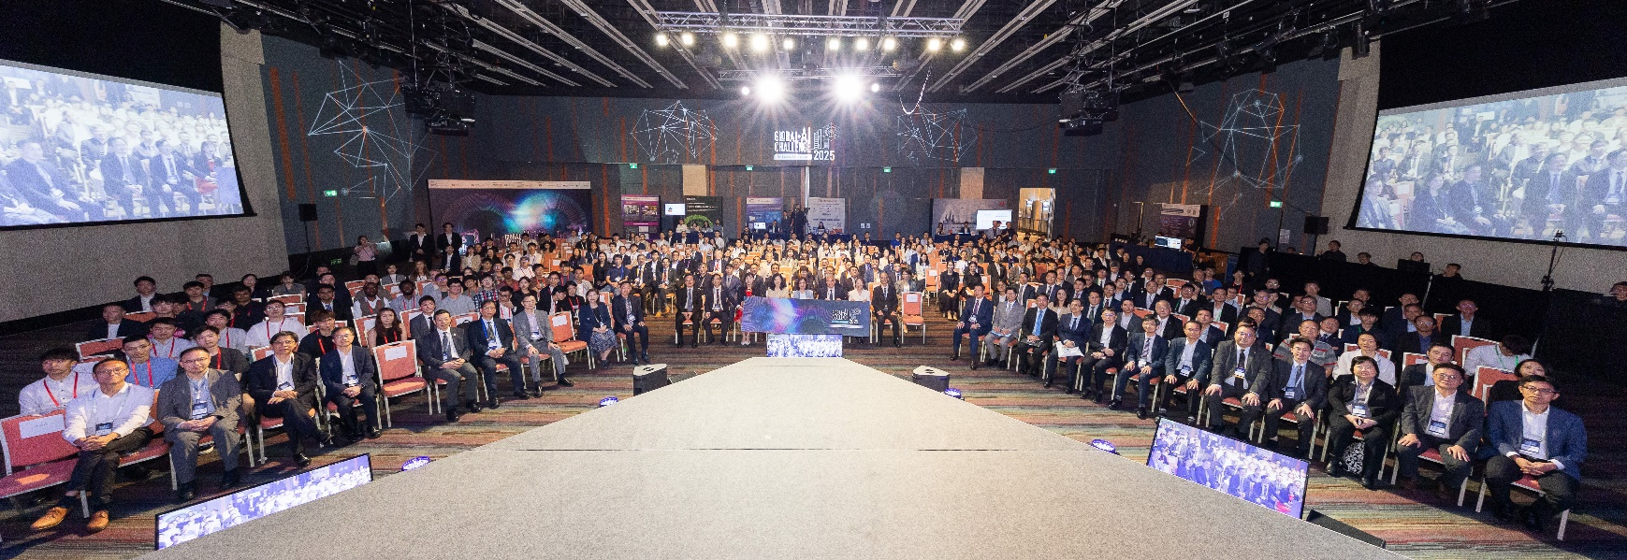


Artificial Intelligence
The Global AI Challenge for Building E&M Facilities is the world’s first and largest AI event related to building electrical and mechanical services!
IEA Energy in Buildings and Communities Programme

Slide 15


Thank You
Hong Kong, China

