Slide 1



Cross-Fora Collaboration: PPSTI + EGNRET/EWG
Concept Note Presentation
Clean & Low-carbon Biohydrogen
Building the Green Transition Pathway toward a Sustainable Tomorrow
Keng-Tung Wu, PhD
Secretary, APEC EGNRET Secretariat
Adjunct Researcher, APEC ACABT
www.apec-acabt.org
Project Overseer: Prof. Dr. Chen-Yeon CHU
Executive Secretary, APEC-ACABT

Slide 2
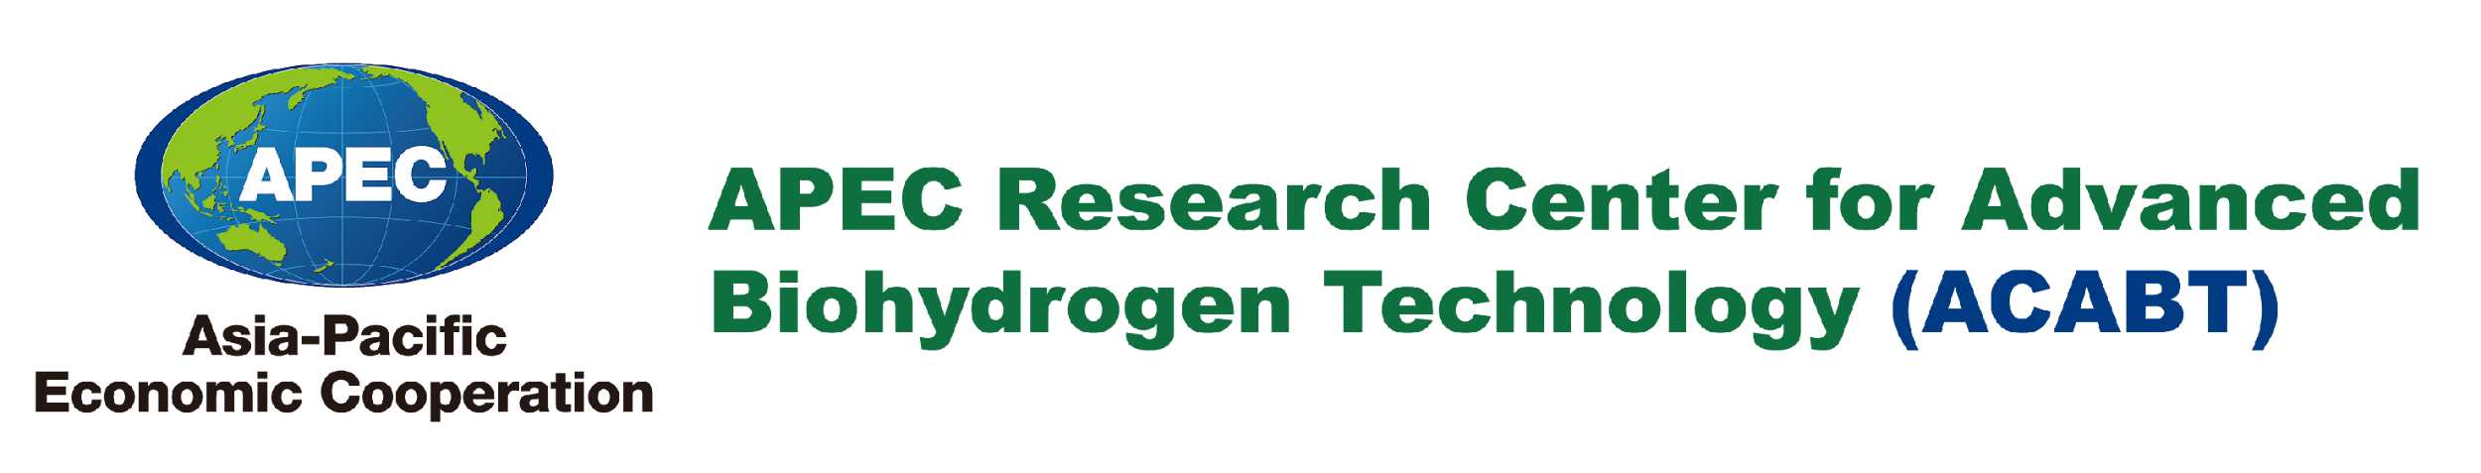
ACABT
Sep 2009
Established
ISTWG 37
Suzhou, China
Aug 2012
ISTWG
PPSTI
Jun 2016
Endorsed
APEC PPSTI CCC 1
Pohang, Korea
renamed
Introduction to APEC - ACABT
An APEC PPSTI Center
Notes:
2

Slide 3


ACABT Organization
1 Headquarters / 12 Chapters & Branches / 10 APEC Member Economies
AUG 2017
SEP 2019
NOV 2023
AUG 2017
Ha Noi Branch
Seoul Branch
California Chapter
Chongqing Branch
2025-2026
Tokyo Chapter
AUG 2022
Chiang Mai Branch
SEP 2009
Chinese Taipei Headquarters
AUG 2017
2025-2026
Khon Kaen Branch
APR 2023
Ho Chi Minh Chapter
California Chapter
Mexico Division
SEP 2024
APR 2024
Bangkok Chapter
Approved in principle
2025-2026
Manado Branch
Peru Chapter
APR 2016
SEP 2024
Malaysia Chapter
2025-2026
California Chapter
Chile Division
APR 2016
Queensland Chapter
Indonesia Chapter
Notes:
2

Slide 4
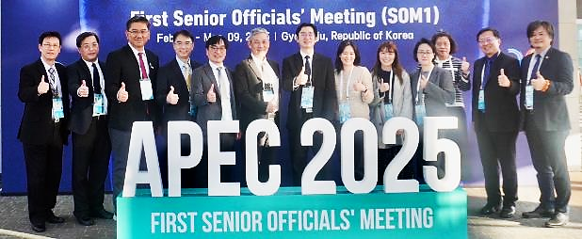
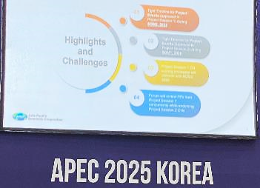
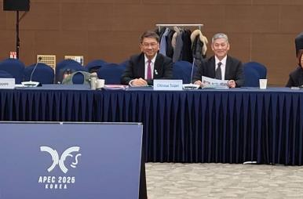

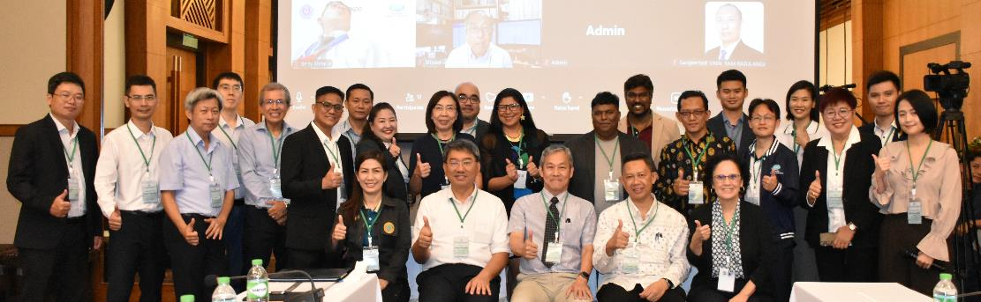
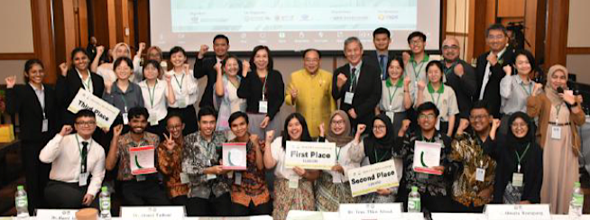



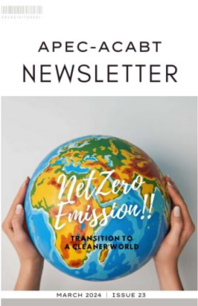
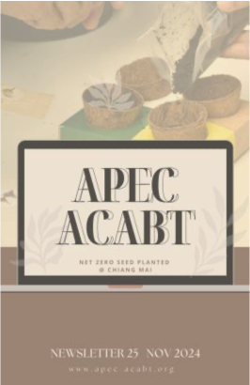
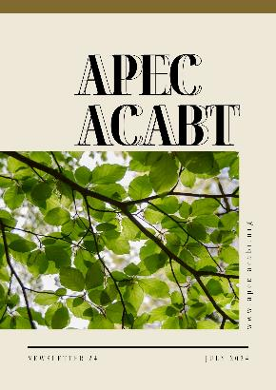
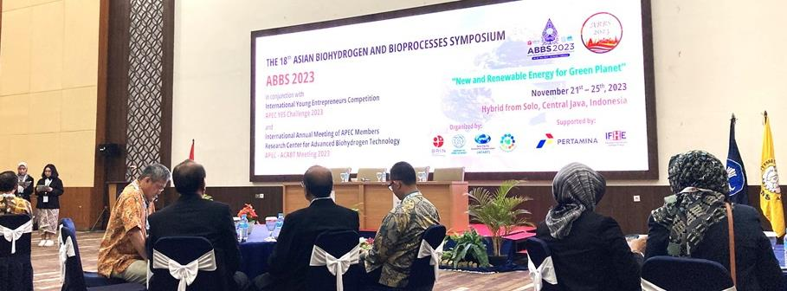


ACABT Tasks
APEC PPSTI
PPSTI 205 2023A / Sub-fund on MSMEs
PPSTI 06 2021A / Sub-fund on EELCER
PPSTI 06 2019A / Sub-fund on EELCER
PPSTI 02 2017A / Sub-fund on EELCER
Steering Committee Meeting
Capacity Building
Newsletter Publications
International Networking
z
z
Notes:
2

Slide 5
CONCEPT NOTE
Proposing Economy
Chinese Taipei
Project Term
April 2027 – June 2028
Co-sponsoring Economy
Canada; Chile; Indonesia;
Republic of Korea; Peru;
Papua New Guinea; Thailand
(Endorsing Forum: PPSTI)
Fund Source & Planned Amount
APEC sub-fund: USD 100,000 (EELCER)
Energy Efficiency, Low Carbon & Energy Resiliency Measures
(EELCER)
Self-fund: USD 50,000
Co-endorsing Forum
Energy Working Group (EWG)
Project Outputs
1. Policy Review
2. Capacity-building Event
3. Project Report
Notes:
2

Slide 6

PROJECT SUMMARY
PPSTI Strategic Plan 2026-35
EWG Lima Statement 2024
SMEWG Pucallpa Statement 2024
WHY
HOW
Policy Dialogue
Workshop
Training Course
Best Practice
Build Capacity on Clean & Low-carbon Innovation
Set up Network on Green Biohydrogen Technology
Facilitate Green Transition for Sustainable Growth
WHAT
WHO
Representative Regulators
Technological Developers
Young Entrepreneurs
APEC Fora Delegates
April 2027 – June 2028
WHEN
Notes:
3

Slide 7




OBJECTIVES
APEC Policy Guidance
to Develop and Implement Clean & Low-Carbon Hydrogen Policy Frameworks
3
1
Sustainability
Capacity
Building
To build capacity by developing skills
on clean and low-carbon innovation
To facilitate green energy transition for sustainable growth
2
Networking
To set collaborative network for stake-holders in fields of biohydrogen technology

Slide 8



APEC ALIGNMENT
APEC 2023-2025 Priorities
Enabling innovative environment for sustainable future
Collaborate and support sustainable energy transitions
Sustainable growth for resilient development
Promote the production and development of low-carbon energy source
Prosper
Accelerate transition to clean energy

Slide 9
APEC FORA ALIGNMENT
PPSTI ¹Strategic Plan 2026 - 2035 ²MOIP Pilot 2025 - 2028
Support resilience, sustainable economic growth, innovative growth, and infrastructure development by maximizing efforts to enhance capacity building.
Reduce barriers for STI networks among economies to facilitate cross-border collaboration on promoting clean and low-carbon technologies.
EWG Lima Statement (14ᵗʰ Energy Ministerial Meeting)
Accelerating clean, sustainable, just, affordable, inclusive and sustainable energy transitions through various pathways such as promoting green biohydrogen.
SMEWG Pucallpa Statement (30ᵗʰ SMEs Ministerial Meeting)
Advancing implementation of Bangkok Goals on Bio-Circular-Green (BCG) Economy model by building the capabilities of MSMEs, such as young entrepreneurs, in sustainability practices.
Notes:
APEC 2022 Bangkok Goals:
Integrate three economic approaches for using technology and innovation to create value, reduce waste, advance resource efficiency, and promote sustainable business models.
APEC 2023 United States Priorities:
Build a resilient and interconnected region that advances broad-based economic prosperity
Enable an innovative environment for a sustainable future
Affirm an equitable and inclusive future
PPSTI Strategic Plan 2016-2025
1. Enhance capacity building in innovative growth and infrastructure development through workshops and projects at individual level and institutional level in terms of knowledge, skills, and uptake of innovation outputs.
2. Promote the important role of business sector in the innovation activities in real sector, and creating innovation-friendly policy environment to facilitate various kinds of enterprises to make more achievements in innovation.
6

Slide 10
TIMELINE
1
Contract Establishment Apr 2026 - Jul 2026
Project Term
General Information Circular
Policy Review
Apr 2027 –
Jun 2028
2
Event Implementation Aug 2026 - Sep 2026
Capacity-building Event:
Policy Dialogue, Workshop, Training Course, Best Practice
3
Project Completion Oct 2026 - Jun 2027
Summary Report
Project Report
Completion Report

Slide 11
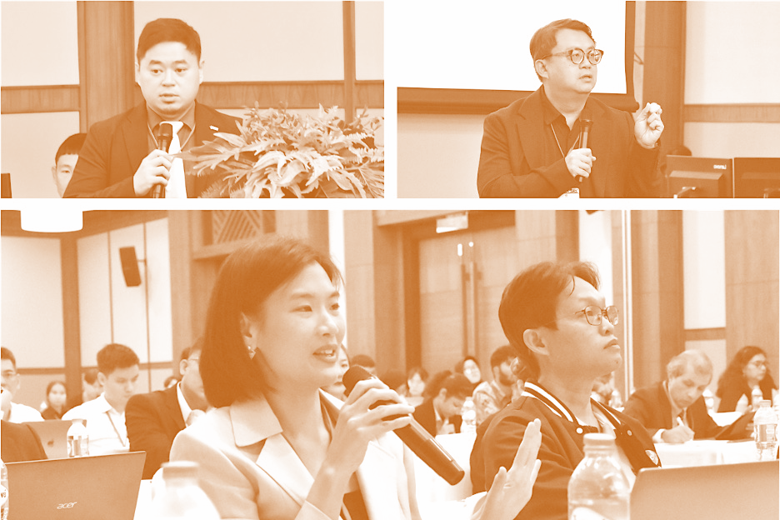
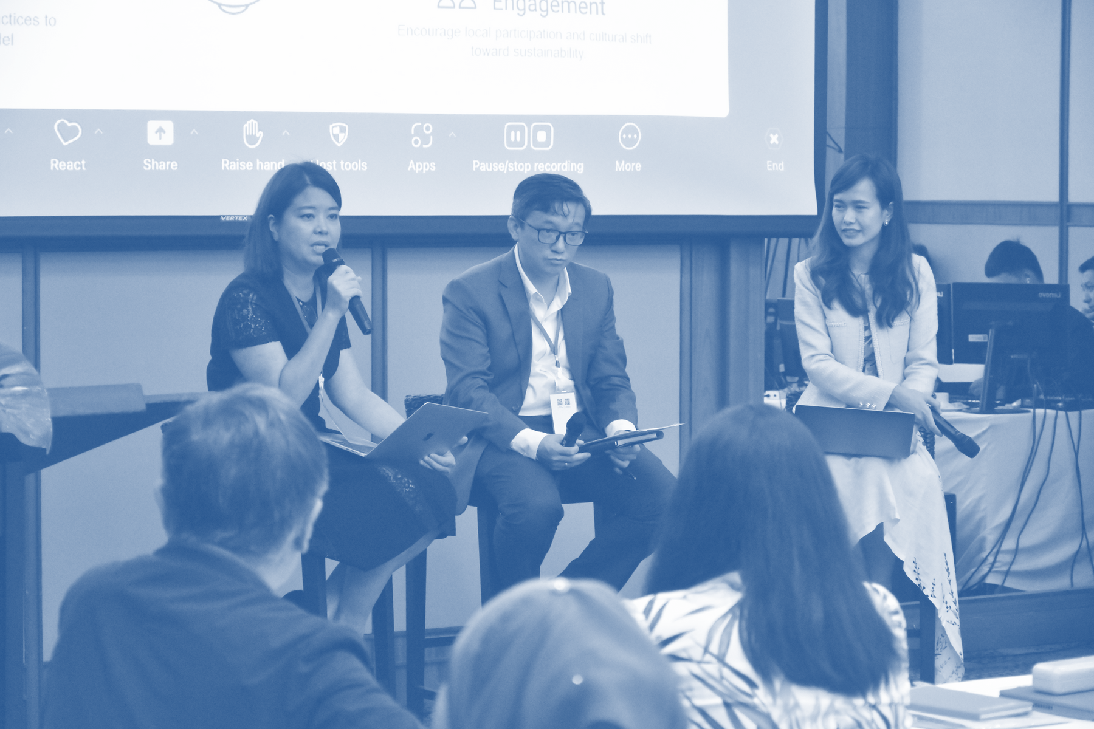





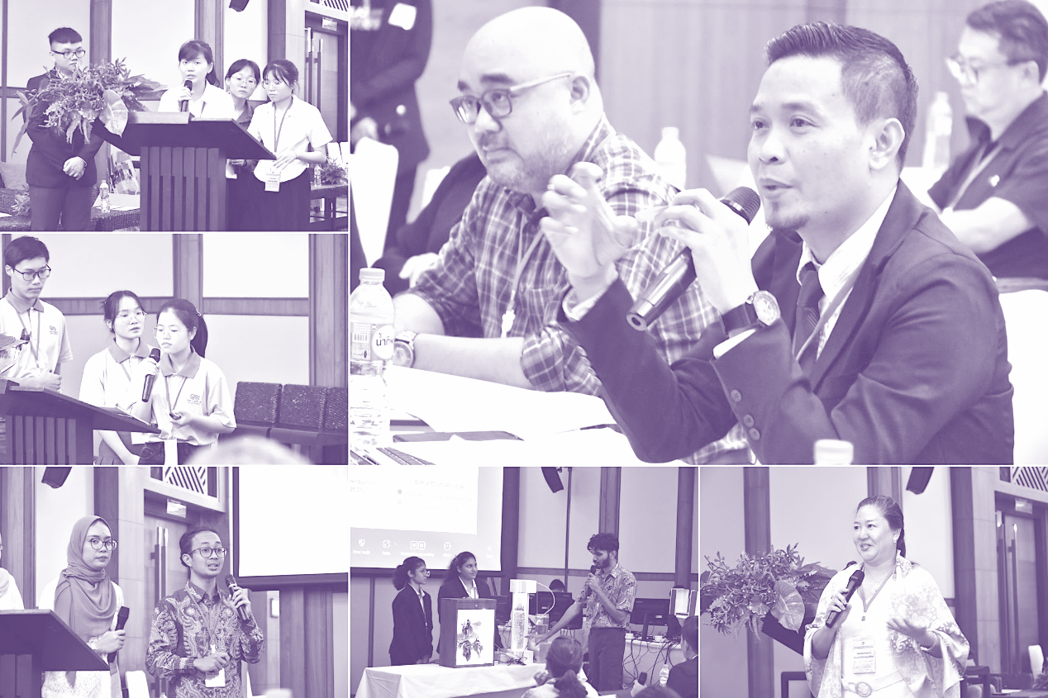
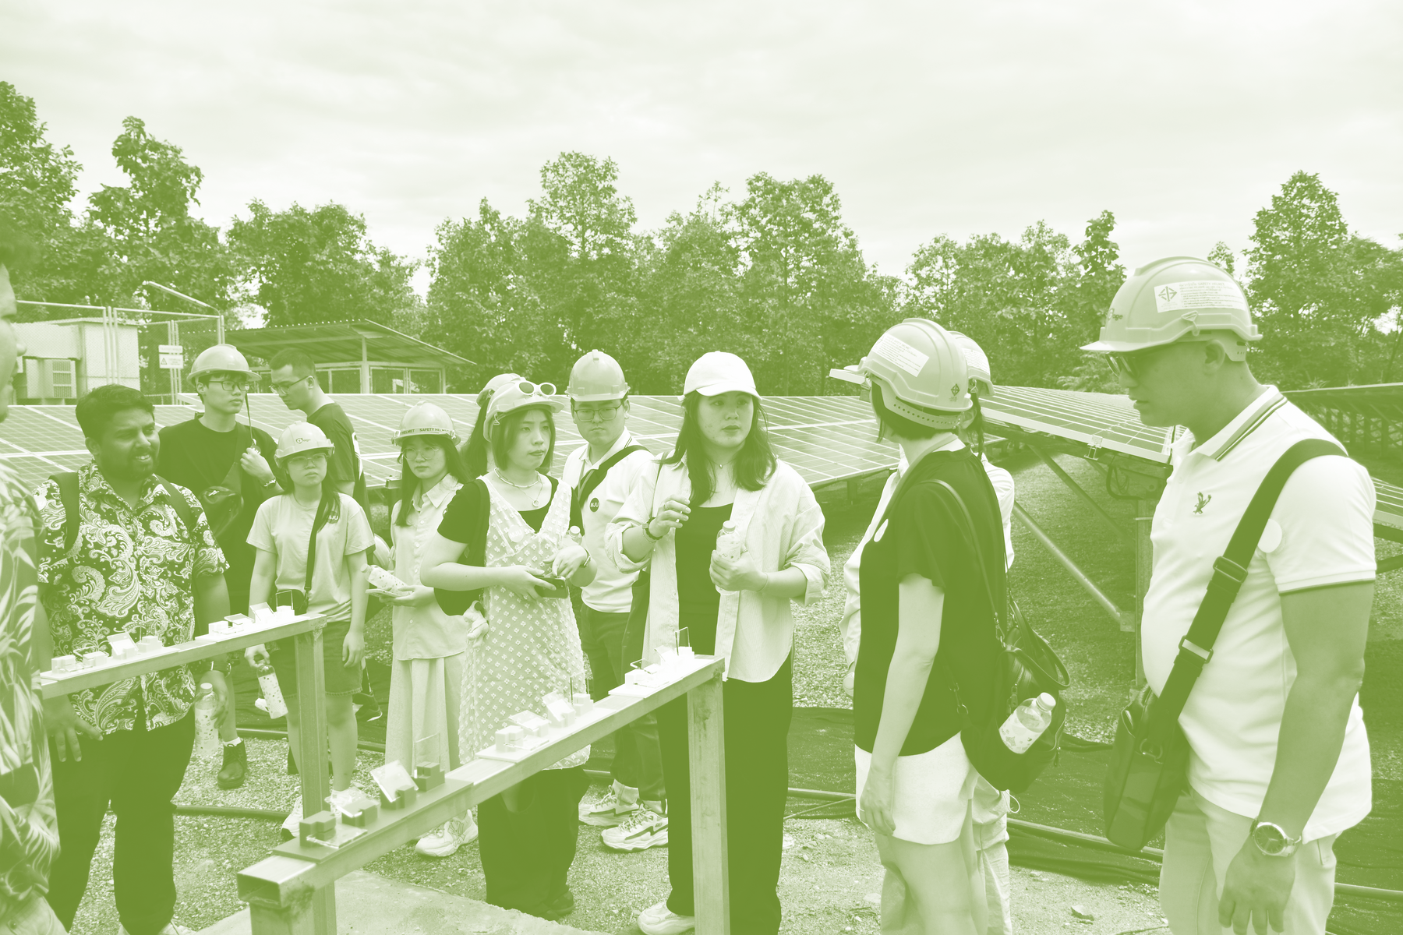
CAPACITY BUILDING
Policy
Dialogue
Regulators
from governmental agencies address clean and low-carbon hydrogen energy policy.
Technologists
from academic/research institutes share knowledge and experience biohydrogen technologies.
Workshop
Young Entrepreneurs
with STI background pitch entrepreneurial solutions to challenges of sustainability.
All Participants
explore industrial application of biohydrogen energy solutions for green transition.
Training
Course
Best
Practice
Notes:
8

Slide 12


EVALUATION
EXPECTED OUTPUTS
2 Policy recommendations
14 Attending economies
12 Travel-eligible economies
6 Event experts
40% Female participants
55% Participants’ knowledge increase
60% Developing economies’ participants’ knowledge increase
50% Female participants’ knowledge increase
Notes:
APEC 2022 Bangkok Goals:
Integrate three economic approaches for using technology and innovation to create value, reduce waste, advance resource efficiency, and promote sustainable business models.
APEC 2023 United States Priorities:
Build a resilient and interconnected region that advances broad-based economic prosperity
Enable an innovative environment for a sustainable future
Affirm an equitable and inclusive future
PPSTI Strategic Plan 2016-2025
1. Enhance capacity building in innovative growth and infrastructure development through workshops and projects at individual level and institutional level in terms of knowledge, skills, and uptake of innovation outputs.
2. Promote the important role of business sector in the innovation activities in real sector, and creating innovation-friendly policy environment to facilitate various kinds of enterprises to make more achievements in innovation.
9

Slide 13


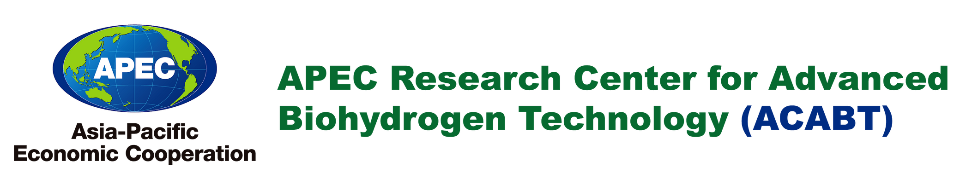

LINKAGES
PPSTI
APEC Cross-Fora
Collaboration
SMEWG
EWG
EGNRET
Notes:
10

Slide 14


Thank You Very Much for Your Attention.
APEC ACABT would like to collaborate with APEC EGNRET and other fora to develop and implement clean and low-carbon hydrogen policy frameworks across the APEC region.
C.E.O.
Prof. Dr. Shu-Yii WU
steinwu2014@gmail.com
Executive Secretary
Prof. Dr. Chen-Yeon CHU
cychu@mail.fcu.edu.tw

