Slide 1



The 65th Meeting of the APEC Expert Group on Energy Efficiency and Conservation (EGEEC 65)
Economy Update in
Chinese Taipei
(AI-Driven Energy Innovation)
17 - 20 November 2025
Directed:
Administrated:

Slide 2

AI Classification
Industrial Applications
Conventional AI
(Analysis and Prediction)
Commercial
Applications
Residential and
Grid Applications
AI
Government
Applications
Generative AI
(Creative and Generative)
ESCO Industry
Applications
Notes:
來源：
圖表：臺灣2050淨零轉型節能關鍵戰略行動計畫（草案）
能源密集度目標：能源轉型白皮書(2019.11) p.21

Slide 3




Conventional AI Overview
Data Collection
Collect extensive data on equipment operation and building energy consumption
Machine Learning Models
Equipment Power Prediction
Building Thermal Load Prediction
Equipment Fault Prediction
Algorithm Optimization
Equipment Operation Optimization
Fault Early Diagnosis
https://www.fsp-group.com/imgs/forum/240705-668769EDDE187.jpg

Slide 4


Applications of Conventional AI
Algorithmic optimization to maximize efficiency and yield, reducing energy per unit.
Use machine learning models to establish system relationships and optimize overall operation.
Process and Equipment
Control Optimization
Applications in Industrial, Commercial, and Residential Grids
Build models to detect equipment anomalies early and reduce maintenance costs.
Already implemented in multiple convenience stores and supermarkets.
Refrigeration System
Optimization and
Fault Prediction
Analyze household electricity usage with load monitoring models to improve energy efficiency.
Predict system power flow and load distribution.
Power Consumption
Analysis and
Grid Applications

Slide 5




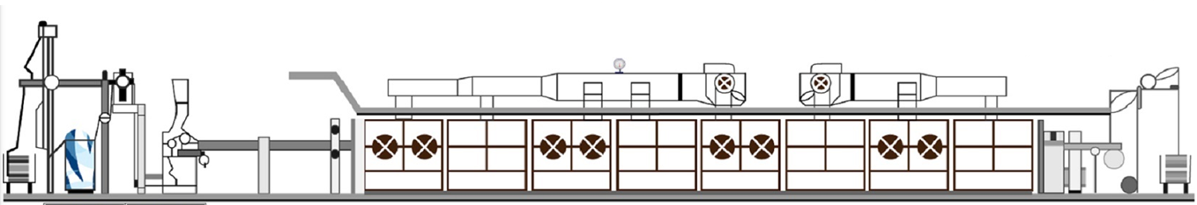
Background of Dyeing and Finishing Processes
Experienced operators adjust fabric speed, airflow, and temperature based on fabric condition and experience.
Many parameters and site conditions can lead to incorrect settings by new employees, affecting production.
Operators’ intuitive know-how is hard to quantify and transfer to trainees.
No unified platform for data management and tracking.
Database
Experienced operators’ know-how
Observe
Observe
Fabric In
Work Order Number
Fabric
Weight
Auxiliary Agent
…
Control
Fabric Out
Moisture Content
Shrinkage
…

Slide 6
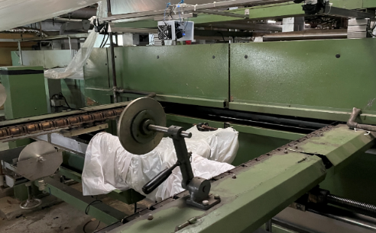
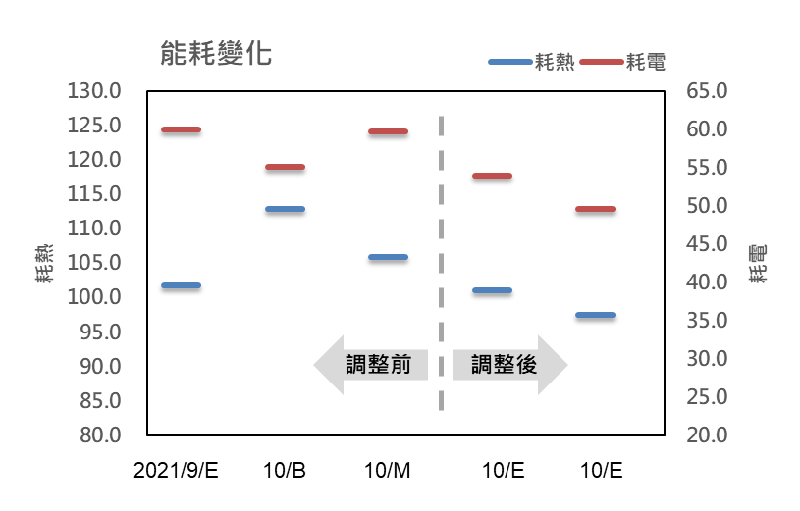
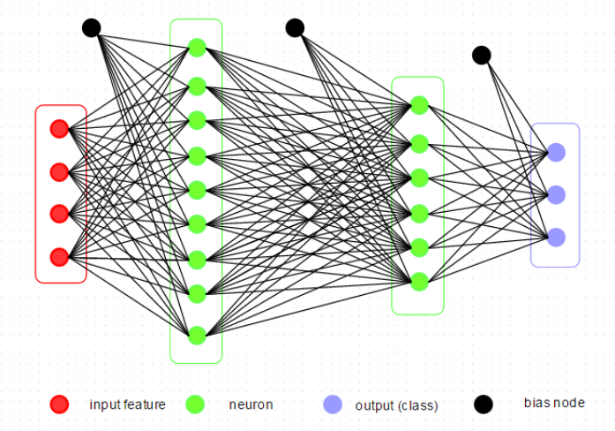
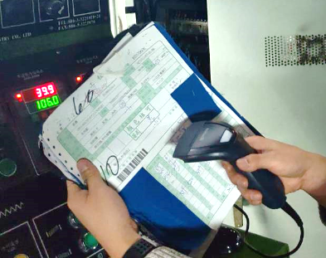
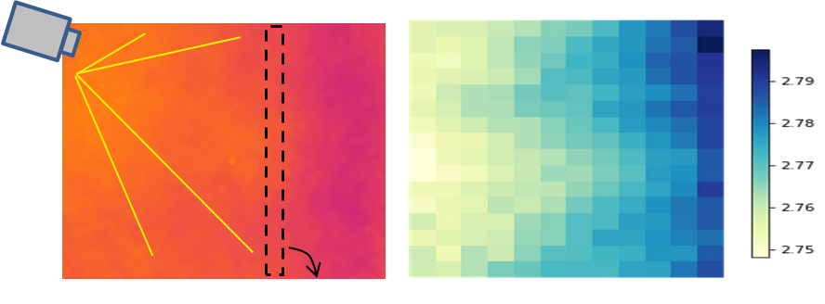
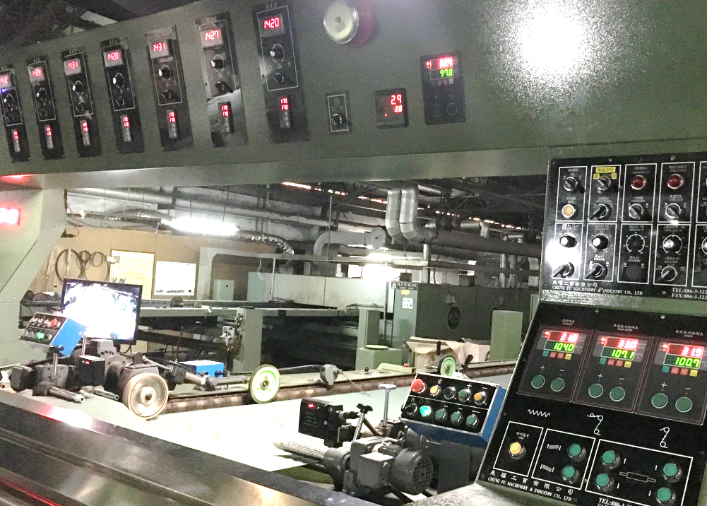
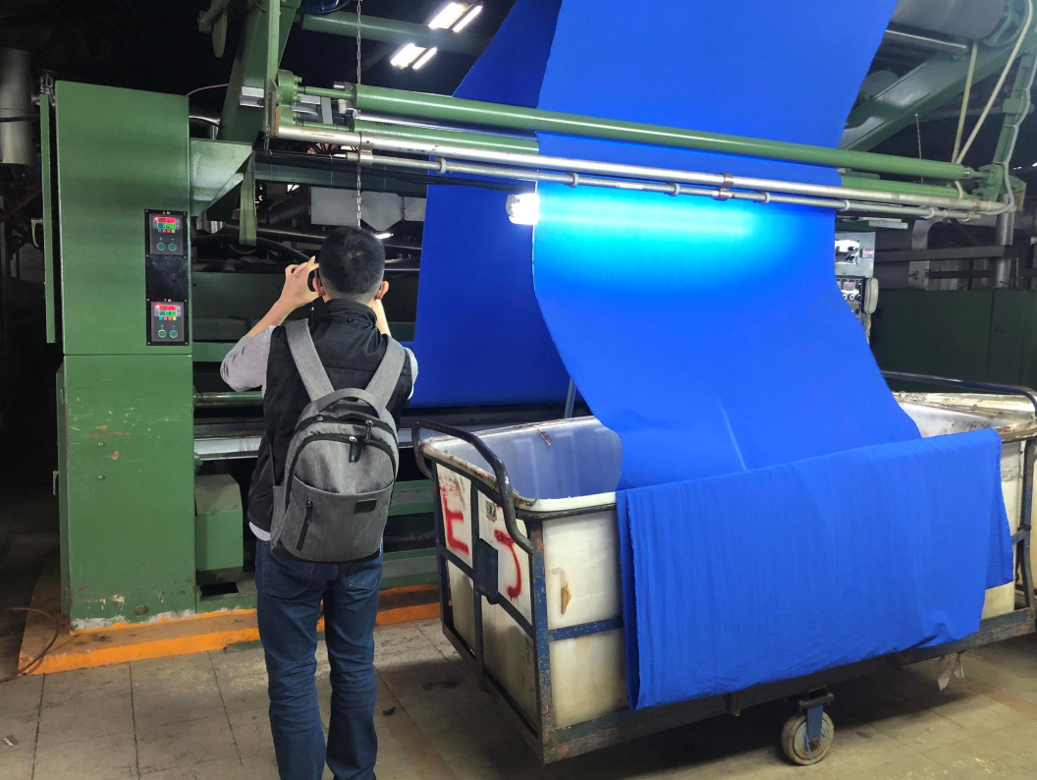
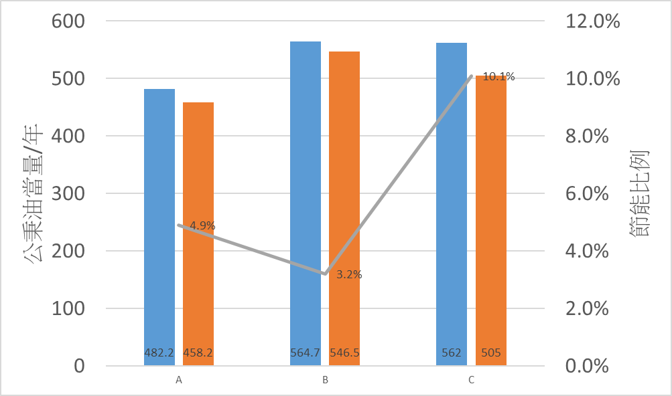
Process Energy-Saving Improvement
AIoT enhanced quality and energy management using key sensors and optimized control, reducing over-drying and rework, validated on four dyeing and finishing lines.
Smart control saved >10% energy, cut rework by 50%, reduced modeling time by 58%, and delivered ~NT$100 million in technical value.
Factory (4 lines) can save ~640,000 kWh/year, Payback Period <2 years, and reduce CO₂ emissions by 354 tons/year.
Sensing
Intelligent control
Energy saving
AIOT
Before
After
recipe
modify
Object
HiRes Sensing
3.2%
10.1%
4.9%
monitoring

Slide 7
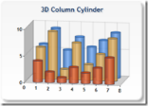
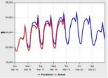




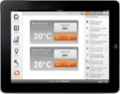
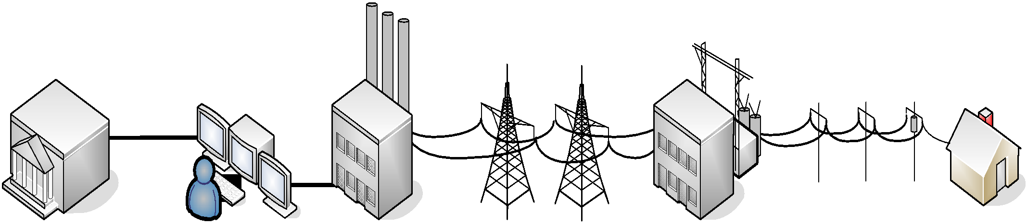
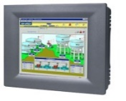

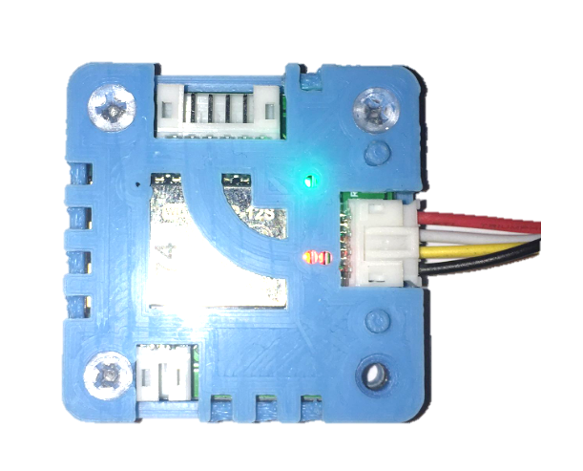


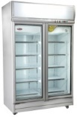

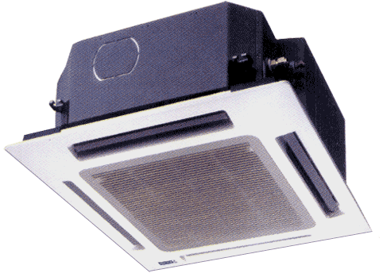
Energy-Saving Control System for Convenience Stores
Combines power data collection, energy-efficient equipment control, and value-added big data services.
Optimal HVAC and refrigeration settings are determined based on environmental changes and past experience to minimize total energy use.
Tests show HVAC and refrigeration daily energy dropped from 794 kWh to 742 kWh, achieving a 6.5% energy reduction.
Over 3,000 FamilyMart stores in Chinese Taipei have been equipped, achieving 5~10% energy savings per store.
Energy Consumption Comparison and Efficiency Analysis
Predictive Maintenance for Equipment
Cloud Server
AI
Demand Response in Smart Grid Interaction
Remote Monitoring
Intelligent Energy-Saving Equipment Control :
Refrigeration
HVAC
Lighting
EMCS Controller
WiFi
Communication Module
IoT
Equipment
Smart
Meter
Open
Refrigerators
Freezers
Lighting
HVAC

Slide 8

Thank You!

Slide 9




Generative AI Overview
Model Training
Generates text, code, images, and videos based on user input
Limitations
Generated outputs are not 100% accurate
Requires human verification
Application Types
Large General-Purpose Model (e.g., ChatGPT)
Small, specialized models, typically running locally
https://www.nss.com.tw/wp-content/uploads/2024/09/shutterstock-2510802885-scaled-1024x512.jpg

Slide 10



Applications of Generative AI
For training new employees in equipment maintenance and operations.
Model deployed at the client side to provide real-time responses to equipment issues.
Employee Training and Workforce Burden Reduction
Applications in the ESCO Industry and Government Sector
Generate various promotional materials and videos.
Become an energy-saving expert model, capable of quickly answering questions and generating documents, press releases, and briefing materials.
Energy-Saving Promotion and Expert Models
Propose innovative R&D ideas for generating new material structures.
Applicable to energy-efficient material research, promoting technological innovation.
Scientific and Technological Research

