Slide 1
SOLAR PV INDUSTRY
IN 2025
45th APEC EGNRET Meeting,
Xiamen China, Nov. 18th, 2015
Alan Xu, 2015.11

Slide 2
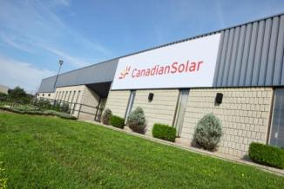
Top Solar Company in The World
Founded in Ontario, 2001
Listed on NASDAQ (CSIQ) in 2006
Over 8,600 employees globally
Global footprint in 90 countries
A leading solar company with the most prudent operation
2014 Revenue
2.96 Billion
Proven project development track record and 9.2 GW project pipeline
2014 Shipment
3.1 GW
Strong bankable brand with global reach
2015 Shipment Guidance
4.0~4.3 GW
Best product warranty backed by investment grade insurance policy
Accumulated modules, projects and systems sales above 12 GW
2

Slide 3
Global Network for Production, Sales & Service
Guelph, Canada
Global Headquarters
London, UK Sales Subsidiary
Munich, Germany EMEA Headquarters
Madrid, Spain Sales Subsidiary
Ankara, Turkey Sales Team
Seoul, South Korea Sales Subsidiary
Framingham, US Sales Subsidiary
Abu-Dhabi
Sales Subsidiary
Suzhou, China Subsidiary
Tokyo, Japan Subsidiary
San Ramon, US Canadian Solar Inc.
Panama
Sales Subsidiary
India
Sales Subsidiary
Thailand
Sales Subsidiary
Philippines
Sales Subsidiary
Singapore
Sales Subsidiary
Vietnam
Module Factory
Brazil,
Sales Subsidiary
Johannesburg, South Africa Sales Subsidiary
Australia Sales Subsidiary
Chile,
Sales Subsidiary
3

Slide 4
Abstract
The shortage of energe resources and environmental pollutions have been calling a global energy transition, to be sustainable and to be clean. PV energy completely suits these both requirements. And the history of PV industry has proven to the world that PV energy has the capability to push this change
Technology innovations has significantly cut the LCOE of PV generation, and the reduction of costs will continue in the future due to the development of new technologies, intelligent manufacturing, increasing produciton scale, government incentives and so on. Therefore, PV application domain will expand at a even more rapid pace
China has been a giant in both PV production and application. With the direction of “Intelligent PV Manufacturing 2025”, Chinese PV industry sets the whole sale grid parity as the goal by 2025 to provide the public with clean and intelligent energy at a fair price

Slide 5
Table of Contents
Benefits of PV Energy
Developments in PV Technologies
Outlook and Development
Developments within the Chinese PV Industry

Slide 6
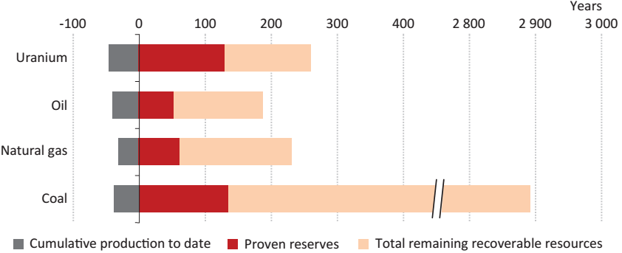
Solar Energy is Infinite
1.1 Renewable & Clean
Amount
173,000TW ~ 6 million tons per second, Standard Coal
Longevity
5 billion years vs. < 150 years , the proven reserve of Coal
Source: World Energy Outlook_2014_International Energy Agency

Slide 7
Energy Payback Period is Short
1.1 Renewable & Clean
Energy Consumed
621 kWh (260 W silicon module, 2012 )
Energy Produced
 | Irradiance Region I | Irradiance Region II | Irradiance Region III
The Gross Generation in a Life Cycle | 12241 kWh | 9728 kWh | 7956 kWh
Annual Generation | 490 kWh | 389 kWh | 318 kWh
Energy Payback Period | 1.25 years | 1.6 years | 2.0 years
Source: Carbon footprint report_2012_Intertek
Notes:
一类地区：3200-3300 小时；二类地区：3000-3200；三类地区：2200-3000小时

Slide 8
Carbon Emission is Low
1.1 Renewable & Clean
Pressure to be Green
Energy Industry, the largest source of GHG emissions, 69%
One Solution
PV power generation, carbon emission, only 2.5% of Coal power
Source: CO2 Emissions Overview_2012_International Energy Agency
Source: Carbon Footprint Report_2012_Intertek

Slide 9
Installation Expanded at a High Speed
1.2 Fast Growing
2009~2014, the global solar module installation, 30GW/year
Source: Global Market Outlook for Photovoltaics 2014-2018_2014_ EPIA

Slide 10
Feed-in-Tariff Dropped Dramatically
1.2 Fast Growing
2005~2015, Feed-in Tariff in Germany decreased 80%, 43 8.7 ct/kWh
80%
Source: Current and Future Cost of PV_2015_Fraunhofer ISE

Slide 11
Development Potential is Unlimited
1.2 Fast Growing
Germany
China
2013,
< 0.12 € / kWh
( 1450-2000 kWh/m²a,
All PV power plant types )
2025,
0.059 € / kWh
( 2000 kWh/m²a,
Utility-scale power plants )
whole sale grid parity
2030,
0.043~0.064 €/kWh
(High solar irradiation)
Source: Levelized Cost of Electricity Renewable Energy Technologies_2013_Fraunhofer ISE

Slide 12
Table of Contents
Benefits of PV Energy
Developments in PV Technologies
Outlook and Development
Developments within the Chinese PV Industry

Slide 13
Table of Contents
Benefits of PV Energy
Developments in PV Technologies
1. Crystalline Silicon Technologies
90%
2. Thin Film Technologies
3. Concentrator PV Technologies
4. Other Technologies

Slide 14
Modified Siemens Process Technology
Significantly Cut the Costs — silicon material
2.1 Crystalline Silicon Technologies
Key technology, improved, based on the traditional Siemens method
Expanded reactor accommodates more pairs of rods
Low-temperature hydrogenation replaces high-temperature hydrogenation
Power consumption 75%， One-time conversion rate 5%
 | Low-temperature hydrogenation | High-temperature hydrogenation
Operating pressure | 2.5~3.0 MpaG | 0.6 MpaG
Operating temperature | 500~550℃ | 1250℃
Reaction principle | Si + 3SiCl₄ + 2H₂ = 4SiHCl₃ | SiCl₄ + H₂= HCl + SiHCl₃
Power consumption | 0.8~1.2 kWh/ kg·Tcs | 3.5~4.5 kWh/kg·Tcs
One conversion rate | 25% mol | 15~20% mol
Source: GCL New Energy

Slide 15
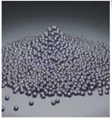
Fluidized Bed Rector Manufacturing Technology
will Continue to Reduce the Costs — silicon material
2.1 Crystalline Silicon Technologies
A more recent alternative technology, producing granular polysilicon
Simple process, low investment, low power consumption and low operation costs
Over 95% one-time conversion rate for silane gas
High recycling rate of main reacting materials
Continuous operation of FBR and thus higher production efficiency
Silicon particles
Source: GCL New Energy

Slide 16
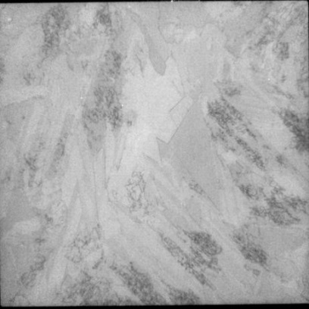
Modified High-Efficiency Ingot Casting Technology
Greatly Increased the Quality — silicon wafer
2.1 Crystalline Silicon Technologies
Improved technology based on polycrystalline ingot casting process, with homogeneous or heterogeneous seeds to optimize the wafers’ grain structures
Similar energy consumption, but much better quality
Lower density of defects, thus higher conversion efficiency of solar cells
Traditional poly wafer
High Efficient poly wafer
Source: GCL New Energy

Slide 17
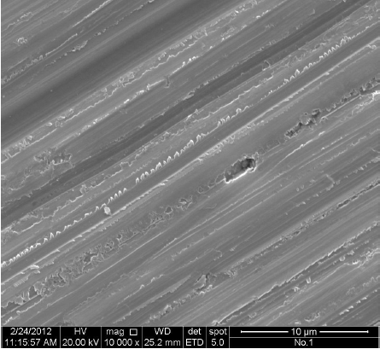
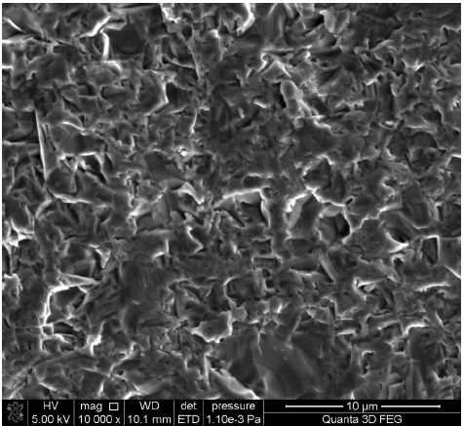
Diamond Wire Saw Slicing Technology
will Bring a Substantial Decline to Costs — silicon wafer
2.1 Crystalline Silicon Technologies
Mainstream for mono wafer, but poly wafers cut by this technology are incompatible with current mainstream cell processes
Advantages (vs. traditional slurry-based cutting technology):
Faster cutting speed, 2-3 times
More stable production, less cutting waste
More uniform thickness, less surface damage
A wafer cut by diamond wire
A wafer cut by slurry

Slide 18
Efficiency has Made a Big Rise — cell
2.1 Crystalline Silicon Technologies
2009~2015, the average annual efficiency increase rate, 0.4%/year ; This rate will continue, tracking the development of technology and the implementation of intelligent manufacturing
sheet resistance rose from 60ohm/sqr to 90ohm/sqr
the width of fine grid lines decreased from 80um to 40um
the number of main grid lines increased from 3 to 4
the quality of silicon improved much
MCCE, PERC........

Slide 19
Future Developments of Cell Technologies — cell
Traditional Poly
P
Nano texture black silicon
P
Nano texture black silicon +PERC P
2.1 Crystalline Silicon Technologies
Medium and long term
19.5%
~
19.8%
20.5%
~
20.7%
22%
~
23%
22%
~
23%
18.0%
~
18.3%
18.5%
~
18.7%
19.3%
~
19.5%
Mono
P
Mono + PERC
P
Mono + IBC
N
Mono + HJT
N
Short term

Slide 20
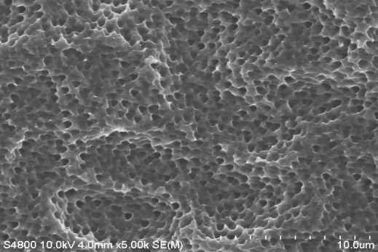
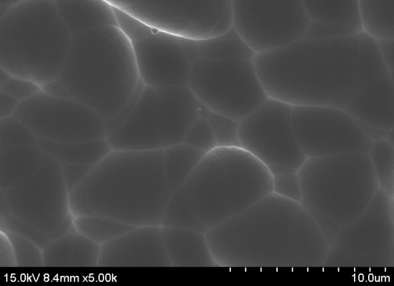
Nano Texture Black Silicon Technology — cell
2.1 Crystalline Silicon Technologies
At the end of 2014, Canadian Solar was the first to realize its industrialization production
Advantages (vs conventional texturing technology):
Lower reflectivity, higher current and increase in efficiency by 0.5%
No longer a problem for diamond wire sawn wafers
Better low-light performance
A wafer textured by conventional tech
A wafer textured by nano
texture black silicon tech

Slide 21
Passivated Emitter Rear Contact Technology — cell
2.1 Crystalline Silicon Technologies
Two-sided passivation, reducing the surface recombination velocity on the back side
Advantages (vs passivation only on the front surface):
Lower minority carrier recombination rate, larger output voltage
Higher back surface reflection, larger output current
Poly cells (nano texture black silicon + PERC) reach efficiency of 19.3% - 19.6% in mass production, mono PERC cells reach efficiency of 20.5% - 20.8%

Slide 22
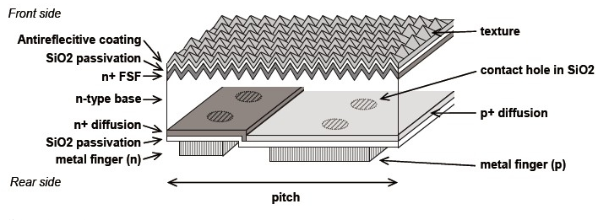
Interdigitated Back Contact Technology — cell
2.1 Crystalline Silicon Technologies
With electric contacts on the back side, increasing sunlight absorption on the front surface
Advantages (vs conventional cells with electric contacts on both surfaces):
No shadowing on the front surface of cells, larger output current
Bigger percent of back electrode contact area, smaller series resistance
Mass production efficiency is expected to reach 22.0% - 23.0%, and laboratory efficiency above 25.0%

Slide 23
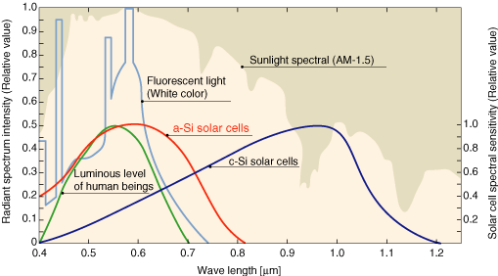
Si-Based Heterojuction Technology — cell
2.1 Crystalline Silicon Technologies
A material with different bandgap to silicon, to increase light absorption
Advantages (vs silicon homojunction cells):
Wider absorption band
Larger output current and voltage
30% higher power output in desert areas per year
Mass production efficiency reaches 22.0-23.0%, laboratory efficiency reaches 25.6%

Slide 24
Si-Based Heterojuction Technology — cell
2.1 Crystalline Silicon Technologies
PERC technology will be the winner, followed by IBC and Si-HJT

Slide 25
Power has Increased at a Rate of 7.5W/year —module
2.1 Crystalline Silicon Technologies
2009~2015, the average annual power increase rate of 60-cell crystalline silicon PV modules, 7.5 W/year
This rate will continue, tracking the improvements in cell efficiency
and module component materials

Slide 26
Increasing the Automation Level of Production
Helped Improve Quality and Reduce Costs — module
2.1 Crystalline Silicon Technologies
By 2014, module production in China had been experienced 3 stages
“Intelligent PV Manufacturing 2025” will direct the Chinese solar manufacturing processes to the application of information technology and artificial intelligence, thus quality will be further improved and costs be further reduced

Slide 27
Next Generation Modules with Double-Glass
Extend the Lifespan to 30 Years — module
2.1 Crystalline Silicon Technologies
Glass sheets in both sides, to meet harsher weather conditions
Advantages (vs modules with polymer backsheet):
Better mechanical performance, more efficient self-cleaning
Stronger resistance to sand and moisture corrosion
Ideal for building integrated PV systems (BIPV)
Superior UV resistance, Lower potential induced degradation (PID)
A longer lifespan of up to 30 years, 21.5% more power output
21.5% more energy output during the life cycle

Slide 28
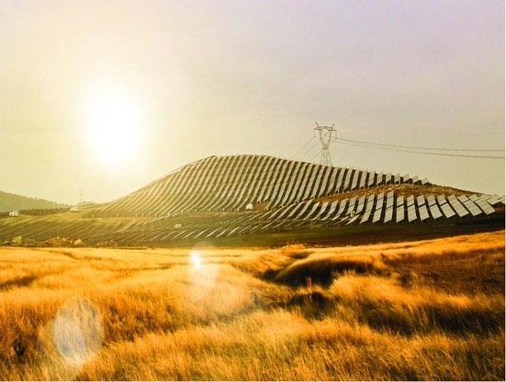
Projects of Double-Glass Modules — module
2.1 Crystalline Silicon Technologies
Double-glass modules are the next generation of solar modules
Location: Luoyang, Henan
Completion: August 2008 Canadian Solar’s BIPV power plant
Location: Nanping, Fujian
Completion: December 2014
Canadian Solar’s power plant with double-glass modules

Slide 29
CIGS Thin Film Technology
2.2 Thin Film Technologies
The highest efficiency among all thin film technologies, 23.3% in lab
Advantages (vs other thin film technologies):
Less defects in CIGS crystal, more stable performance
A lower degradation rate and a stronger low-light performance
AR coating
ZnO
N-CdS
p- CIGS absorber
Sputtered Mo
Substrate

Slide 30
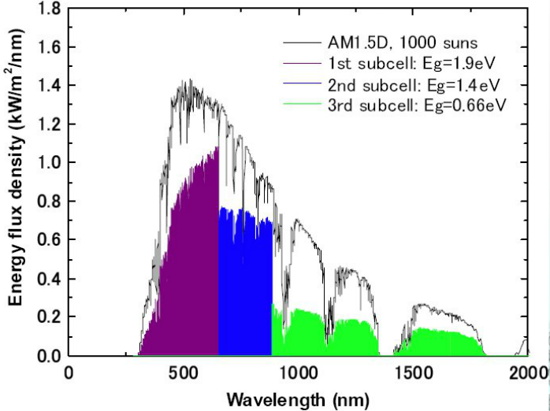
GaAs Multi-Junction Technology
2.3 Concentrator PV Technologies
Lenses and curved mirrors are used to concentrate the sunlight,
Multiple sub cells stack on the top of each other
Advantages (vs other technologies):
Much wider absorption band
Much higher conversion efficiency, 46% when concentrated 297 times
Cell1 （Eg1)
Eg1>Eg2>Eg3
Cell2 （Eg2)
Cell3 （Eg3)

Slide 31
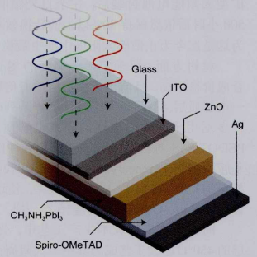
Perovskite Thin Film Technology
2.4 Other Technologies
Efficiency increased dramatically in 5 years , 3.8% 16.2%
Advantages (vs. other technologies):
High extinction ratio
Relatively easy to make the film by spin coating
Less chance for photon induced carriers to recombine
The laboratory efficiency is as high as 20.1%, but not stable

Slide 32
Table of Contents
Benefits of PV Energy
Developments in PV Technologies
Outlook and Development
Developments within the Chinese PV Industry

Slide 33
Technological Developments are the Cornerstone
3.1 LCOE will Continue to Decrease
The selling price of 320W one-sided modules is 30% higher, but its LCOE is still 10% lower; the more efficiency the back side of bi-facial module contributes, the lower the selling price will be

Slide 34
Intelligent Manufacturing Reduces Production Costs
3.1 LCOE will Continue to Decrease
The manufacturing level of PV equipment
By now,
Automation development
has effectively reduced manufacturing costs
To 2025,
Artificial intelligence & Information technologies
will lower LCOE even further

Slide 35
Intelligent Manufacturing Reduces Production Costs
3.1 LCOE will Continue to Decrease
The manufacturing level of PV equipment
By now,
Automation development
has effectively reduced manufacturing costs
To 2025,
Artificial intelligence & Information technologies
will lower LCOE even further

Slide 36
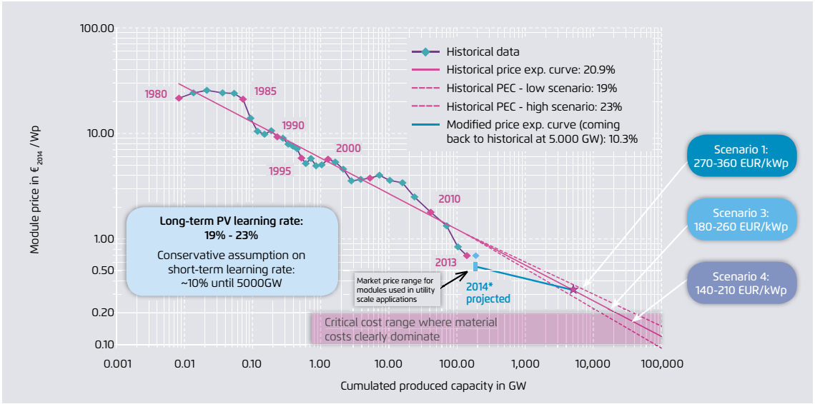
Enlarged Production Scale Reduces LCOE
3.1 LCOE will Continue to Decrease
Solar module prices decrease with the increase of production scale
Source: Current and Future Cost of PV_2015 _Fraunhofer

Slide 37
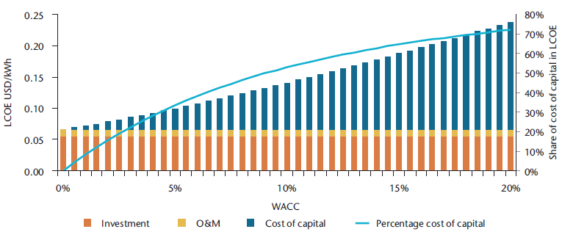
Government Incentives will Help Drive Down LCOE
3.1 LCOE will Continue to Decrease
Policy types |  | PV industry needs
1 | Financial policy | Long term, stable low capital cost
2 | Grid connection policy | Simplified grid connection policies and zero connection costs
3 | Approval policy | Simplified approval process and zero approval costs
4 | Land use policy | Well defined and low-cost land use policy
Source: Technology Roadmap Solar Photovoltaic Energy_2014 _IEA

Slide 38
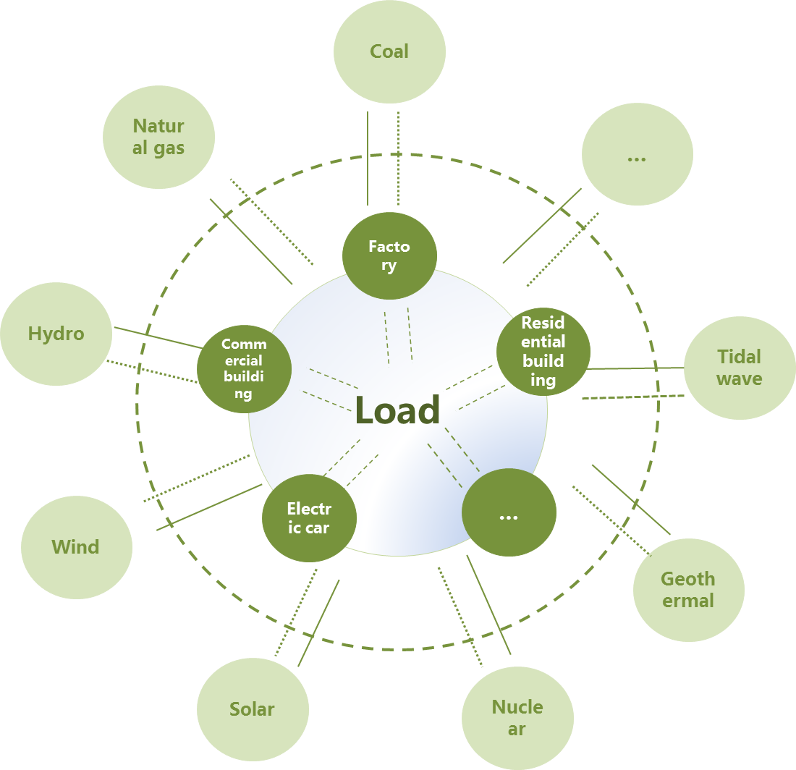
The Global Power Grid will be Transformed into
an Energy Sharing Network
3.2 The Development of an Energy Internet
will Help Reduce PV Energy Curtailment

Slide 39
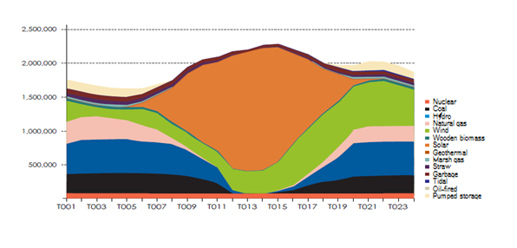
The Intermittency and Volatility of PV Generated
Electricity can be Adjusted and Managed
3.2 The Development of an Energy Internet
will Help Reduce PV Energy Curtailment
Source: China 2050 high renewable energy penetration scenario and roadmap study_2050
_ the National Development and Reform Commission's Energy Research Institute

Slide 40
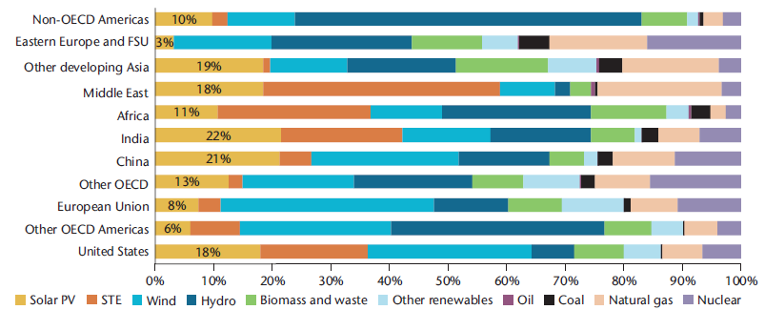
The Forecast Data of PV Proportion Goes Up
3.3 Solar PV Power
will Have a Higher Level of Penetration
2010,
IEA
By 2050, the global PV power percentage, 11%
2014,
IEA
By 2050, the global PV power percentage, 16%
In China, it will be 21%
Source: Technology Roadmap Solar Photovoltaic Energy_2014 _ IEA

Slide 41
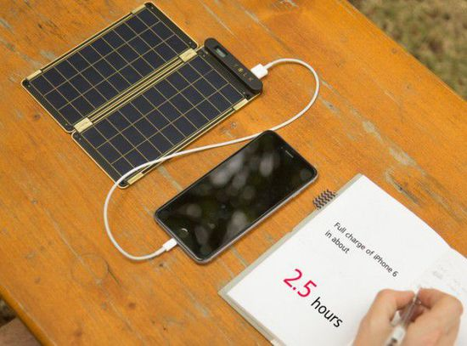
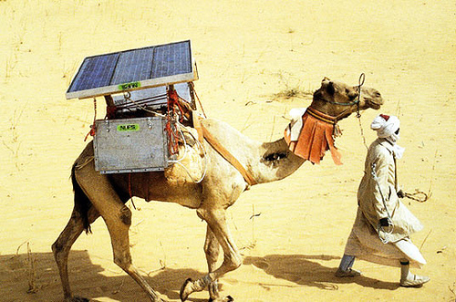
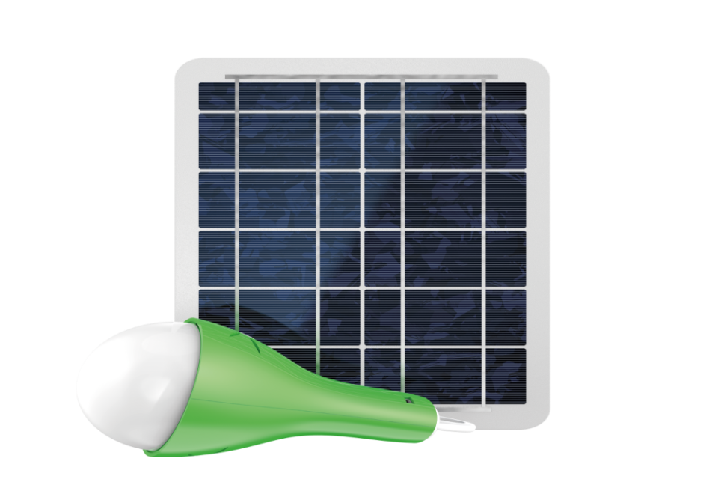
All Kinds of Environments and Uses
3.4 PV Applications
will Become Increasingly Diverse
For basic daily energy needs in rich areas
For basic daily energy needs in poor areas
For special energy needs in deserts
LED light charger

Slide 42
Table of Contents
Benefits of PV Energy
Developments in PV Technologies
Outlook and Development
Developments within the Chinese PV Industry

Slide 43
A Manufacturing Giant
Since 2007, the Chinese PV industry had been keeping its leading position
4.1 China has Become the PV Leader
in Both Production and Application
Source：The Current Status and Outlook of
the Chinese PV Industry_ 2015
_ China PV Industry Association

Slide 44
The Power of Application
Global PV installation in 2014
4.1 China has Become the PV Leader
in Both Production and Application
The Chinese domestic market has grown at a surprising pace
Source：The Current Status and Outlook of the Chinese PV Industry
_ 2015 _ China PV Industry Association

Slide 45
Three Stages of Intelligent Manufacturing in China
4.1 China has Become the PV Leader
in Both Production and Application
Automation, 2005~2015
Completely replace simple manual operations
Partly replace complex manual operations
Lower labor cost and quality cost
Intelligentization, 2015~2020
Intelligentize and interconnect equipments
On-line control production processs
Analyze the data through information and communication technology
Cut quality and management costs
Informatization, 2020~2025
Remotely and centrally control the production process
Collaboratively manage information in the whole industry chain
Cut costs of administration, logistics, service and financing

Slide 46
New Innovation Systems will be Built
4.2 Intelligent Manufacturing will Help the
Chinese PV Industry Become Powerful
The government needs to help build an open innovation platform
PV Industry
Raw material suppliers
Equipment manufactures
Technology research institutes
Organizations for standardization
Government &associations
Market research instittutes

Slide 47
Whole Sale Grid-Parity will be Achieved
4.2 Intelligent Manufacturing will Help the
Chinese PV Industry Become Powerful
With the implementation of “Intelligent PV Manufacturing 2025”,
the costs of PV plants will be reduced to RMB 4.0 per Watt

Slide 48
Thanks !

