Slide 1
USA Clean Energy Update
EGEEC -49/EGNRET-48
Jeju, Republic of Korea
March 27-31, 2017

Slide 2
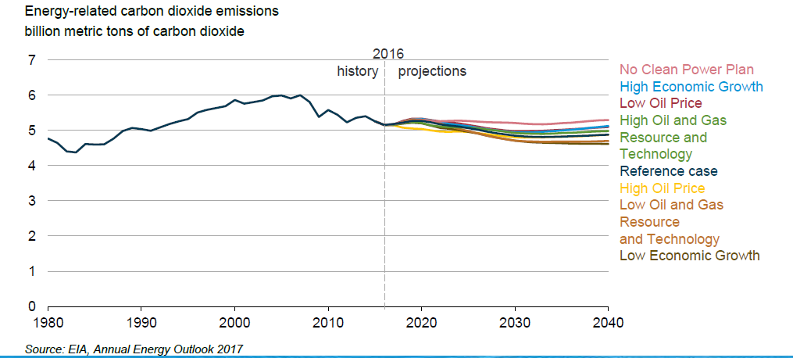
U.S. Energy related carbon dioxide emissions decline in most Annual Energy Outlook (AEO) cases, with the highest emissions projected in the No Clean Power Plan case
January 5 2017: https://www.eia.gov/pressroom/presentations/sieminski_01052017.pdf

Slide 3
The U.S. has implemented a number of cross-cutting clean energy projects over 2016-2017 (1)
Announcement that U.S. Federal Government facilities exceeded the President’s Performance Contracting Goal by entering into energy efficiency and renewable energy performance contracts between 2011 and 2016 that are valued at $4.2 billion of investment and will save $8 billion over the next 18 years
  https://www.energy.gov/eere/articles/federal-government-exceeds-4-billion-goal-renewable-energy-and-energy-efficiency
Announcement of DOE funding for a new open-water, grid-connected national wave energy testing facility at Oregon State University to be completed by 2020
  https://www.energy.gov/articles/energy-department-announces-investment-wave-energy-test-facility

Slide 4
The U.S. has implemented a number of cross-cutting clean energy projects over 2016-2017 (2)
Announcement of DOE funding for the design-and-plan phase of 2 demonstration-scale integrated biorefineries, 2 pilot-scale integrated biorefineries, and 2 pilot-scale waste-to-energy projects
  https://www.energy.gov/eere/articles/energy-department-announces-six-projects-pilot-and-demonstration-scale-manufacturing
Launch of the Solar in Your Community Challenge, a DOE program to expand solar access to populations who have been left out of the growing solar market; the Challenge encourages development of innovative financial and business models that serve low- and moderate-income communities, local governments, and non-profit organizations
  https://www.energy.gov/eere/articles/5-ways-cities-can-benefit-sunshot-s-latest-solar-prize-challenge

Slide 5
The U.S. has implemented a number of cross-cutting clean energy projects over 2016-2017 (3)
Launch of the Better Buildings Zero Energy Districts Accelerator; with DOE support, six U.S. cities will develop plans and models for zero energy districts, which maximize energy efficiency and aggregate renewable energy sources within the district, so that the combined on-site renewable energy could offset the combined building energy consumption within the district
  https://www.energy.gov/eere/articles/energy-department-announces-partnerships-under-new-better-buildings-zero-energy
Launch of the Reducing Embodied-energy and Decreasing Emissions (REMADE) Institute with DOE funding; it will focus on driving down the cost of technologies needed to reuse, recycle, and remanufacture materials, with the aim of achieving a 50-percent improvement in overall energy efficiency by 2027
  https://www.energy.gov/articles/energy-department-launches-new-manufacturing-usa-institute-focused-recycling-and-reusing

Slide 6
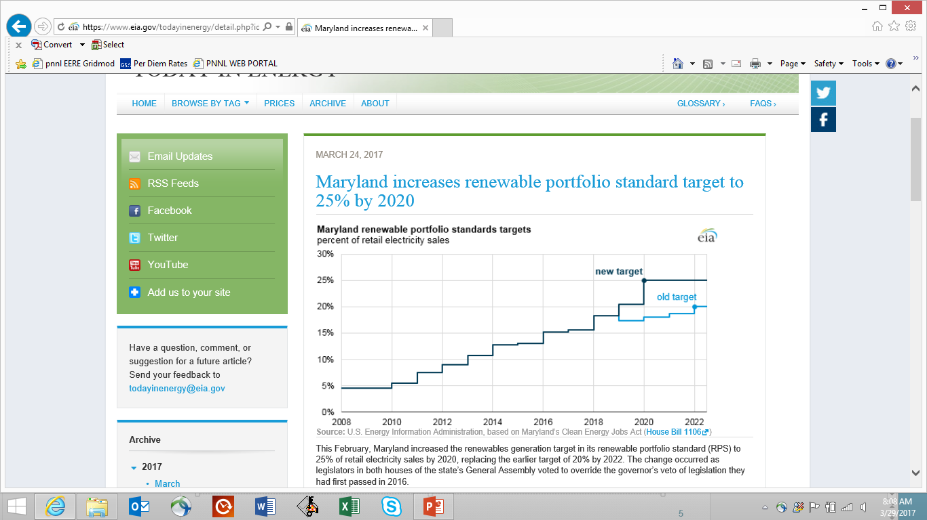
Maryland increases renewable portfolio standard target to 25% by 2020
EIA: March 24, 2017: https://www.eia.gov/todayinenergy/detail.php?id=30492
This February, Maryland increased the renewables generation target in its renewable portfolio standard (RPS) to 25% of retail electricity sales by 2020, replacing the earlier target of 20% by 2022. The change occurred as legislators in both houses of the state’s General Assembly voted to override the governor’s veto of legislation they had first passed in 2016.

