Slide 1

APSEC Research and Activities Updates
Jinlong MA
APEC Sustainable Energy Center
The 61th Meeting of APEC Expert Group on New and Renewable Energy Technologies
16-17 January 2025, Chinese Taipei (online)

Slide 2

Outline
APEC Projects Briefs
Activities Highlights
Inputs to Policy Dialogue
Progress Update: APEC Urban Energy Report

Slide 3
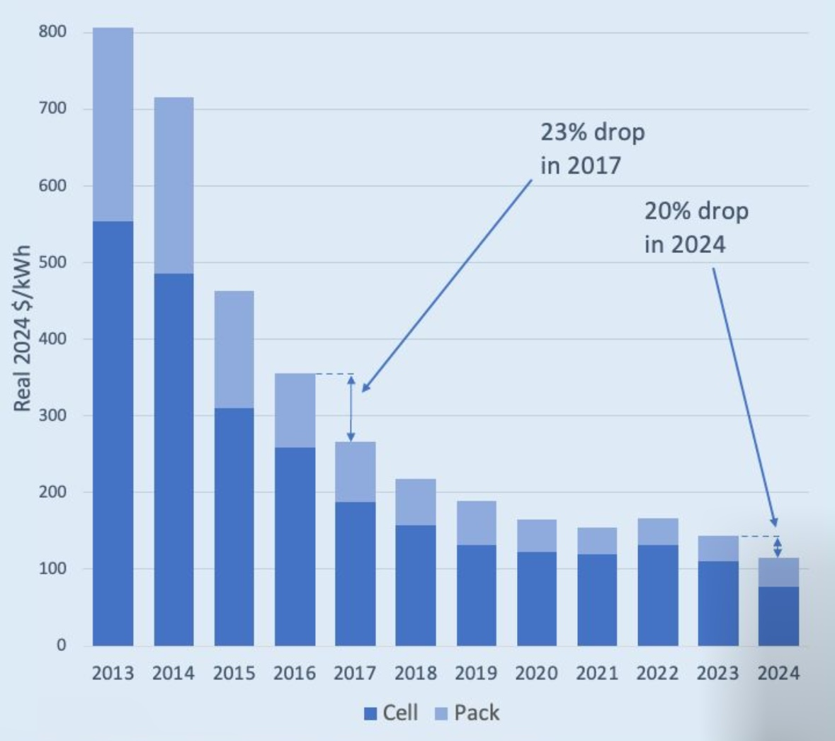
APEC Projects Briefs
EWG 03 2024S Research on energy storage to enable energy transition in APEC cities
Project summary
Role of energy storage in the changing energy landscape: with the rising proportion of variable and less predicable renewable electricity in the energy system, there is a strong need for more flexible and resilient energy system to ensure the security and reliability of the system operation and electricity supply.
Cities count for 56% of the world population and for about 70% energy consumption and associated carbon emissions.
Technology development: battery, BESS
One of the foundations and cores for cities to cope with the increasing higher proportion of variable renewable energy and volatile loads in the system: resilience of the system.
Aims at researching into the development and applications of energy storage technologies, the approach to support the deployment of storage, and formulating strategies and policies to accelerate energy transition in APEC cities.
The average price of a lithium-ion battery pack fell by 20 % in 2024 to $115 per kWh -- the biggest drop since 2017.
The global average cost for turnkey storage systems (BESS) falls to $165/kWh in 2024, 40% drop compared to 2023.

Slide 4
APEC Projects Briefs
Research Framework
Activities, milestones and deliverable: Research and investigation Workshop on Deployment of Energy Storage Technologies, in line with the 10th Anniversary Forum of APSEC, Nov, 2024 Project report
In progress
4

Slide 5
APEC Projects Briefs
EWG 05 2022S: Practical Experience and Prospect of Energy Access in APEC Region
Project Information
Reviews the recent advancements and best practices in energy access within the APEC region
Investigates strategies to enhance energy accessibility throughout the region
The project workshop has been successfully held on the 10th anniversary event of APSEC.
Over 20 experts and scholars from four APEC economies participated in the workshop.
9 experts from 3 economies, China, Malaysia and Papua New Guinea, presentations on key topics including APEC regional energy transition policies and advancements, energy technologies, international cooperation to enhance energy technology assessments and energy access, and speed up energy access.
Final draft report has been submitted.
Information collection
Analysis of advancement and best practices
Workshop
Project report

Slide 6
APEC Projects Briefs
Data driven carbon neutral disaster resilient cities, APEC EWG 04 2022A
Project summary
Aims at accelerating the development towards carbon neutrality by increasing the number of APEC cities having the capacity to collect relevant data and to use a multi-stakeholder dialogue to become carbon neutral and disaster resilience.
Training of Trainers (ToT) held in August 2023 empowered 67 local planning officers from 10 APEC economies, coached by leading experts of 10 organizations on collecting energy and climate data.
Multi-stakeholder dialogue (MSD) was held in North Sulawesi Province Indonesia in February 2024 and brought together 102 online and in-person participants from 10 APEC economies and 12 international organizations to elaborate a carbon neutrality vision and for setting three specific 2030 targets.
The Final Report “Promoting Carbon Neutrality in North Sulawesi: Vision, Targets, Benchmarking and Monitoring” has been completed in October 2024, https://www.apec.org/publications/2024/10/promoting-carbon-neutrality-in-north-sulawesi---vision--targets--benchmarking-and-monitoring .

Slide 7
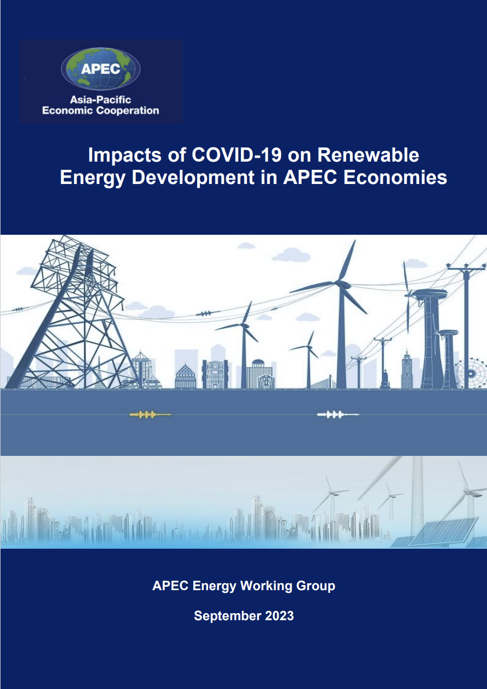
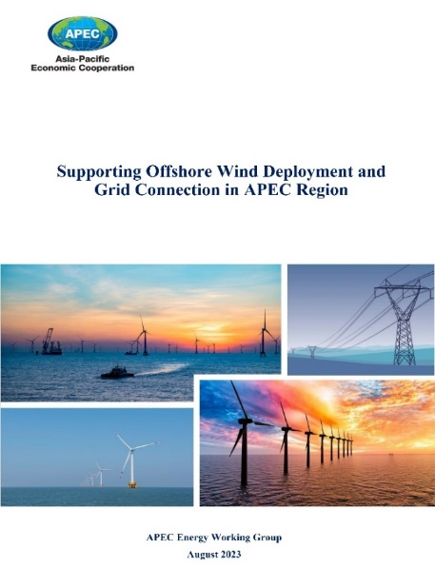

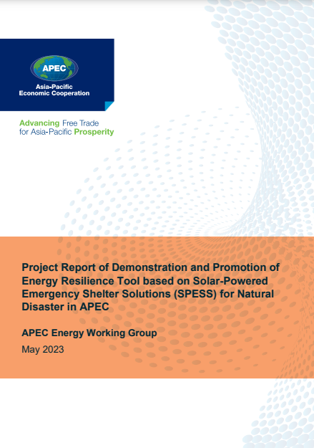
APEC Projects Briefs
Other Recent Reports
Impacts of COVID-19 on Renewable Energy Development in APEC Economies
https://www.apec.org/publications/2023/09/impacts-of-covid-19-on-renewable-energy-development-in-apec-economies
Supporting Offshore Wind Deployment and Grid Connection in APEC Region
https://www.apec.org/publications/2023/09/supporting-offshore-wind-deployment-and-grid-connection-in-apec-region
APEC Green Finance Report – Unlocking the Urban Energy Transition
https://www.apec.org/publications/2023/03/apec-green-finance-report-unlocking-the-urban-energy-transition
Project Report of Demonstration and Promotion of Energy Resilience Tool based on Solar-Powered Emergency Shelter Solutions (SPESS) for Natural Disaster in APEC
https://www.apec.org/publications/2023/05/project-report-of-demonstration-and-promotion-of-energy-resilience-tool-based-on-solar-powered-emergency-shelter-solutions-(spess)-for-natural-disaster-in-apec
CR submitted/accepted in March 2024
CR submitted/accepted in
May 2024

Slide 8
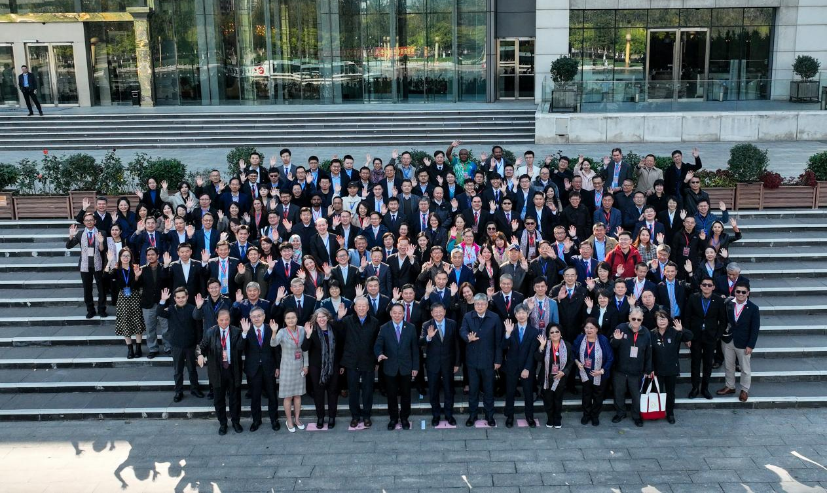
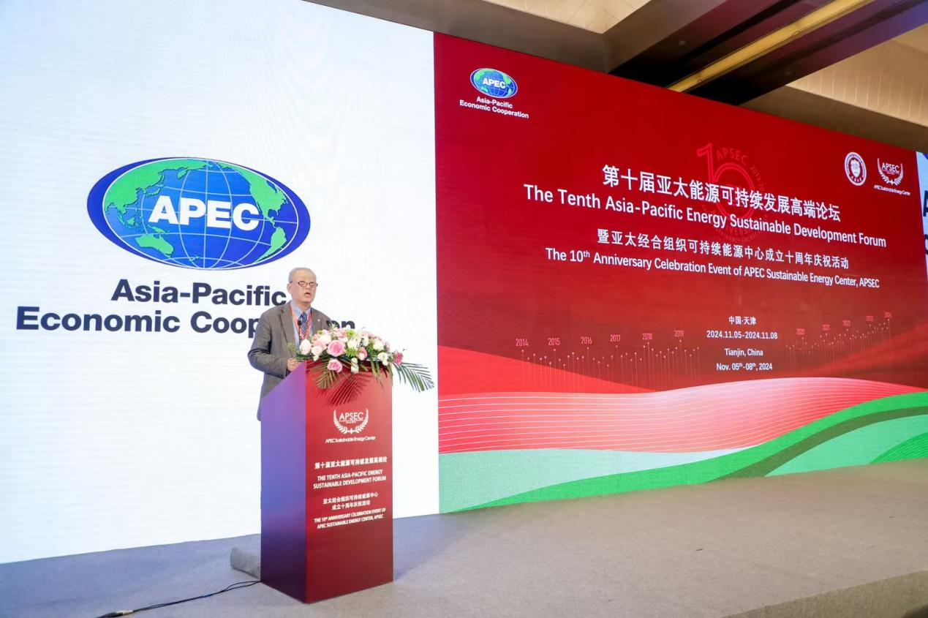
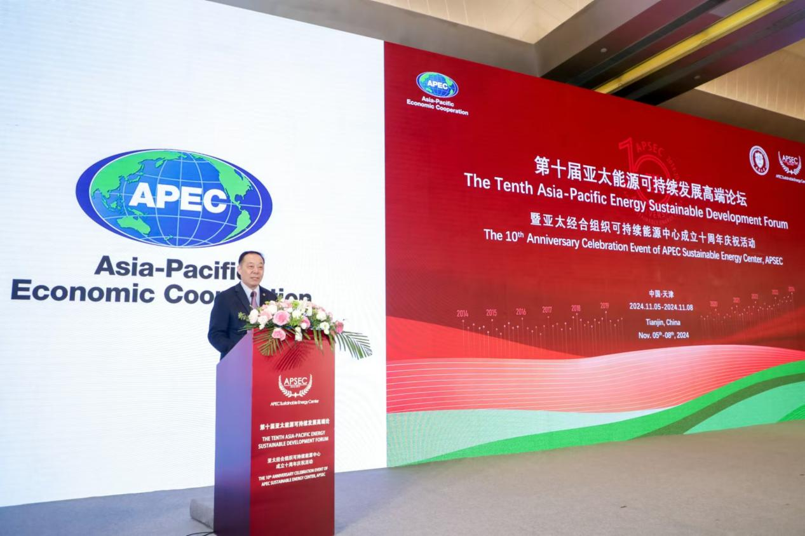
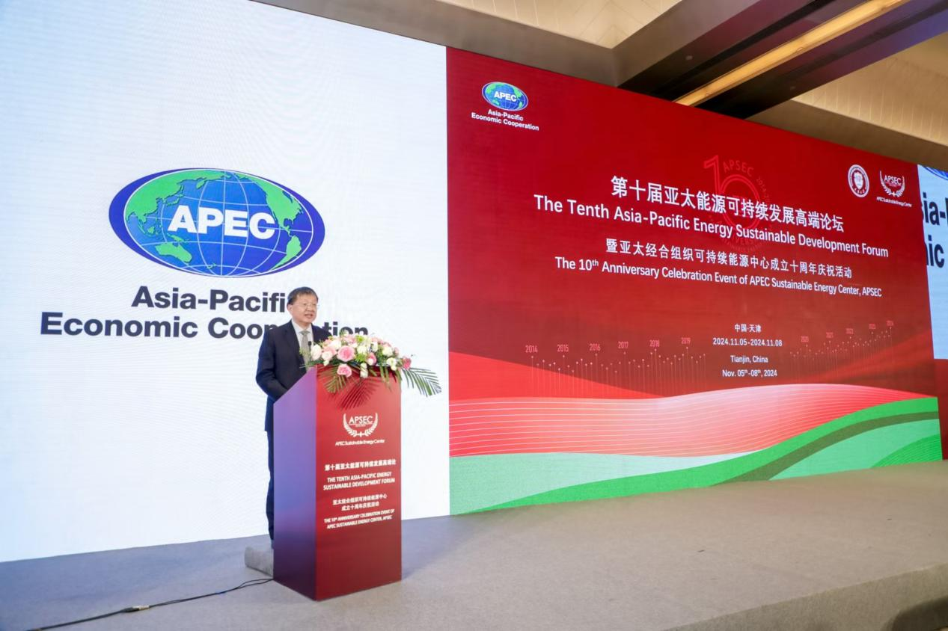
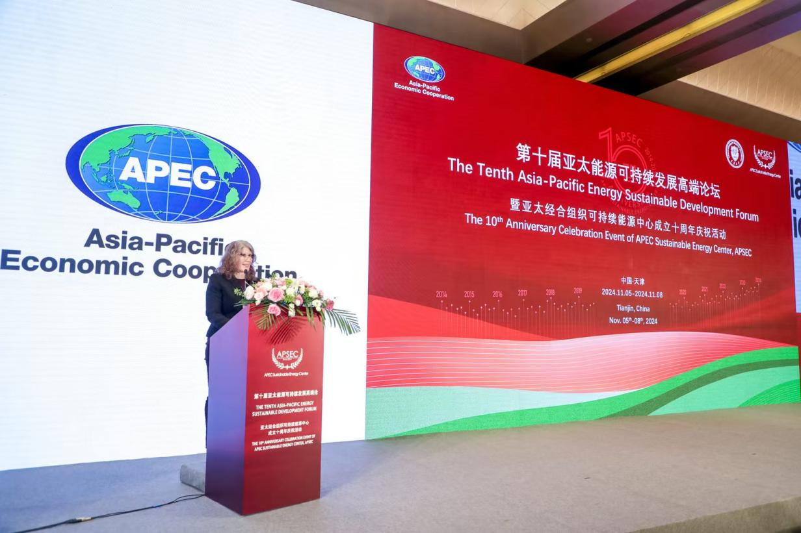
The 10th APSEC Sustainable Energy Development Forum (the 10th Anniversary Event)
5-8 November 2024, Tianjin, China
More than 300 experts and officials from 15 APEC economies
16 international organizations, as well large number of domestic entities including research institutions, enterprises, universities and governments participated in the forum.
Openings:
Zhang Jianhua, Director, National Energy Administration
Zhao Yali, Vice Chairman, the China Pacific Economic Cooperation National Committee
Adriadne Benaissa, Lead Shepherd, APEC EWG
Yang Xianjin, Secretary of the Party Committee, Tianjin University

Slide 9
The 10th APSEC Sustainable Energy Development Forum (the 10th Anniversary Event)
Keynote speeches
Michael Williamson, Section Chief in the Energy Division, United Nations Economic and Social Commission for Asia and the Pacific, UN ESCAP
Jie TANG, Former deputy mayor, Shenzhen Municipal Government/Board member, the Chinese University of Hong Kong (Shenzhen)
Kwok Ying POON, Director, Electrical and Mechanical Services Department, Hong Kong, China
Wenjie WANG, General Manager, China Energy Technology and Economics Research Institute
Report on the development and achievements of APSEC, Prof Li Zhu, President, APSEC
Opening ceremony for the Future Clean Energy Technologies Joint Operations Center (CET), jointly with China Energy Investment Group
Concurrent meetings, workshops and sub-forums
The 63rd EGEEC Meeting
The 8th EEP Workshop: APEC Peer Review on Energy Efficiency (PREE) Phase 13 (EWG 202 2023A)
APEC Project Workshop: Practical Experience and Prospect of Energy Access in APEC Region (EWG 05 2022S)
APEC Workshop on Sustainable Cities
Future Clean Energy Technology Workshop
APSEC Asia-Pacific Energy Transition Solutions Sub-forum
The 10th meeting of the Steering Committee of APSEC

Slide 10
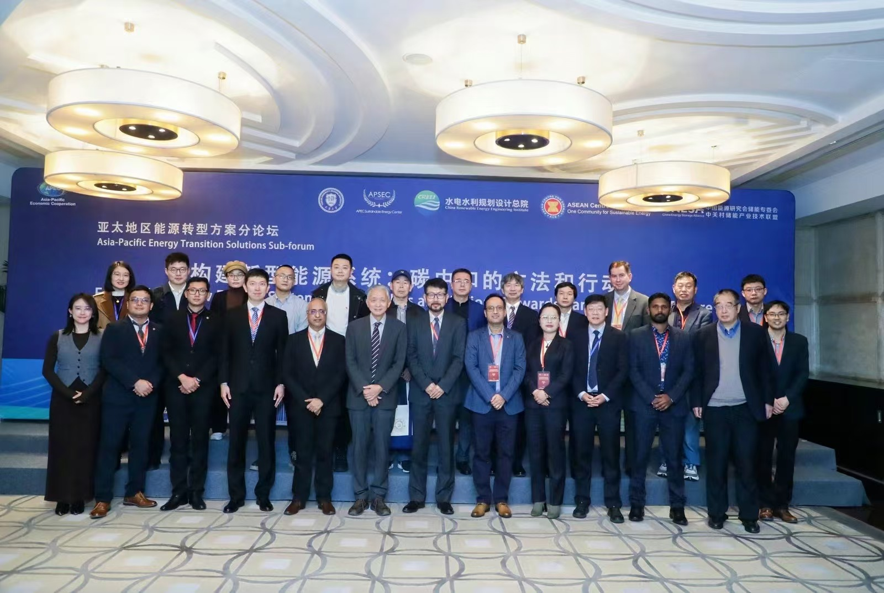
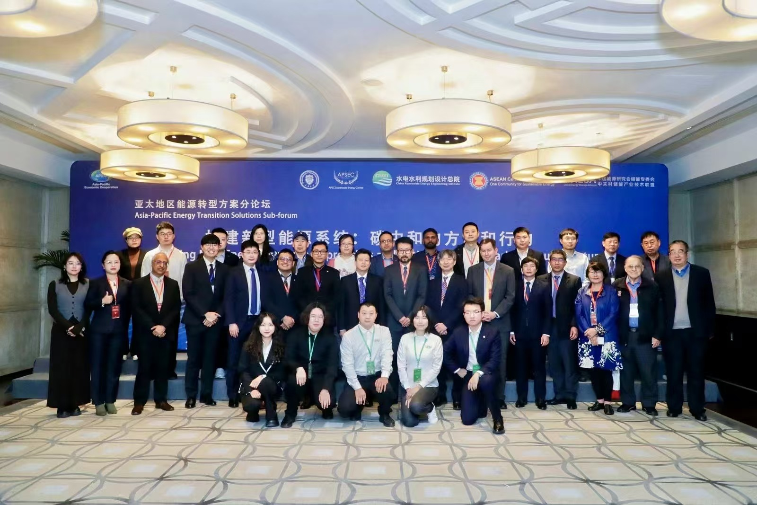
APSEC Asia-Pacific Energy Transition Solutions Sub-forum
7 November 2024
Theme: Establishing New Energy Systems: Approaches and Actions towards Carbon-neutral Future
Jointly organized by
APSEC
China Renewable Energy Engineering Institute
ASEAN Center for Energy (ACE)
China Energy Storage Alliance
Participants: More than 60 experts and scholars from 11 APEC economies, including the United States, Australia, South Korea, Singapore, Vietnam, Indonesia, Thailand, Malaysia, the Philippines, Hong Kong, and China
International Organizations: UN ESCAP, IRENA, ASEAN Centre for Energy (ACE), CLASP，Asian Development Bank (ADB)
Opening remark
Takayuki Niikura, Program Director, APEC Secretariat
Heping Gong, Deputy Director General, China Renewable Energy Engineering Institute
Zulfikar Yurnaidi, Head, Energy Modelling and Policy Planning Department, ASEAN Centre for Energy
Program: expert presentation, panel discussion
Session 1: Asia-Pacific Low Carbon Development and Green Energy Transition Pathways
Session 2: Innovation and Technology Advancement for Carbon Neutral Future

Slide 11
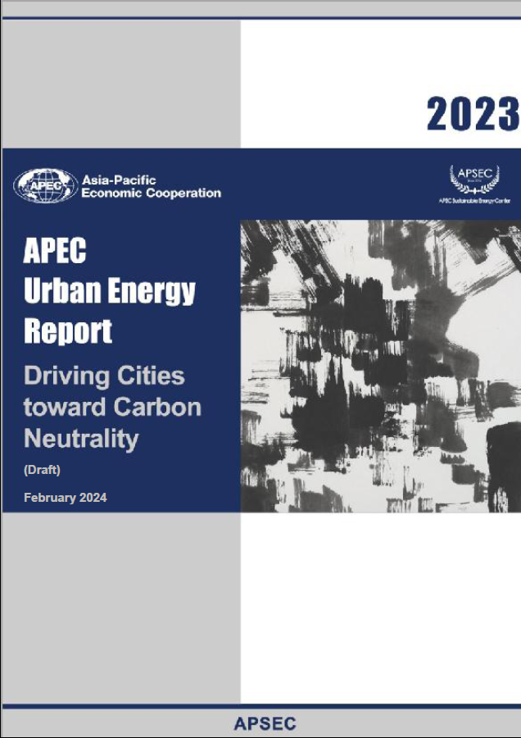
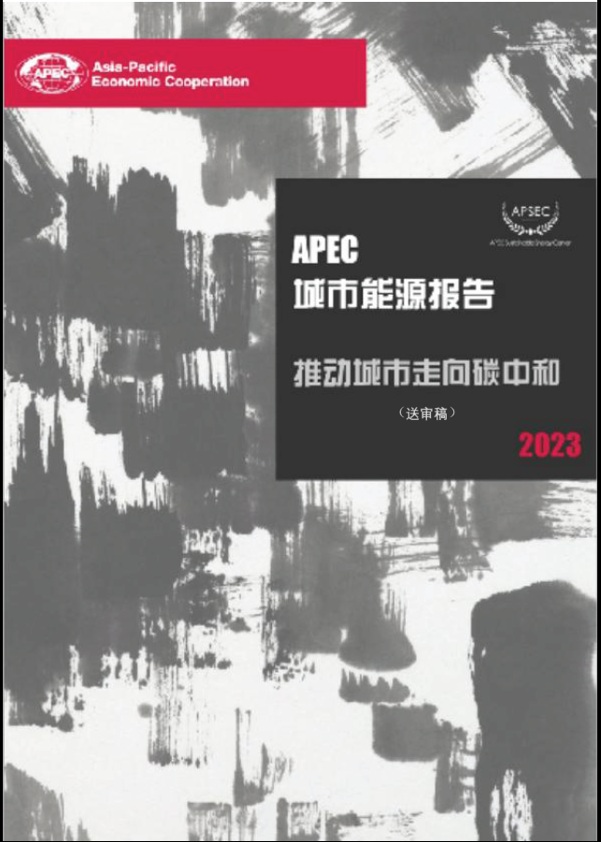
APSEC Research Highlights
APEC Urban Energy Report：2023
Driving Cities towards Carbon Neutrality
Word and summary
Focus on ‘Urban Energy’ in APEC region, drive towards carbon neutral and actions on low carbon energy transition
Technologies, policies, plans and tools achieving carbon natural goal
Establish database and indicator system for sustainable cities
Historical changes and trends: social economic, energy and emissions
Categorization of the selected APEC cities, clustering analysis, the characteristics analysis of cities
Case studies and best practices of urban energy transition
Scenario analysis: simulation of selected city – Tianjin, China
Policy recommendations
Two reports: Chinese and English versions produced
标题
Title

Slide 12
Urban Energy Report 2023: Driving cities towards carbon neutrality
Inspirations from the cases of carbon neutrality in APEC cities
1
Overview of carbon emissions and energy development
2
Carbon neutrality goals, challenges and ways to achieve
3
Urban clean energy development strategy analysis
Los Angeles, USA
Tokyo, Japan
Improving building energy efficiency and building energy electrification
Promote the use of renewable energy in buildings
The development of green buildings and zero carbon buildings
Promote the new energy vehicles such as electric vehicles or hydrogen fuel vehicles
Suzhou
China
4
Urban carbon neutral investment and green finance application strategy analysis
Canberra, Australia
Shenzhen, China
Step up government investment in clean energy projects and power infrastructure
Attract private sector investment in green industries
Develop various green financial products to channel the financial resources to low-carbon and sustainable projects
5
Analysis of urban smart construction strategy
Cloud computing, big data, artificial intelligence, Internet of Things, 5G, etc.
Development of 'Digital twin cities'

Slide 13
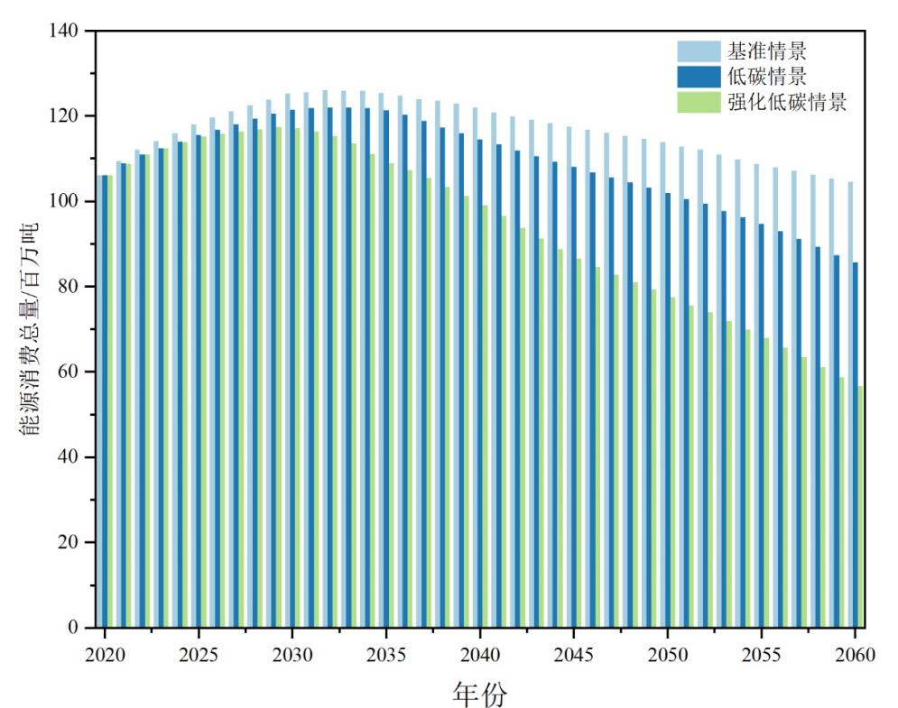
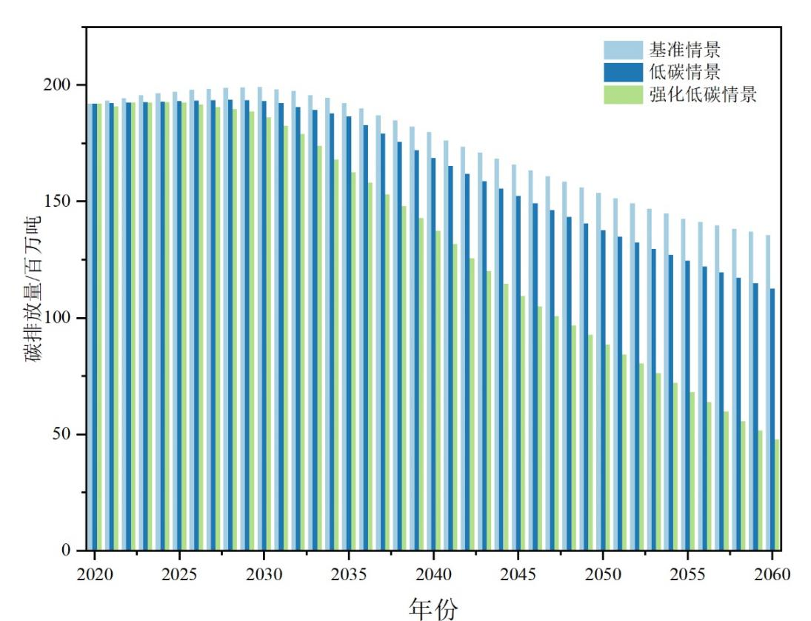
Urban Energy Report 2023: Driving cities towards carbon neutrality
Scenario analysis of carbon emission, Tianjin city, China
Base-year: 2020
The energy demand mode used to forecast and analyse the energy demand over 2021-60
Scenario analysis: BAU, Low Carbon, and Enhanced Low Carbon Scenarios
Analysis of the main measures of carbon neutrality
Low Carbon Scenarios
Improve end-use energy efficiency
Accelerated electrification
Enhanced Low Carbon Scenarios
Clean energy substitution
Economic transformation
Total energy consumption under different scenarios
Total carbon emissions under different scenarios

Slide 14
APSEC Research Highlights
APEC Urban Energy Report：2024
Storage Enables Transition
Enhance resilience of urban energy systems
Promote green industries and green economic growth
Satisfy urban energy demand
Better urban energy management
Support scaling-up RE deployment
Energy storage technology can support reliable supply and efficient usage, and achieve flexible scheduling of urban energy, balancing energy demand in different periods.
Energy storage technology, combined with advance IT and telecommunication technologies AI, can contribute to achieve smart urban energy management, including analysis of energy system, accurate prediction and optimal scheduling of urban energy consumption, and reduce the energy bills of the customers..
Energy storage technology can be used as a "buffer" of the urban energy system, providing backup energy, ensuring the normal operation of key facilities, and improving the resilience and security of the urban energy system.
Energy storage technology support the optimization of the urban energy structure, support the penetration of renewables in the energy system, and promote low carbon and sustainable development of the cities.
The development and operation of energy storage technology and facilities drive the improvement and upgrading of the relevant industrial chain, including the manufacturing, engineering, and technical services, which will incentives industrial innovation and development, and promote the transformation and green economic growth.
标题
Title
14

Slide 15
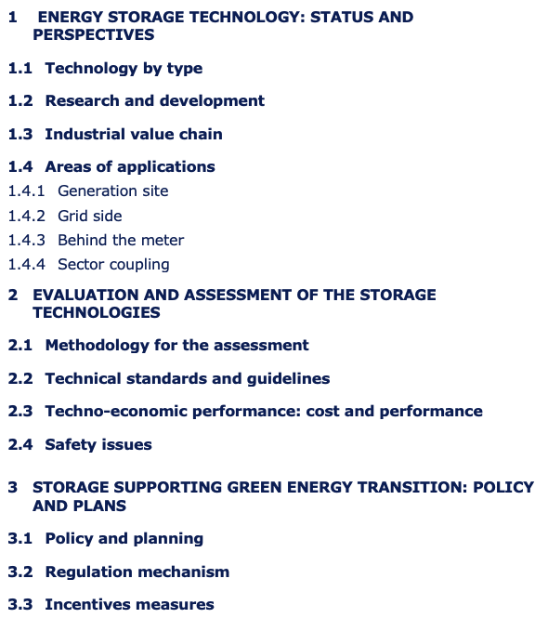
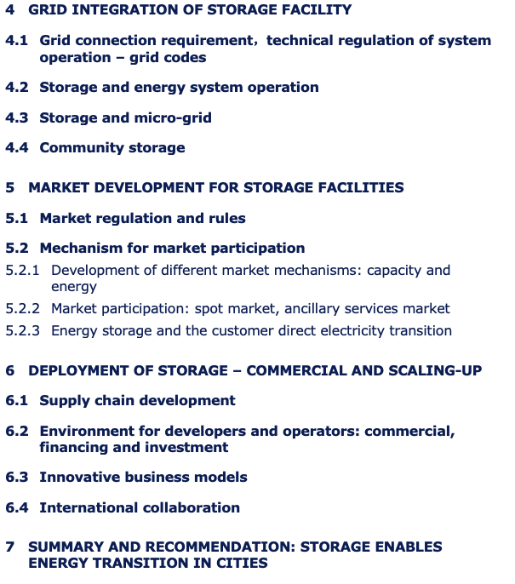
Urban Energy Report 2024 – Storage enables transition

Slide 16
Inputs to the Policy Dialogue: Green and low carbon hydrogen development
Worked with the Peruvian Ministry of Energy and Mines and the host of the 2024 APEC Energy Ministers' Meeting to deeply participate in the development of high-level policy initiative.
At the 14th APEC Energy Ministers' Meeting in August 2024, unanimously adopted the "Policy Guidelines for APEC to Develop and Implement Low Carbon Hydrogen Policy Framework”, which serves as an important component of this year's APEC cooperation, supporting the formation of the Leaders' Declaration.
Provided feedback on the Policy Dialogue Concept Note prepared by Peru
Organised hydrogen energy progress survey
Organized survey on hydrogen energy policy
14 of 21 APEC economies have adopted hydrogen-related development policies
Organised a green hydrogen expert meeting: in China, policy discussions
Participated in Policy Guidance Revision
Submitted proposed feedback, “Discussion Paper: APEC Policy Guidance” to Peru
Participated in two virtual workshops on May 17, 2024, and May 28, 2024
Engaged in drafting sessions and submitted additional comments to Peru in July 2024.
Contribution to the workshop
Workshop on “Exchange of best practices for the development of green and low carbon hydrogen roadmaps in the Asia-Pacific region”, 11 Aug 2024, Lima
16

Slide 17
THANK YOU !
Jinlong MA, Prof
APEC Sustainable Energy Center
Tianjin University
jinlong_ma@tju.edu.cn

